Slide 1
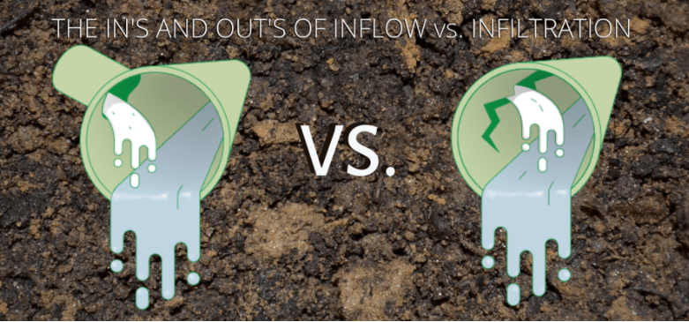
The Gold Coast Approach
Dominique Keirens – qldwater – 10/11/2022
Notes:
Good morning everyone out there in virtual land – thanks for coming to listen to me rattle on about some of the things our people are doing to manage a pesky problem.
A bit of background – My name is Dominique Keirens, I work in a team that looks after all things required to maintain the performance of the Gold Coast water and sewerage network assets.
We also try our best to reduce & manage the impacts of excessive inflow and infiltration – the issues that can become unbearable if not controlled.
So here we are – a little insight into the Ins & Outs of Inflow and Infiltration – The Gold Coast Approach

Slide 2
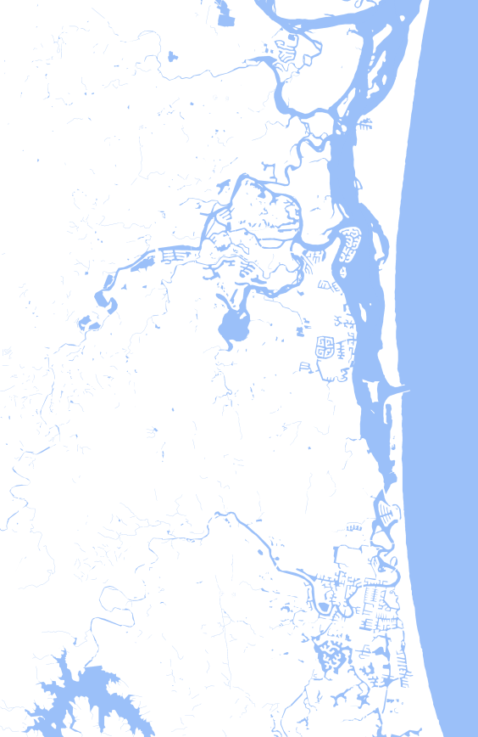
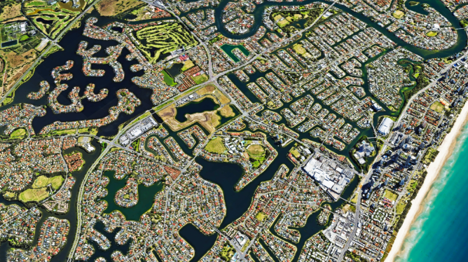
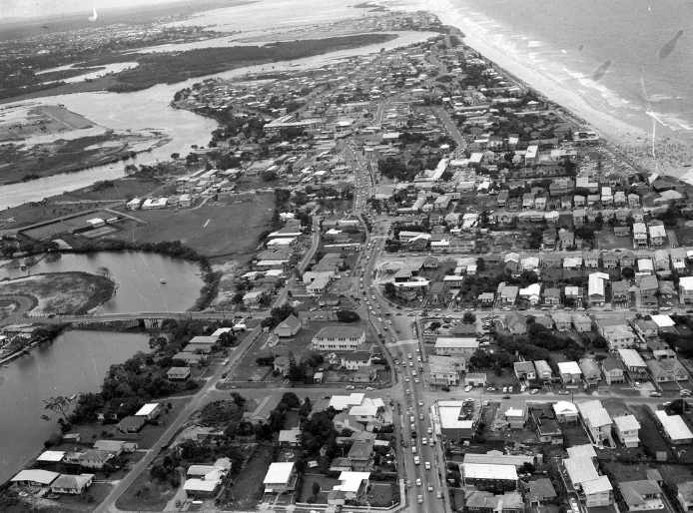
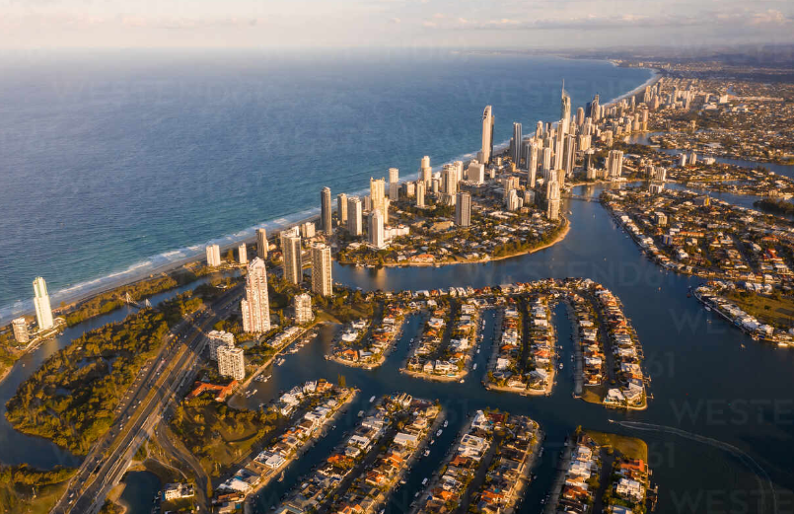
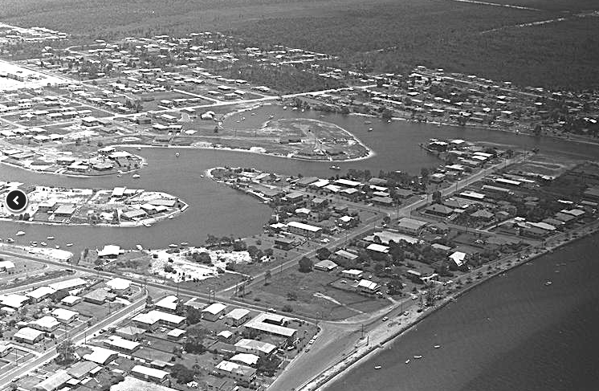
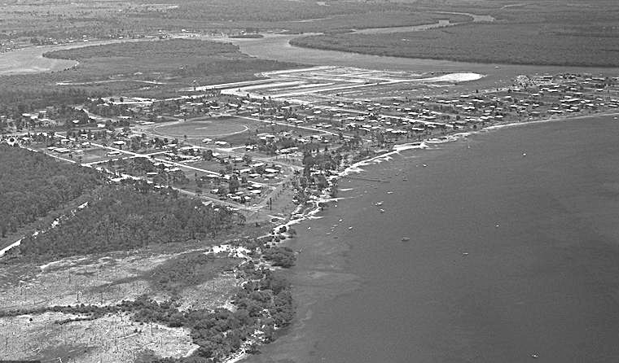
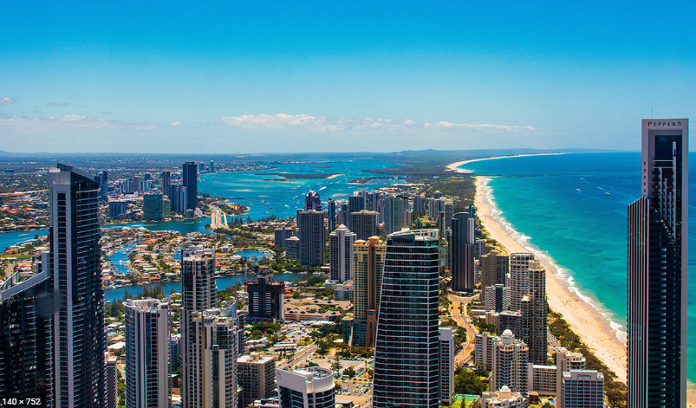
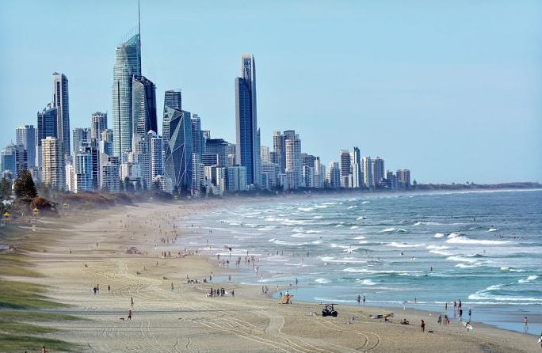
The Beautiful Gold Coast
Notes:
The Beautiful Gold Coast
I know I am of course biased, and each city and local area has their own credential for beauty, but few would argue that the Gold Coast is up there as a bit of a wonder land.
Beautiful and has plentiful beaches.
Development rates and property prices competing now with the other big Australian cities.
But I’m not here to market the gold coast, nor overload you with growth stats, what I simply want to highlight is something that you see in the imagery… something the City is known for, and treasures, for residents and visitors… we are a water city, some like to call us a canal city. We are predominantly flat along the coast line, spotted with elevations which become more prominent as you move inland. CLICK
We’ve had pretty rapid growth, and as we experienced various materials and construction methodologies, some that have proven not to be ideal for our particular environment, so we adjust and do things differently as the industry provides alternatives. However, the result is we are often left dealing with ‘assets’ that don’t always perform as expected.
So, as the saying goes, with beauty often comes some pain – while we are fortunate not to have too much risk of cyclones and wide spread flooding (which we can thank our city planners/ and fairly robust stormwater infrastructure) or the worry of earthquakes. We do however have high brackish / saline groundwater tables which present complexity and issues with construction and certain materials exposed to these conditions will deteriorate at faster than expected rate.
Another little ‘blessing’ is the nature of Qld climate. I won’t do a global comparison, but to provide a little context, while places like Europe (my place of birth for example, Belgium) has a healthy annual rainfall of about 820mm / year, and spread nicely over about 200 days of drizzle. Where as the Gold coast it’s about 1300mm over about 100 days, so nearly twice as much rain over half the amount of days. And every rain event will be somewhat different and the receiving environment will be a different state, for example tidal conditions, groundwater tables, developed areas, distribution of rain intensity – like a snow flake ;).
But what this type of conditions does say is that rain doesn’t always get time to soak in the soil and water can pool in unwanted areas and it doesn’t always find the right escape route. Also, groundwater tables are high, and water likes to be comfortable, and will find voids and low pressure areas to escape.

Slide 3
Inflow & Infiltration
What is inflow and infiltration
01
Fighting Infiltration.
04
Fighting Inflow
03
WHY IT MATTERS & HOW DO WE MEASURE
02
FUTURE PLANS
05
Notes:
Now that you have a little context – I’ll go into a high level description of what is I&I as I assume most people are aware – some general reasons why its important to keep it in check, how we measure/monitor and how this has evolved over time, and still is – then what we are and have done to try to get on top of things, some lessons learnt and future plans.

Slide 4
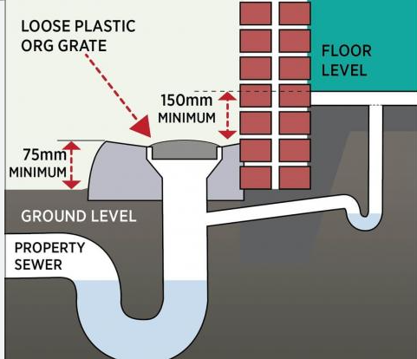
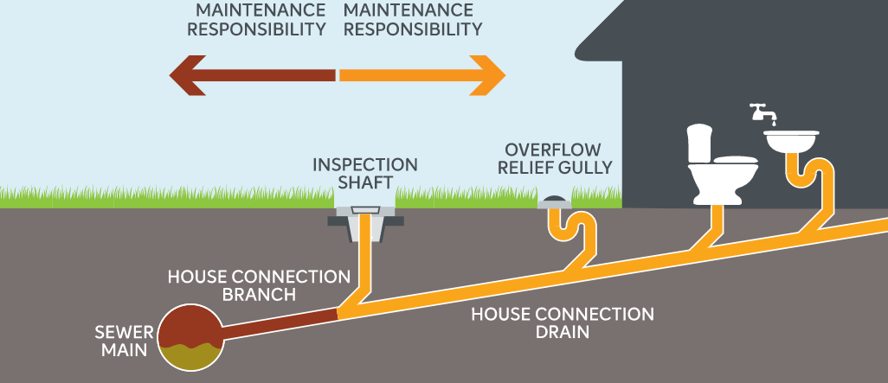
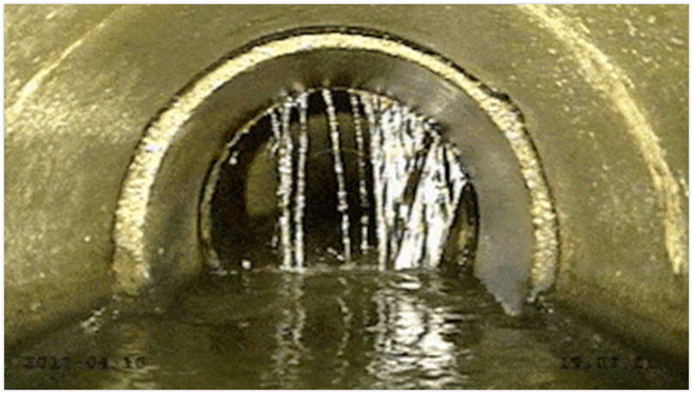
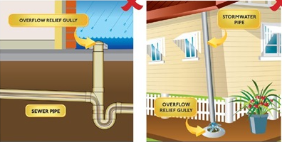
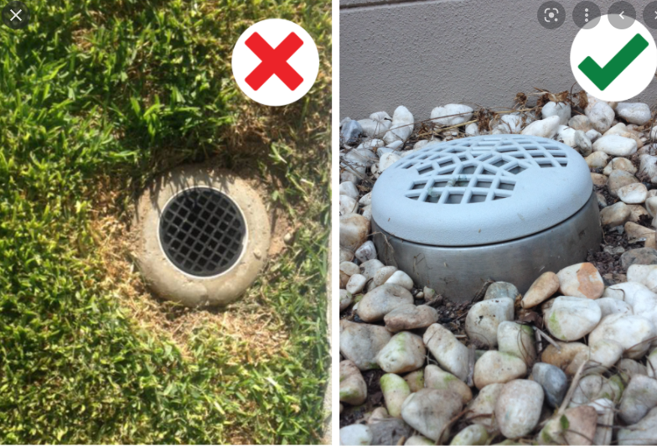
1. Inflow & Infiltration
Illegal and unwanted stormwater connections
Cracks in our sewerage assets allowing groundwater in
Notes:
Inflow and infiltration
Inflow is essentially when unwanted stormwater enters our sewerage system.
Typically how this happens is either through direct connections of stormwater pipes into out network on private properties, or low lying ORGs – I’ll explain what an ORG is in a minute.
Other types of inflow can be when MH lids are removed, or not secured, and they are low lying and creek or stormwater flows directly into them during rain events. Or an overflow system is malfunctioning and creek, or stormwater enters through the relief point rather than escaping.
Now, what is an ORG. Its an Overflow Relief gully (or grate) – and as the name suggests, it is a outlet found near buildings with a grate on it, that is designed to ensure that a network that is surcharging or backflowing can spill at this point – avoiding the spill from occurring in the home. This picture on the right is what we want to see, and the picture on the left is what concerns us. If this is too low, it can invite stormwater to collect on top and drain through. If we have many of these situations in an area, it quickly starts exacerbating the system. This picture may also help explain it, noting where an ORG is typically located, and while this picture doesn’t clearly show it, it is required to be 1
Infiltration is the result of groundwater entering the sewerage network through cracks, so rather than a direct connection, it is due to some flaw in the integrity of the asset.

Slide 5
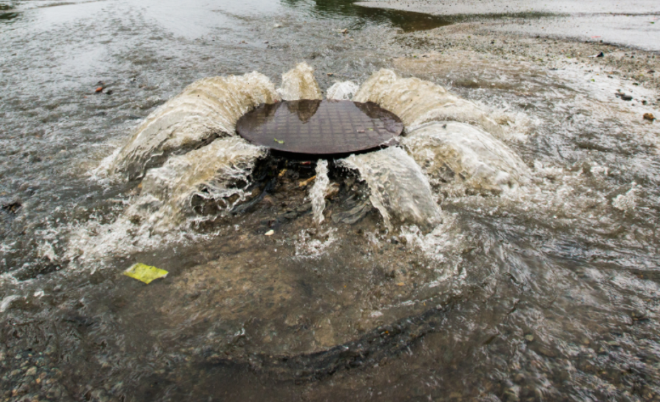
Why is inflow an issue?
Capacity
Cost
Environmental
Public Health
Reputation
Notes:
Why is inflow an issue
Too much stormwater suddenly entering the network, capacity is exceeded, and system pops which can be in undesirable locations.
The consequence of this can be cost was predominately associated with clean ups – cleaning up after a spill (toilet paper, and other nasties), which you can imagine was very dependent on where the high intensity rain hit and whether we could find the spills.
Of higher consequence is the potential environmental impacts: Sewage has a high nutrient load, which can generate an imbalance in the receiving ecosystem if not flushed away, can accumulate in stagnant water ways, potentially generating algal blooms, depleting oxygen, and in worst case causing fish kills. While typically in rain events the waterways have good flushing systems, it remains undesirable.
Public health, it the highest potential consequence, people should not be swimming in waters that have untreated sewage in it, simplistically, nasty microorganisms can make people sick.
All these things contribute to the City’s reputation, where in some cases we have community members particularly affected by these events. And from the perspective of someone working in Council, and knowing all the efforts put into activity to prevent failures it is shame to have these incidents dimmish all those silent achievements.

Slide 6
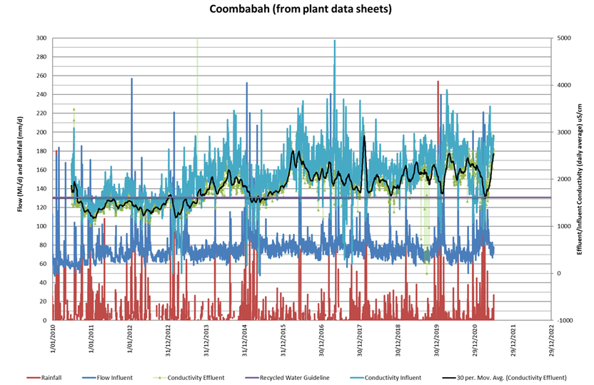
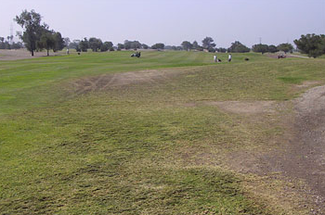
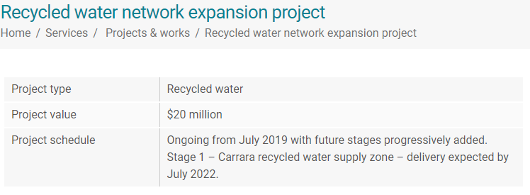
Why is infiltration an issue?
Capacity
Cost
Reputation
Notes:
Now a look at why we need to manage infiltration –
It has a mild impact on our network capacity – while usually contained it does increase load, and that load is longer lasting than inflow as seen by this graph. This is the flow coming into the Coombabah STP. The slow trickling into the network can last days even months after a heavy rain event as ground water levels remain high. This impacts cost for treatment at the STP but also pumping through our daisy chain of pump stations in the City, and trough our major recycled water release system.
In 2015 we undertook some analysis to estimate Cost impacts of I&I during a particular wet year and it was found that ~ 8% of total STP operating cost or about $1.5 mill was associated with infiltration & Pumping cost ~$400,000.
Our findings however have found that a specific type of infiltration has broader negative consequences than fresh water infiltration. It is saline infiltration, or seawater getting into our network, that was the most damaging.
Many of our mains lay in ground surrounded by saline ground water, as highlighted previously. And salinity, or the sulphide found in seawater generate higher levels of H2S which then generate increased sulphuric acid in sewerage systems that in turn degrade our many cement based assets such as MHs and gravity mains.
There is not only an increase in cost associated with odour management, but also the degradation of our recycled water quality will have raised consequences as we move into a cycle of drought once again.
We measure levels of saline infiltration using conductivity units (micro siemens/cm).
We aim to have less than 1600 Us/cm of Electrical Conductivity in our recycled water.
Sea water is typically about 35,000 – 55,000 Us/cm, and raw sewage is typically between 600- 1,000. Therefore it does not actually require much saline infiltration to raise the concentration to an unacceptable quality.
This limit is set to ensure that when it is applied to land for irrigation purposes, the land and vegetation typically grass can manage that load and doesn't essentially get poisoned and die.

Slide 7
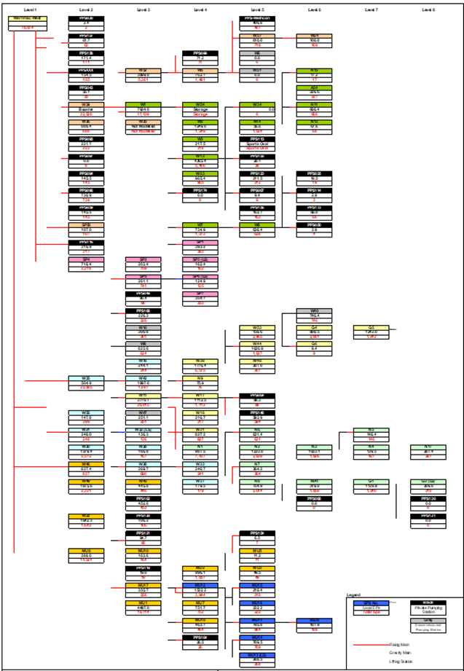
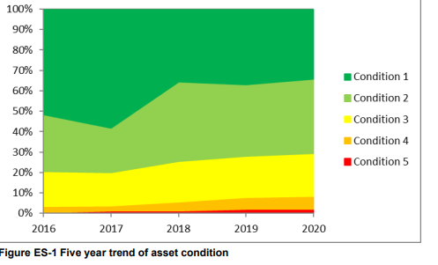
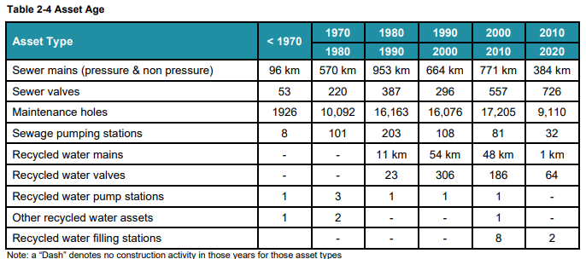
Asset Data & Trends
Notes:
Again, I don’t want to throw a bunch of big numbers at you, however if any of you out there are in the area of managing inflow and infiltration, I think it’s useful to talk context.
To provide a little context to the complexity. We have ~3000 kms of sewer gravity main under the ground. This is about the distance from the GC to Sydney and back. It is predominantly uPVC, but also ~1,000km of150mm Asbestos cement. CLICK
We also have about 530 sewage pump stations, a beautiful array of daisy chains, sometimes as much as 10 in a row. – this only represents about 10% of our network CLICK
On paper (so our desktop data), we are looking pretty good, most of our assets are condition 1 2, or 3 – fabulous to fair.
So, what’s the problem? - well there is other ‘data’ that suggests this may not be 100% the case.

Slide 8
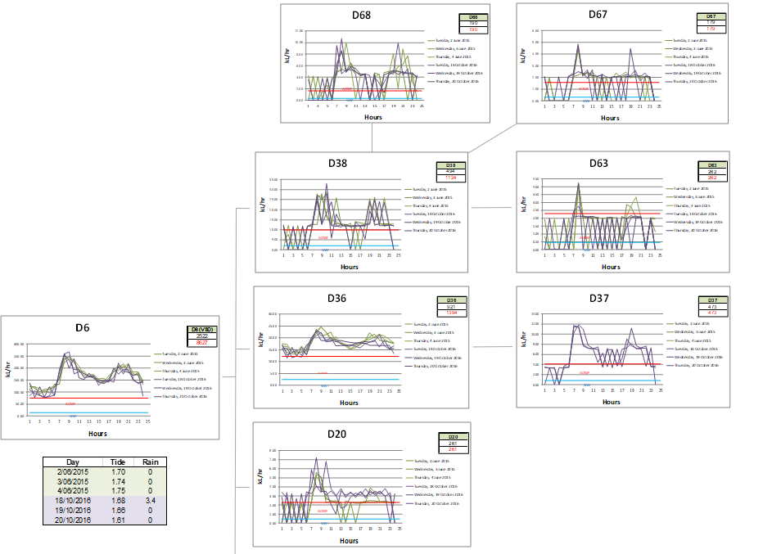
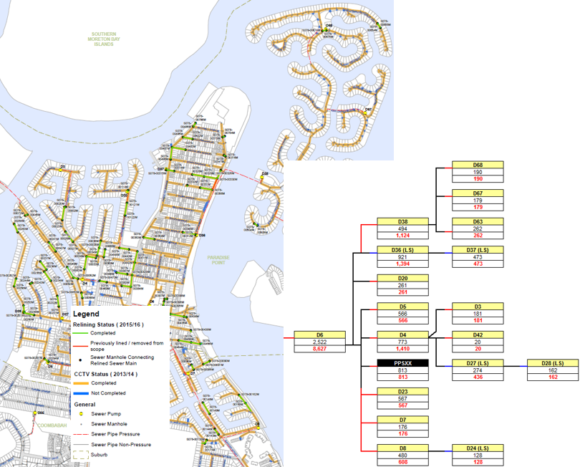
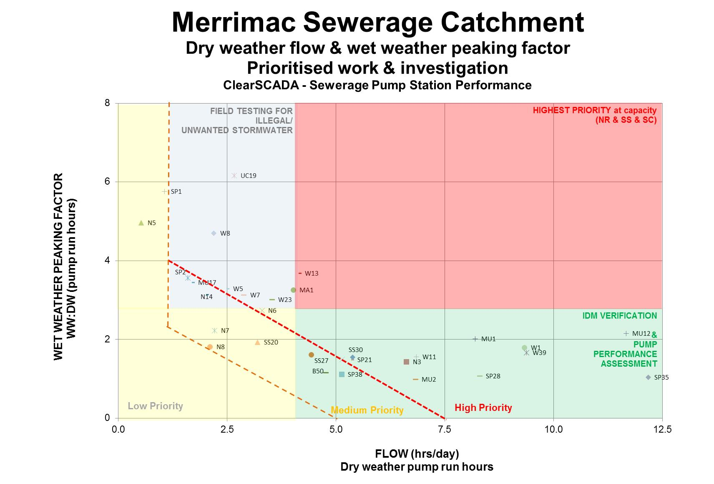
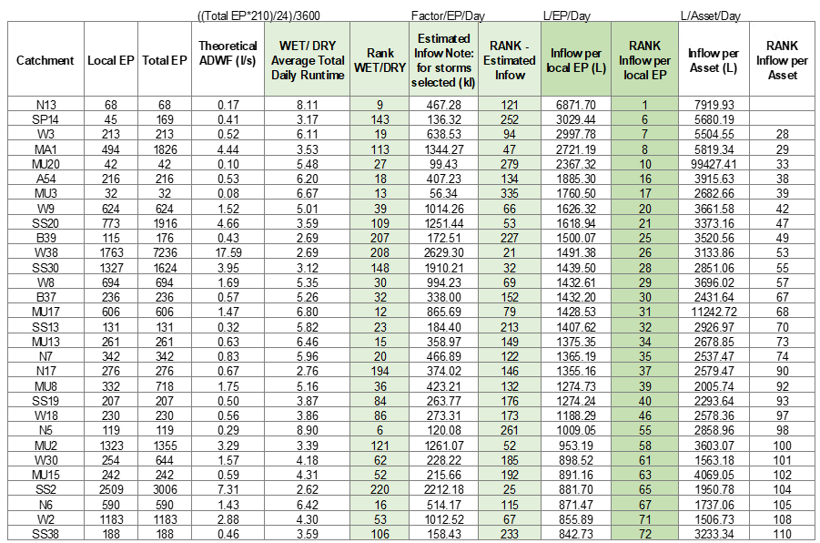
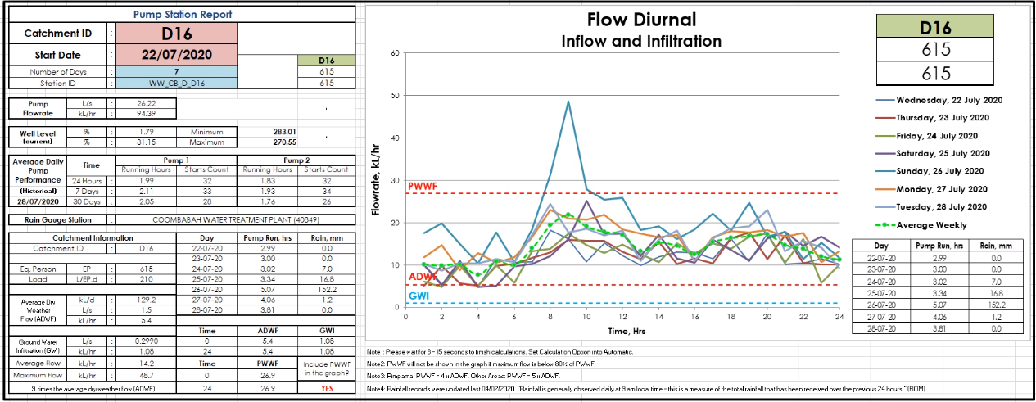
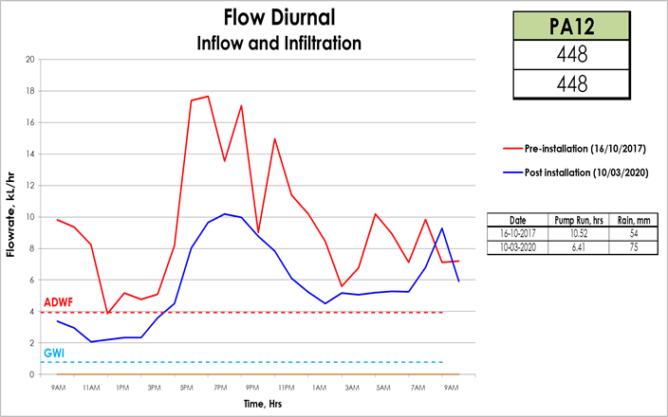
Quantifying I&I – How far do you go
Engineers/scientists achilles heel
Data, tools and skills journey
Notes:
If we are experiencing these flow peaks at the STPs, the network has some I&I issues – but where is it coming from? And how much is it really? Do we see it all at the STPs?
This has been one of the biggest challenges in my career. I have been asked to do this on a number of occasions, and don’t get me wrong, we need to measure, because if we don’t measure how do we know we have achieved anything?
But, what does it mean to measure I&I?
As engineers, scientists, financial experts, asset management specialists – we like numbers, we like to see what the problem is in terms of numbers, quantifiable impacts, costs. We like to know so we can predict and prevent.
In my opinion however, going to deeply into this, can be the achilles heel to successful management of I&I.
The ideology of perfectly measuring I&I can take you down a wormhole, and stifle progress. That is ‘don’t let perfection get in the way of progress’.
Have a picture and a vision of what measurement you want, use the monitoring tools, data and information you have, and start with that – look at trends rather that hard numbers, look at impacts (actual and potential) that need addressing, and plan around these and in parallel, build on the monitoring tools and measuring tools/techniques to improve quantifying and analysis.
I recall being tasked with I&I reduction ~6 years ago. Back then I didn’t even know what I&I was. To be honest, when I understood what it was, I thought, simples – I can calculate this, it’s a fairly simple water balance. We look at our daily flow from wastewater discharged & when there is rain, anything above that is inflow.
Or, we estimate our flows expected from connections and in dry weather anything above that is groundwater infiltration.
Find the I&I, then go plug the holes – YES, somewhat naive – but it does explain why others that aren’t deeply involved in this may come to the same conclusion and wonder why it hasn’t been fixed yet..
CLICK
So, we started with what we had, very little flow monitoring in the network, but we do have 530 odd sewage pump stations, where we have access to pump run hours. CLICK
6 years ago, we looked at, which pump stations had higher than expected daily dry weather flow – indicating infiltration and those that had higher than expected peak flows during a rain event – this was inflow. Ones that had both were high priority, indicating inflow and infiltration. I like visual representation of data, so, I developed this little graph for all STP catchments. The areas identified with infiltration were prioritised for condition assessment & remediation (gravity mains and maintenance holes). – plug the holes – right?
So, did it work? Well these programs take a while to deliver – one year of condition assessment, followed by the next year of relining and MH refurb. - a minimum of two year turn around, sometimes longer, as the MH and SGN were not managed together, and the timing of not always aligned.
In the mean time, our tools were getting better – we now had a tool called OSI Pi – which is essentially a historian tool, where you could extract data from SCADA and other sources, and develop a kind of live template. The first one developed, was a hydrograph using pump run hours representing the diurnal flow pattern received at pump stations. WE built on this and overlay rain flow data from a neighbouring BOM rain gauge, then we even looked at tidal conditions.
But as you can imagine, looking at each one of these independently was not practical, very interesting to look at, and retrospectively reviewing, and if remediation occurred in one area you can look at diurnal pre and post work, to look at whether there was a reduction in infiltration and inflow under similar conditions. BUT this is key – while we picked a days which had a similar daily rainfall, tidal conditions, weather conditions pre and post, every single event is different, not to mention the variability in wastewater base flows – it would be like trying to find twin snowflakes. & in Queensland as well.
But we continue to build and use the tools we have, see what works, what doesn’t, and progress in a ‘prudent manner’.
Developed a daisy chain model, can be spot the catchment in the chain that is biggest culprit? Again, nice to see, but our tools made this onerous to run, and needed a team have eyes on it at all times.
Some clever people (not me) then developed a type of leader board.
In the end, we needed to ensure we progressed, the aim is to reduce and manage, not to stand up in a court of law to defend exact numbers.

Slide 9
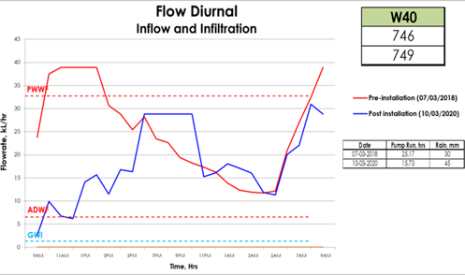
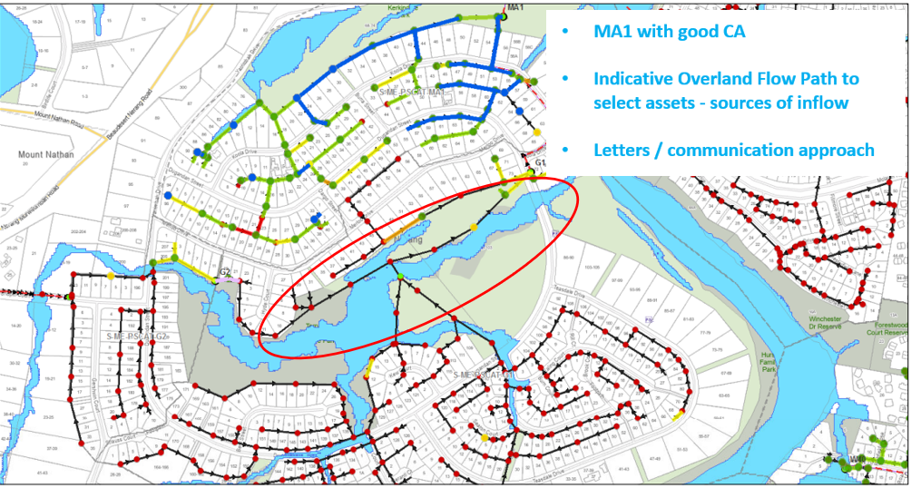
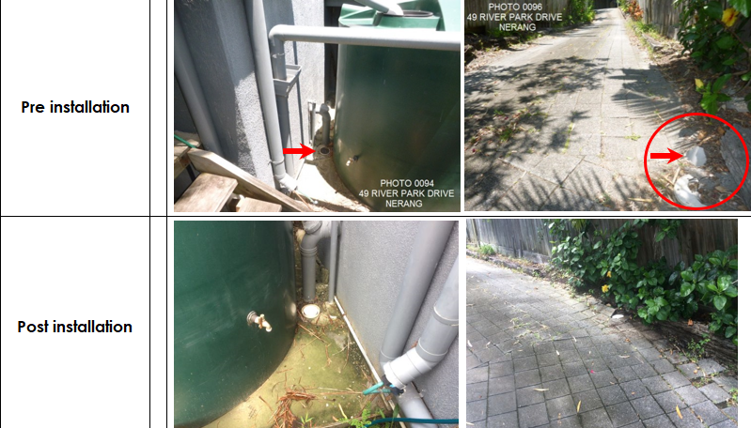
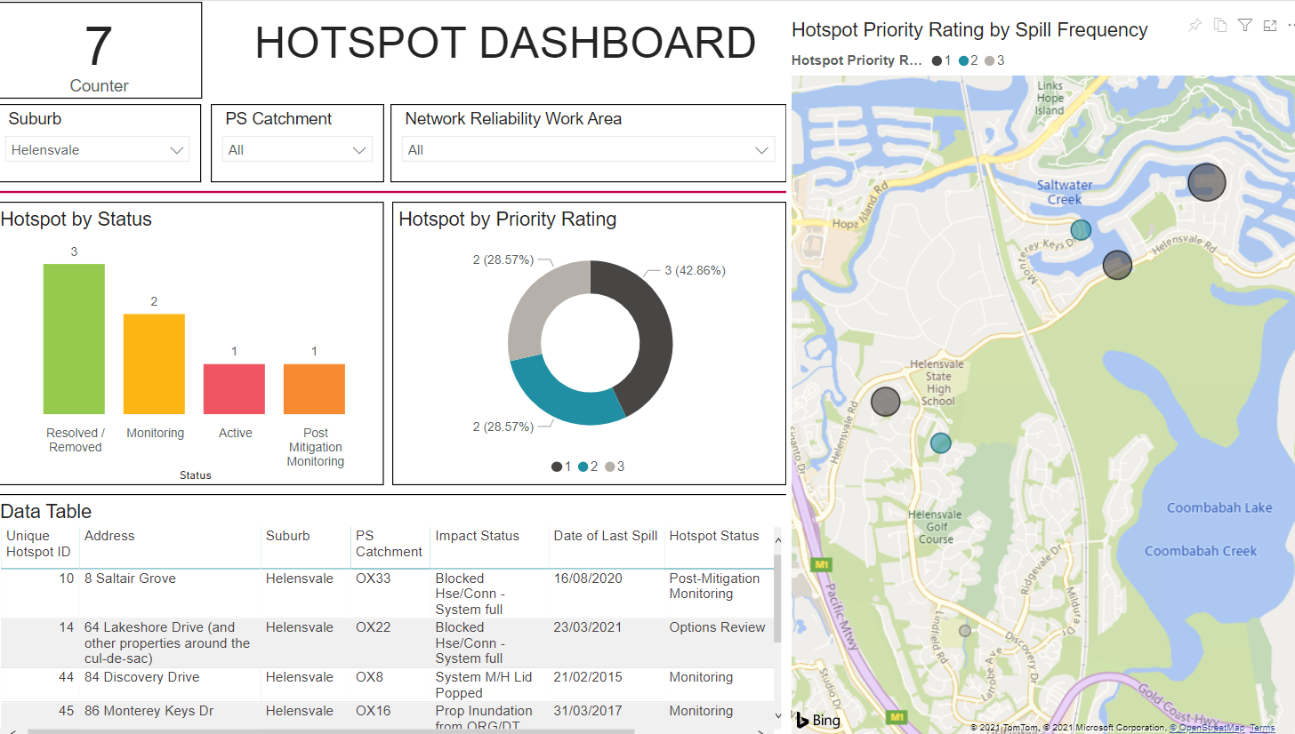
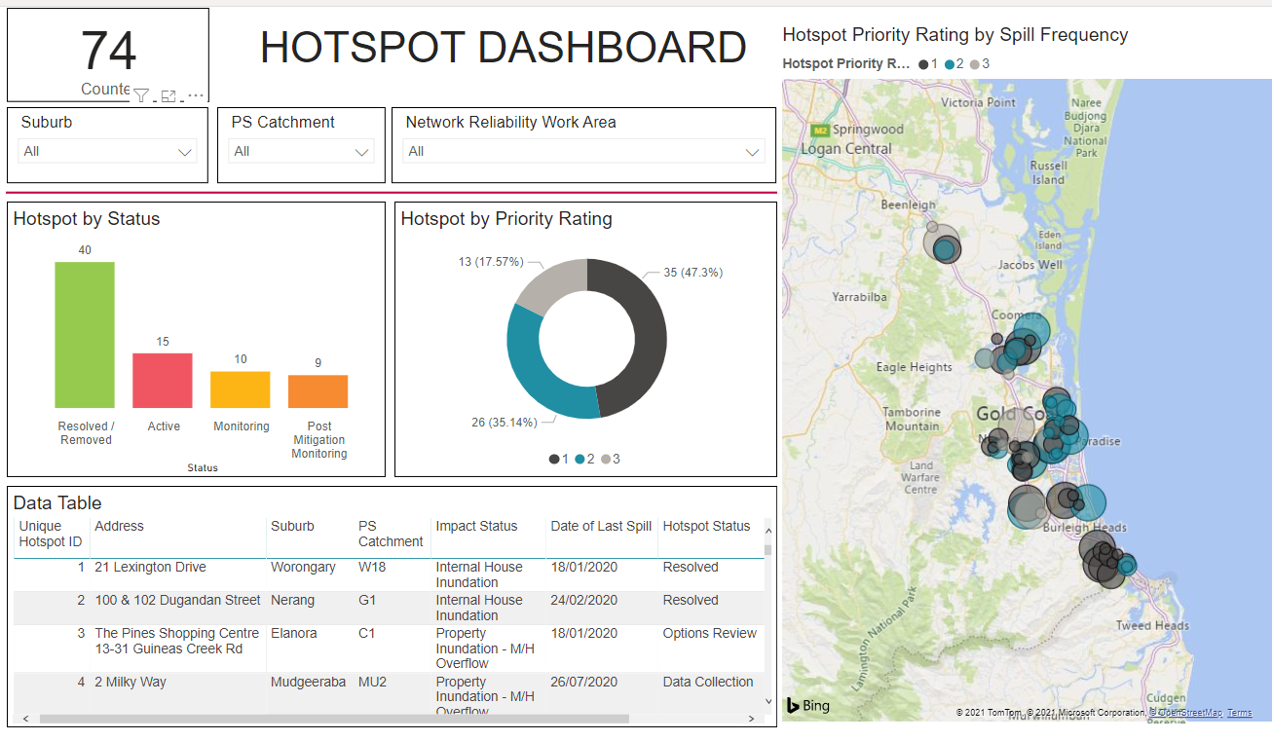
2. Fighting Inflow
Inflow Mitigation Project
Hotspots Management
Notes:
What are we doing about Inflow…CLICK
We have the Hotspots program – CLICK – no this is not wifi – it is where we experience wet weather spills that are less than desirable. – those spills that are frequent and near sensitive receptors such as schools, day cares, walking parks, hospitals, tourism attractions etc.
Dashboard was developed to provide people with insight into progress….don’t you love a good dashboard!
Here we can better share to broader stakeholders where our hotpots are, and what we are doing to manage these – they are notoriously challenging to ‘fix’ as they are typically in low lying areas, where there are few practical solution, but what we typically aim to do is direct the flow to other more palatable spill points as well as look at the root cause of the inflow (which can take some time). Sometimes, if the spill is on properties, we can install reflux valves on house connections – not ideal, as we run the risk of these getting stuck, but they are effective, and we now are trying to capture these better in our systems to then start an ongoing maintence program on these.
So Hotspots looks at the result of the inflow issue.
The Inflow mitigation project tries to minimise inflow coming into the network.
This project essentially finds problem areas, targets properties that we suspect to be contributing to stormwater inflow and visually inspects the properties for low lying ORGs and direct connections. As we find these we inform the property owner to remediate. Now traditionally this has been challenging, as a low lying ORG may meet code requirements, but it still invited stormwater in due to the nature of the surrounding land and our weather events. So instead of asking them to rip up their backyards, we offered ORG caps. This is essentially a non-return valve that sits on the ORG, allowing sewage to flow out if the network surcharged, but essentially stopped stormwater entering. We had previously undertaken a pilot project to assess the effectiveness of this approach and it indicated a marked reduction in inflow.
The first package of visual inspection was conducted in November 2020. This was in Helensvale, Nerang & Elanora – based on hotspots and pump run hour analysis.
845 private properties were inspected
> Total number of defects found were 155 in 134 properties. (16% of properties – which is quite high. Typically hit rate is 5-15%)
> From these 110 were low lying ORGs, or 71 % of all defects.
60 ORG caps were installed and ten IO caps were repaired during inspections.
As of 10 September 2021, 70.3% of the non-compliance found were rectified. Rectification works expected to reduce inflow from all defects by ~60%
And 32 submitted to the Plumbing and Drainage for further action (this is a different directorate to WW) and the outcome of this will be continue to be monitored.
Now, I know many of you will be wondering about smoke testing. The process of blowing a cloud of non-toxic smoke through the network and visually observing if smoke came up through roofs, indicating an illegal stormwater connection. At this stage, while we are not ruling out using it in the future, we find that that visual inspection is sufficient to find most issues, and in areas where we are not getting the results we want, we will initiate smoke testing, most likely targeting non-residential areas first, as the sight of ‘smoke’ coming from peoples houses, venue when well informed, may be distressing to certain community members.
We also do not ignore the areas in the network where inflow may be coming in though the public assets. We use our visual mapping tools, to ensure that our mains that are located in overland stormwater flow paths are visually inspected, looking out for MH lids that are not secured, or other obvious defects. But as you can imagine, this is a manual and labour intensive exercise.

Slide 10
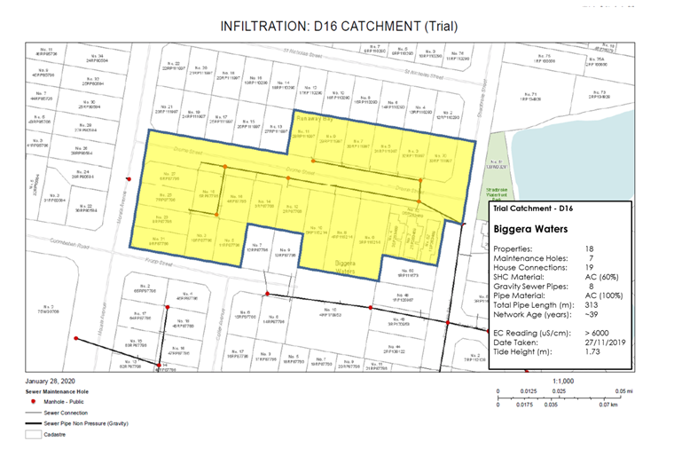
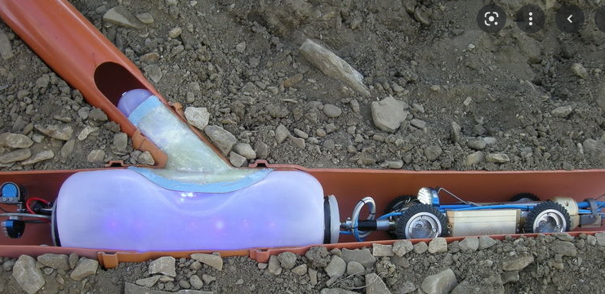
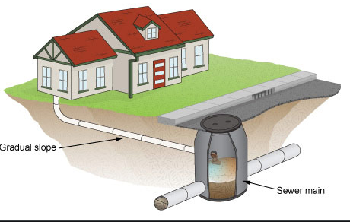
2. Fighting Infiltration
Targeted condition assessment & renewals
What were we doing and was it effective?
Where is the majority of the issue?
Salinity Reduction Pilot
Notes:
What are we doing to fight infiltration CLICK
Firstly, we have identified saline infiltration is the most important to tackle, and that which occurs in areas that have older cement based assets. This information is used to target gravity main and maintenance hole and now sewerage house connection condition assessment programs. Which we inspect about 120kms annually. In turn, this develops scope for relining and refurbishment. On average we reline about 30kms of main a year, or about 1% of our assets. CLICK
Our findings from this process have indicated dubious confidence that we are achieving the reduction in infiltration that we are wanting. We are improving our asset strength and renewing its life, but infiltration is not coming down. CLICK
Literature supports our findings, noting that you would need to typically remediate 80% of the network to get the desired reduction in infiltration. CLICK;CLICK;CLICK
This means MH; Mains & laterals - So how far do we really need to go to get on top of this? and how much would that cost? Can we get the reduction (in salinity) we need by finding areas that have the highest impact and completing extensive remediation on these areas alone? and continue our typical network remediation on everything else.
So we started a salinity reduction pilot study, where we are looking at understanding where are the area in the network that have the highest salinity reading, can we target this part of the network to reduce infiltration in a more prudent manner.
CLICK A small area in paradise point was our study area: using pump run hour analysis and field conductivity monitoring to drill down to the areas that were the ‘major culprits’. We monitor pre & post remediation to try and find the effects of holistic repair, the second area yet to be found will look at the effective after each stage of repair.
Preliminary findings
80% of the properties in the pilot area either does not have an IO or the IO is buried.
An IO is an inspection opening which is used to assess the condition of the HC.
This is problematic as cutting in an IO can be very costly, making the benefits of this project start looking meek compared to the cost.
So the guys started looking at different ways to look at the pipe - they used snake cameras from the ORG – which proved to be effective – but time consuming
Where we are at now
Findings are:
7 out of the 8 gravity sewer were relined. Most of the gravity mains were lying below sea level and have infiltration based on the CCTV assessment. - only 1 did not require relining as it was above sea level.
7 out of 19 SHC required reline. Complete
All MH were in good condition requiring no work.
Reduction in infiltration – unfortunately, the jury is still out. A series of issues occurred to make it premature for me to say (while I am quietly optimistic) I can’t definitely say. We have had issues with EC monitoring equipment, and as we could not monitor flow from this small area, we relied on EC. There was significant rain events which could impact EC readings if freshwater was entering the system. So, while we are preparing to do the same exercise in another are to help validate experiences, we will keep monitoring this.
In the mean time also, while we are looking at this, our amazing sewer asset engineers and project delivery team, have worked together to go that little bit further in remediation. When they see infiltration, in the areas where saline groundwater is problematic, not only will they reline, and top hat house connection points (CLICK), if they continue to see infiltration they will find an IO, or through the ORG will reline the house connection. And now that this incorporated in normal practice, we will continue to use our monitoring tools to measure the effectiveness.

Slide 11
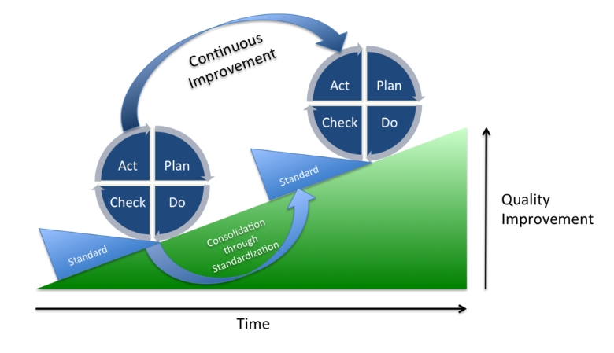
Future Plans
Notes:
As a utility, with limited resources – we do tend to move around what is urgent and important, which can result in things falling off the radar.
I&I is one of those things that can drop off depending on what else is going on in the business and community.
But we have and continue to prioritise the program, managing resource fluctuation and rotation, it may lose pace at times, it remains something we strive to manage and reduce the impacts, now and for the future.
We have recently initiate a I&I working group, this is largely to ensure that people work together in developing a single template to monitor and measure I&I areas and the effectiveness of remediation work.
We are initiating an education program, informing people (including Councillors) of the importance to manage their sewerage connections and continue to offer free ORG caps and installation (noting that it is the responsibility of the customer to maintain this fixture)
We continue to target areas to undertake an aggressive approach to sewerage network remediation to address infiltration.
We have recently partnered with a delivery contractor that will be the principal contractor that can complete condition assessment and remediation, so for certain areas, we can tighten that turn around time, and get on top of problem areas quicker, and more efficiently.
In my opinion, a big challenge is to highlight the successes – as with many of our achievements, success results in silence – where there is no spill or complete asset failure there is no attention and little recognition of the problem that was solved or prevented – all too often we look at big failures and celebrate the success of managing these – which we should – but do we celebrate the silence enough – I don’t think so.
So, what we intend to do more of, with our increasing suite of tools, improved skill and team of motivated individuals – we will be able to better highlight what we achieved before things failed, as well as learn from the failures to improve the next iteration of efforts.

Slide 12
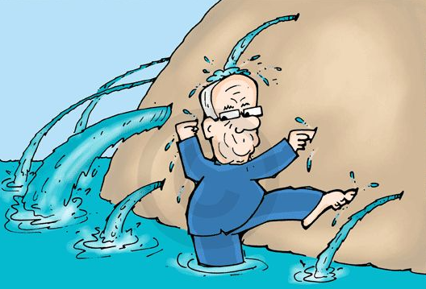
Thank you
Many people have been involved and new people being brought in to fight the good fight.
Management not elimination
Want a job for life, get into I&I ☺
Notes:
I wanted to highlight that this is a beast of a problem and has been looked at by many people throughout the years, and we continue to fight the good fight.
If you want a long lasting career, get into I&I, you will have a job for life

