Slide 1

Queensland’s Urban Potable
Water and Sewerage
Benchmarking: 2024/25
™
Medium, Large and Extra-large service providers
Sewerage Services

Slide 2
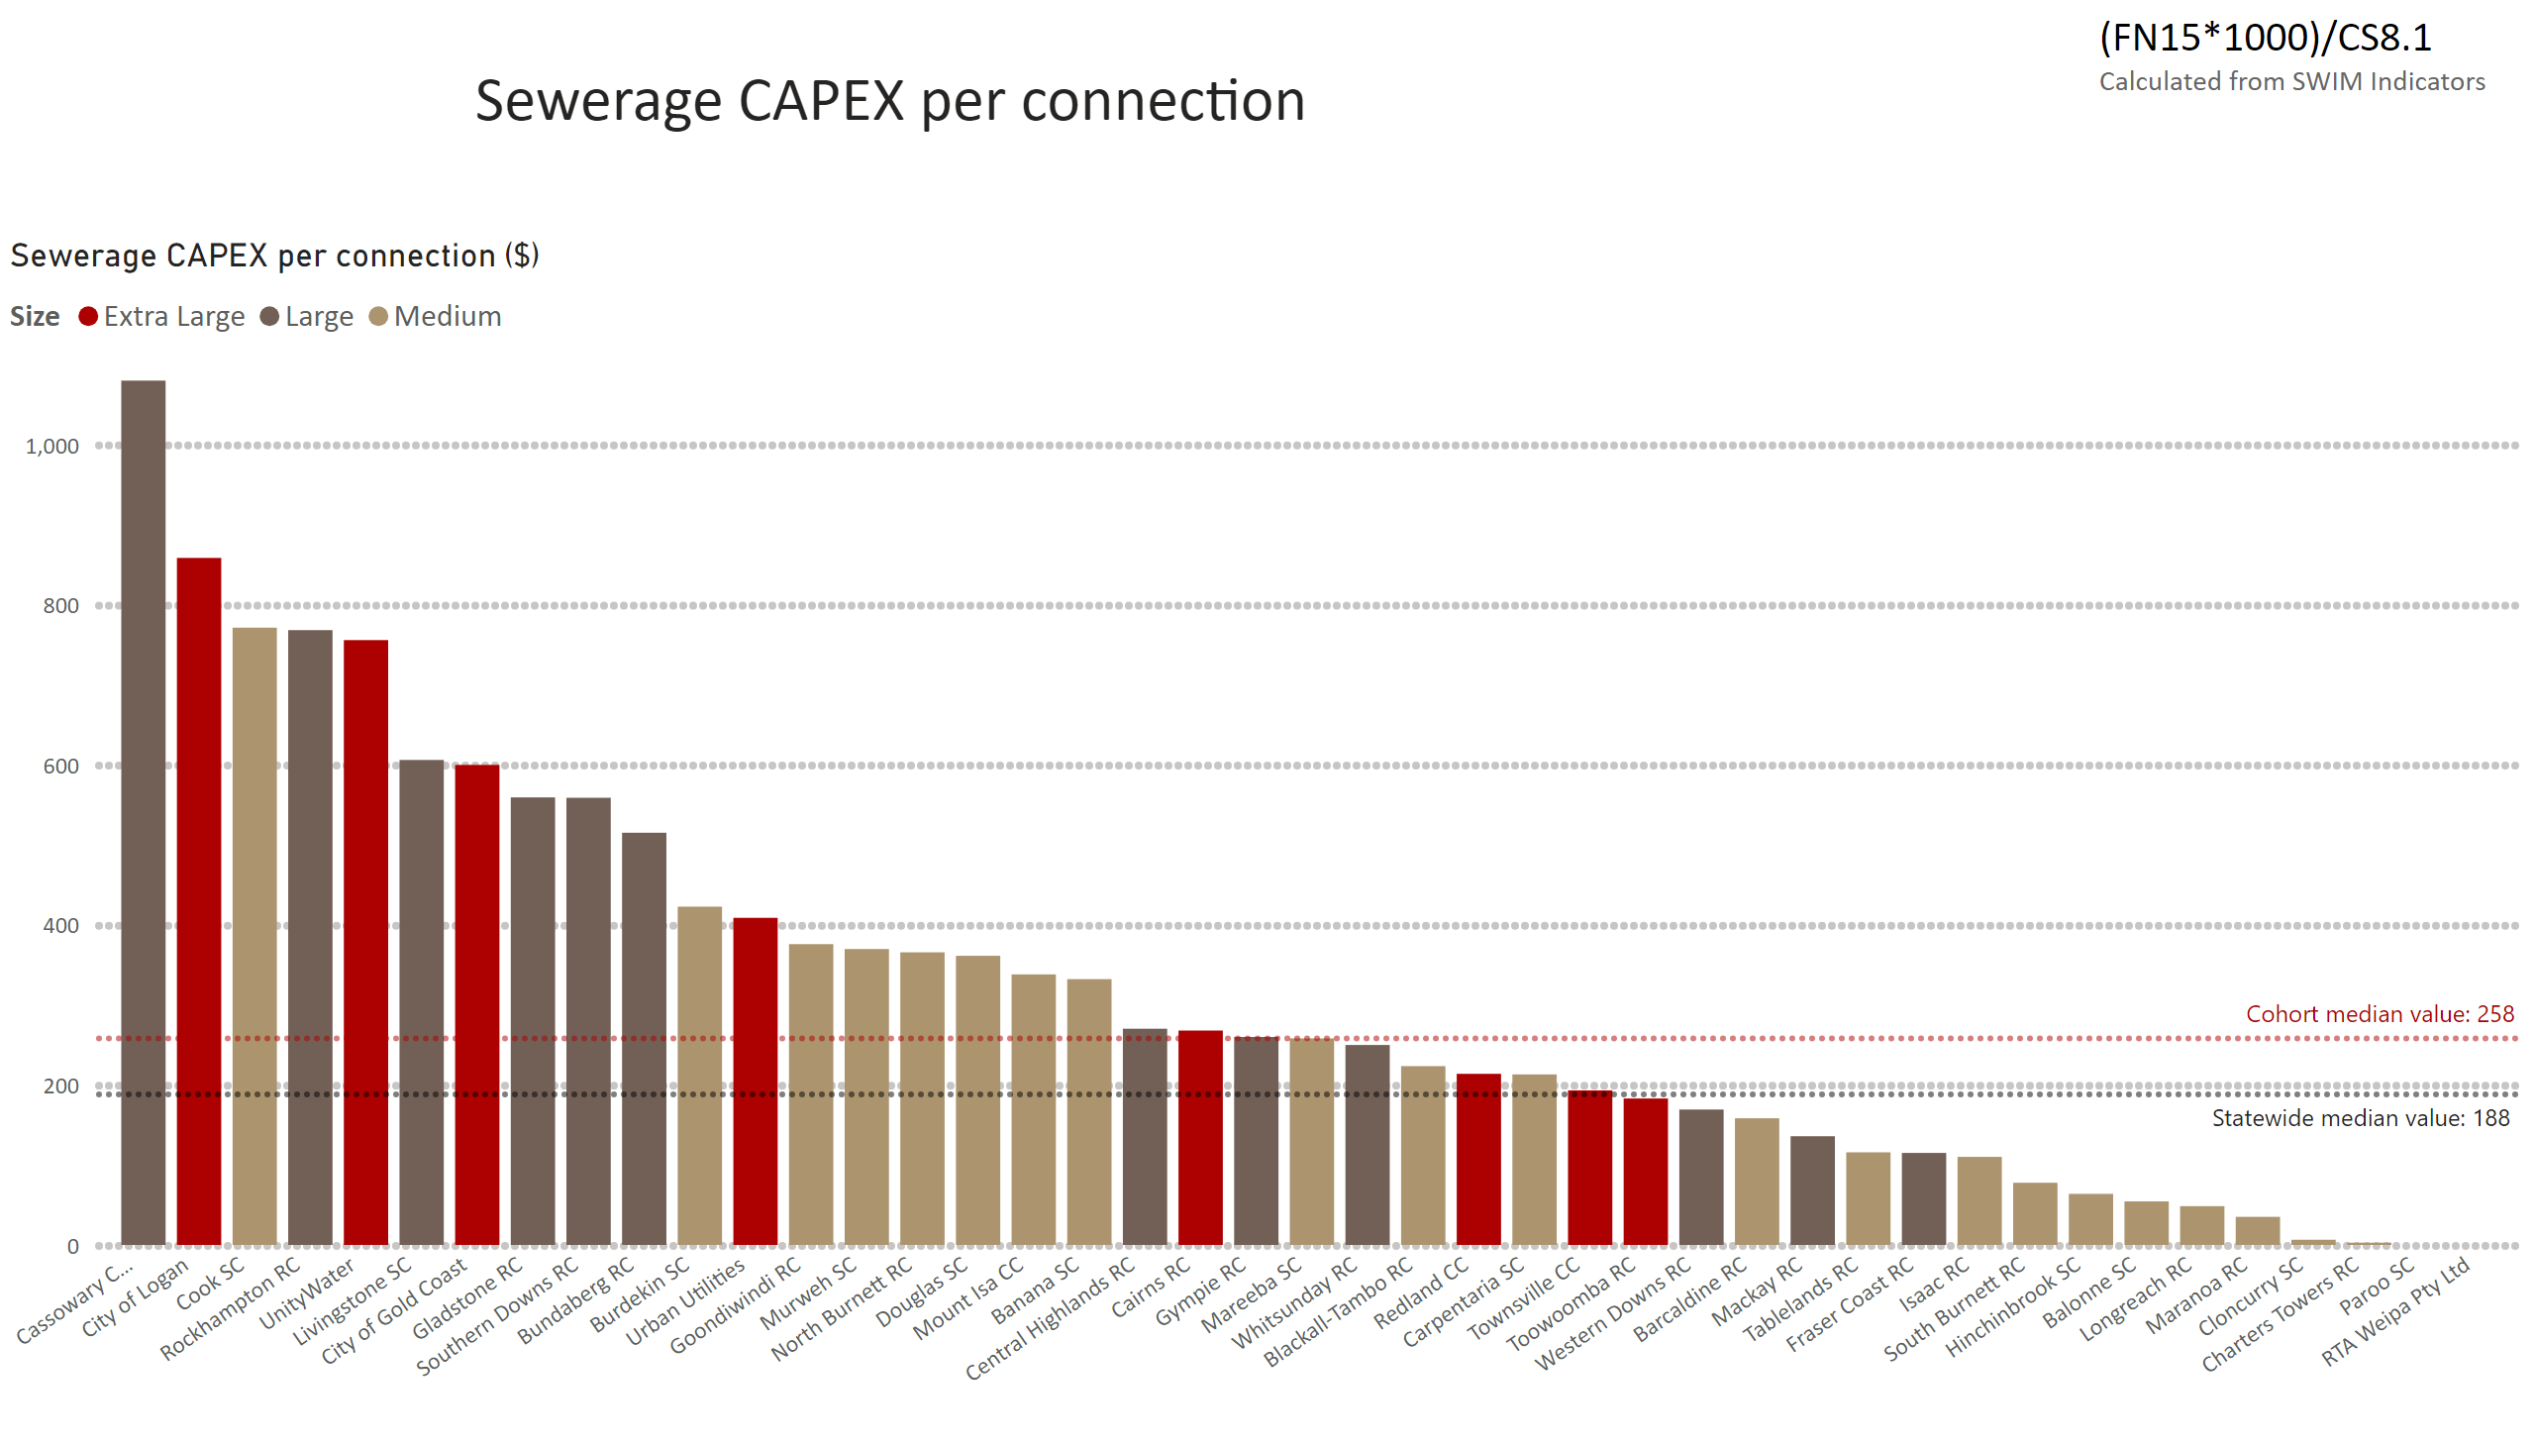
Sewerage CAPEX pp
Notes:
Sewerage CAPEX per connection ($)
No alt text provided
textbox
No alt text provided
textbox
No alt text provided
textbox
No alt text provided

Slide 3
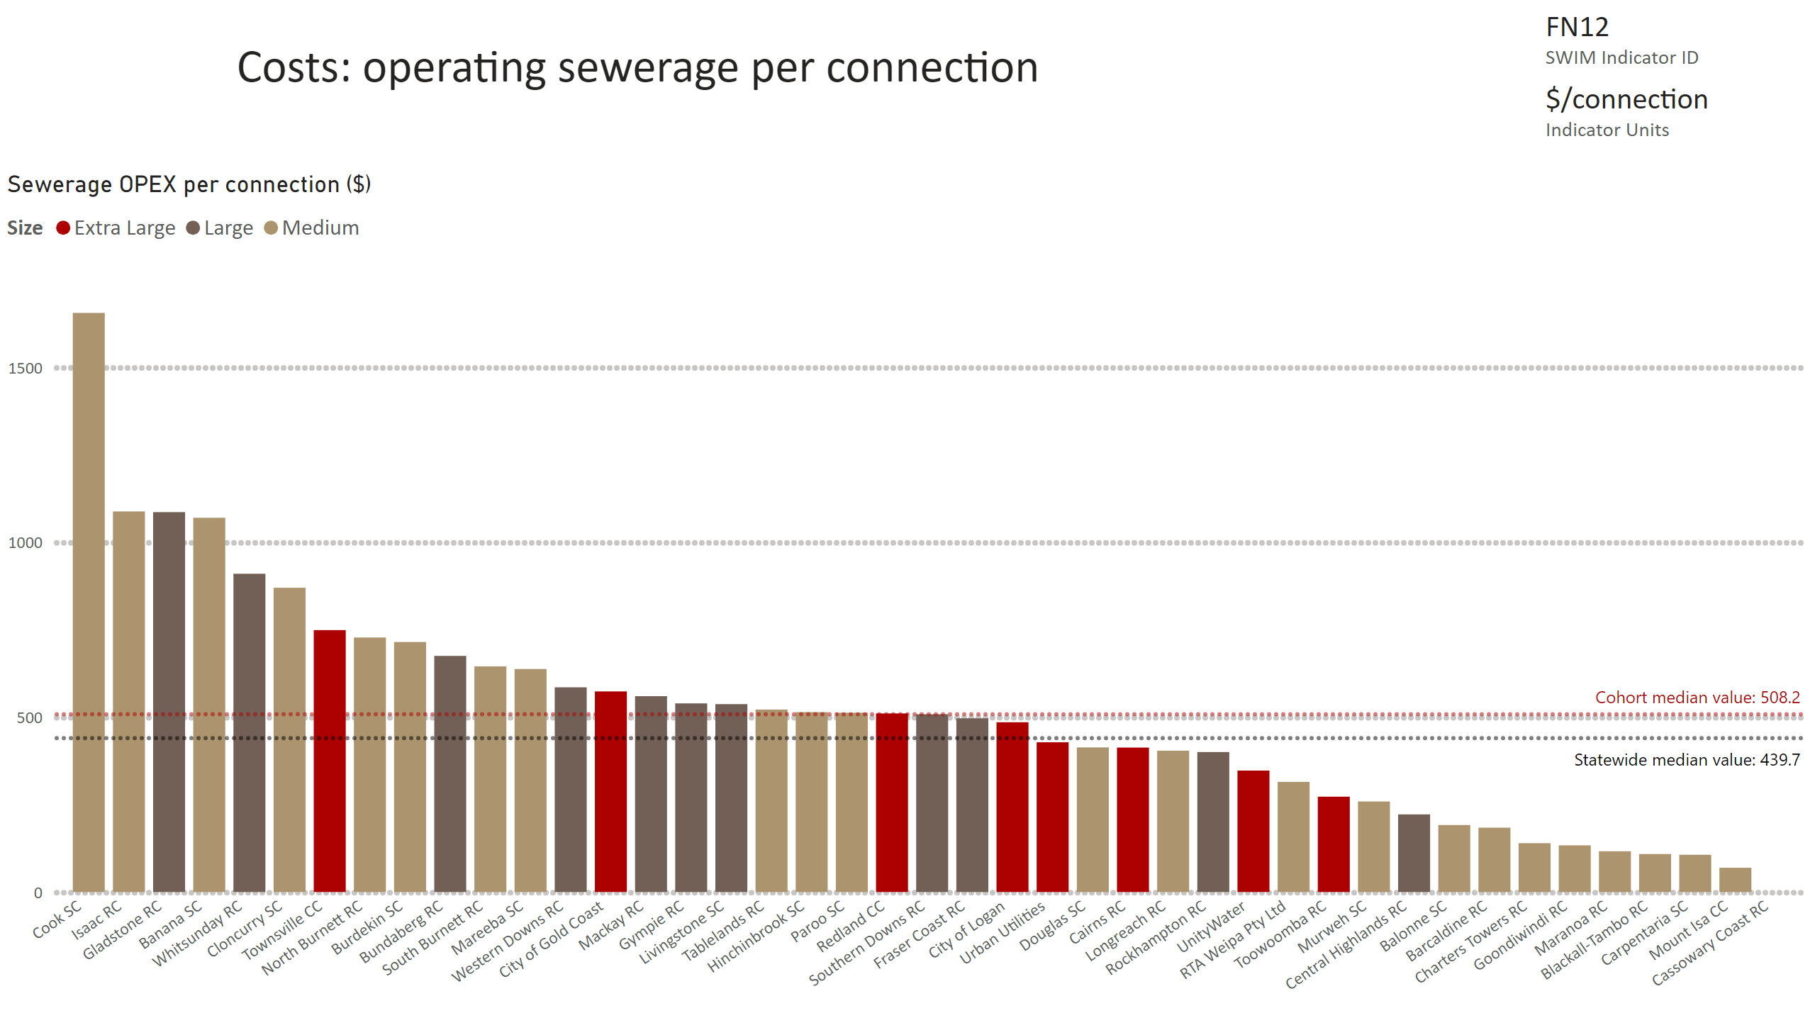
FN12 - need to convert in Excel first
Notes:
Sewerage OPEX per connection ($)
No alt text provided
card
No alt text provided
multiRowCard
No alt text provided

Slide 4
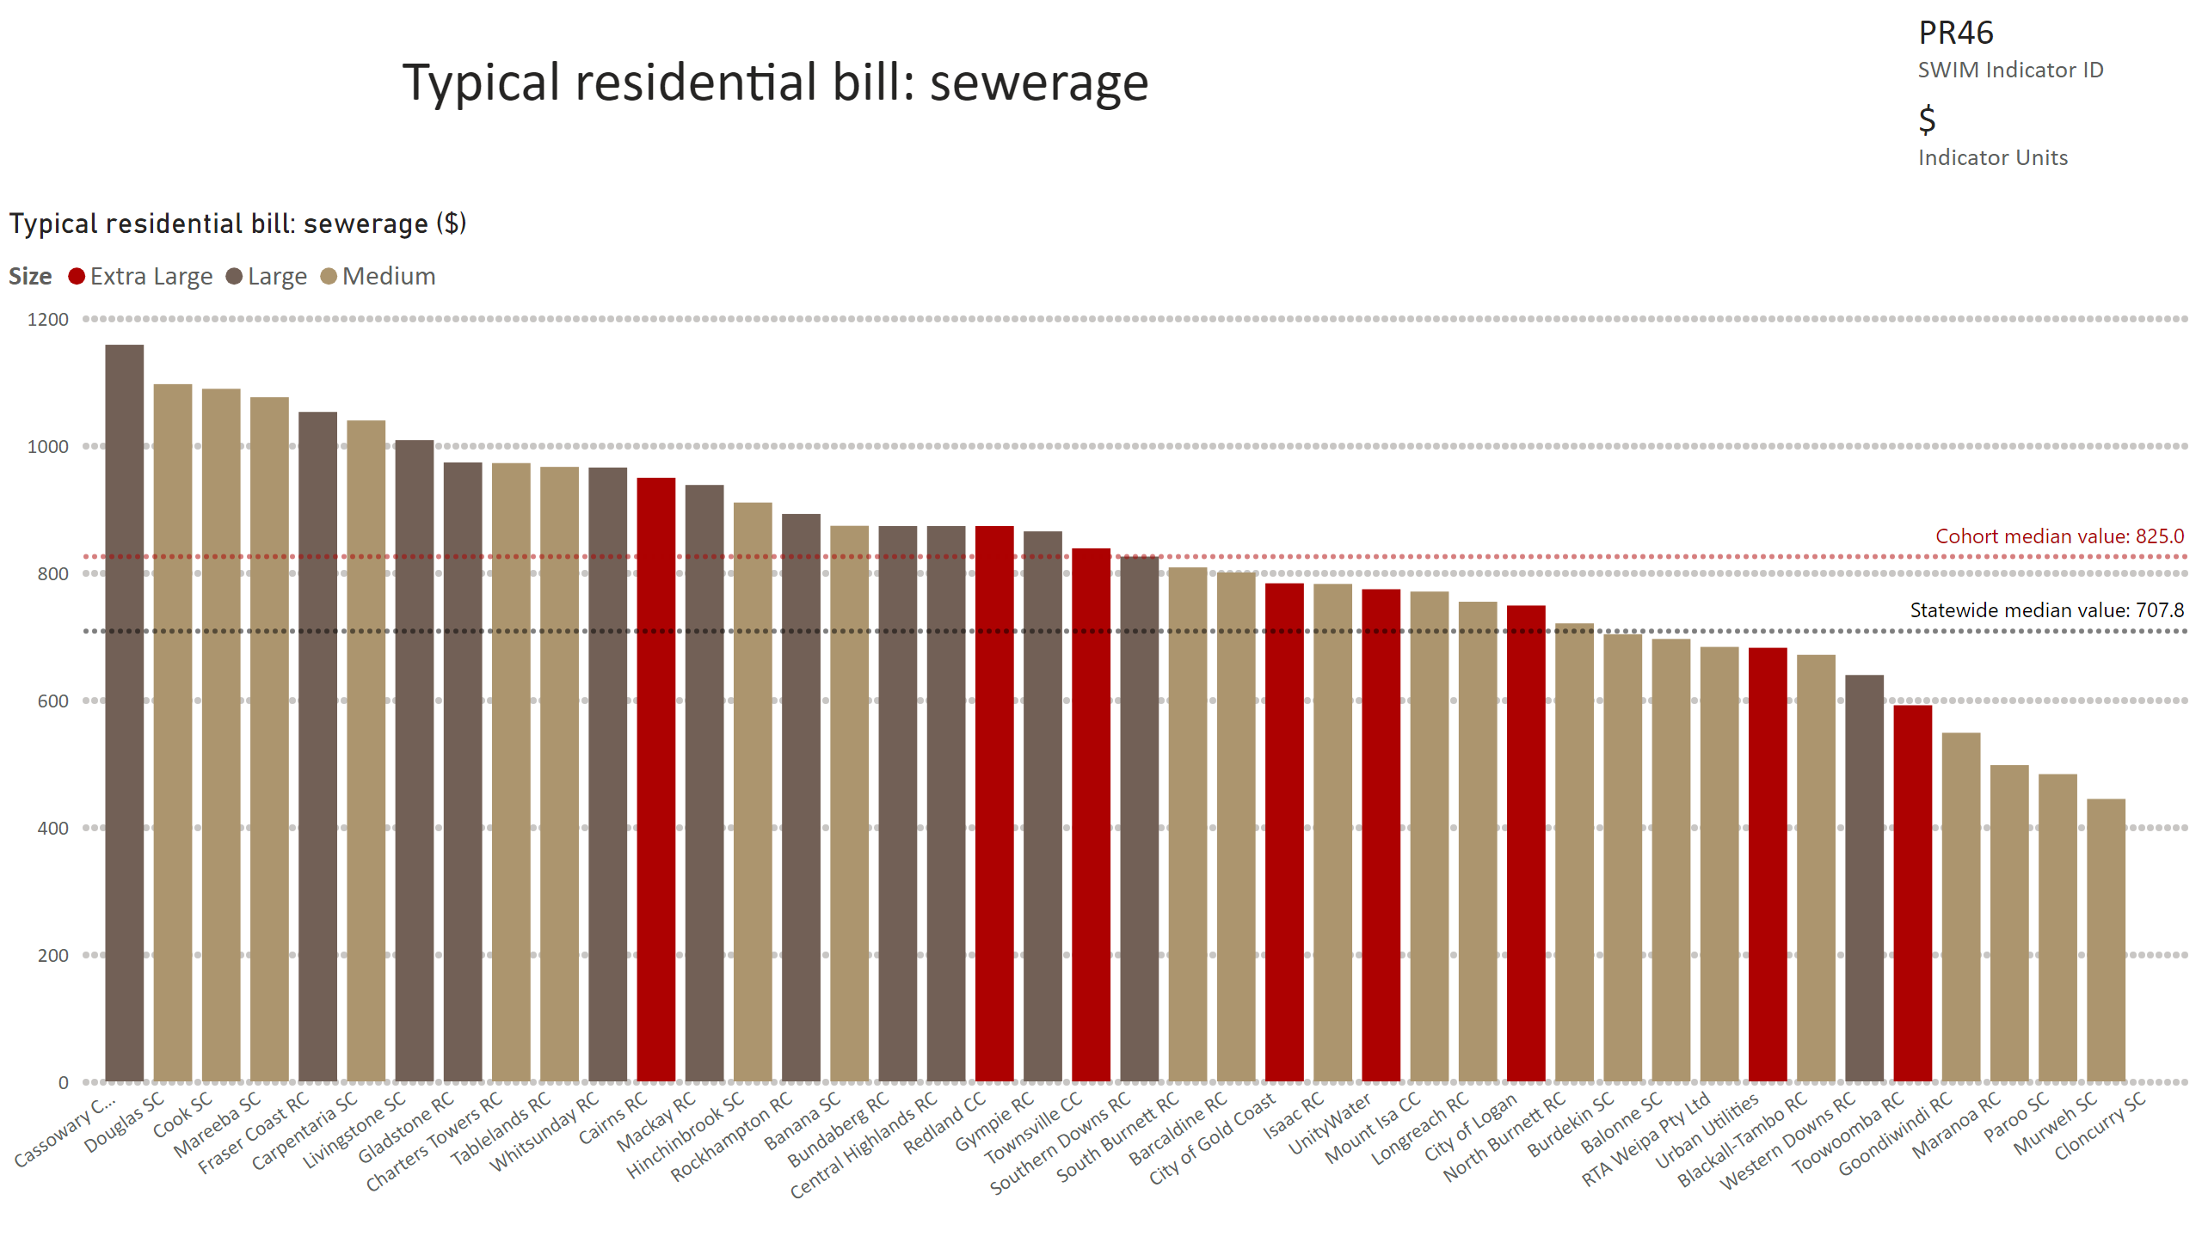
PR46
Notes:
Typical residential bill: sewerage ($)
No alt text provided
card
No alt text provided
multiRowCard
No alt text provided

Slide 5
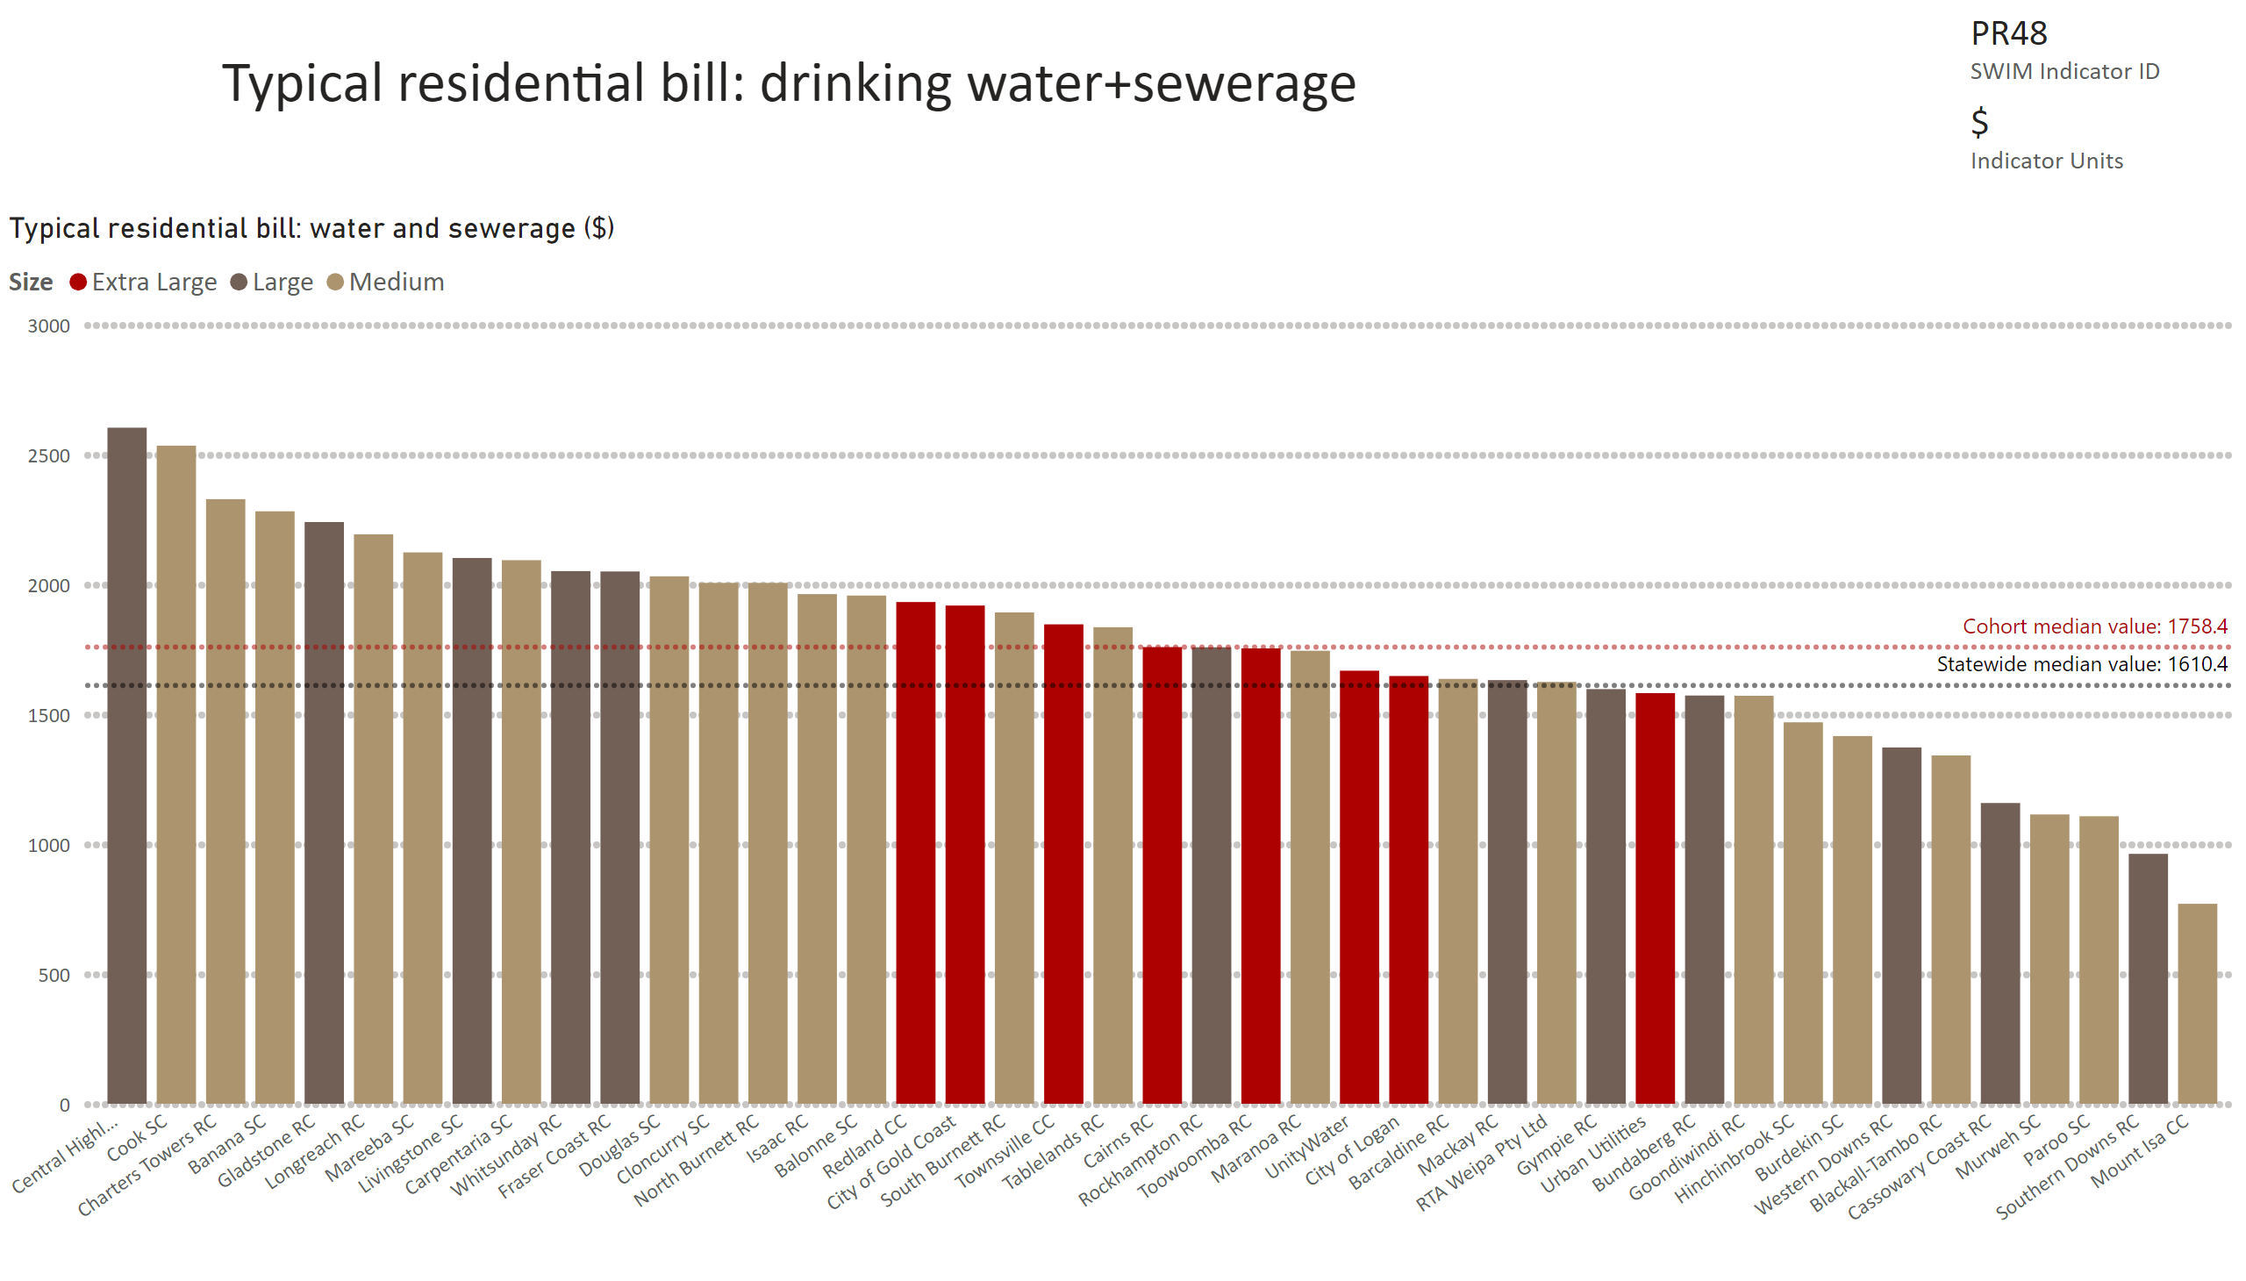
PR48
Notes:
Typical residential bill: water and sewerage ($)
No alt text provided
card
No alt text provided
multiRowCard
No alt text provided

Slide 6
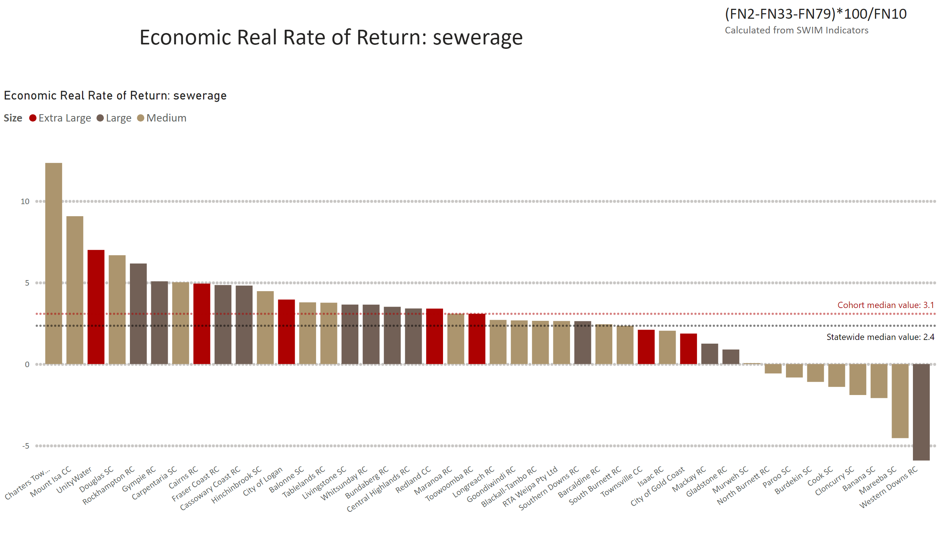
ERRR sewerage
Notes:
Economic Real Rate of Return: sewerage
No alt text provided
textbox
No alt text provided
textbox
No alt text provided

Slide 7
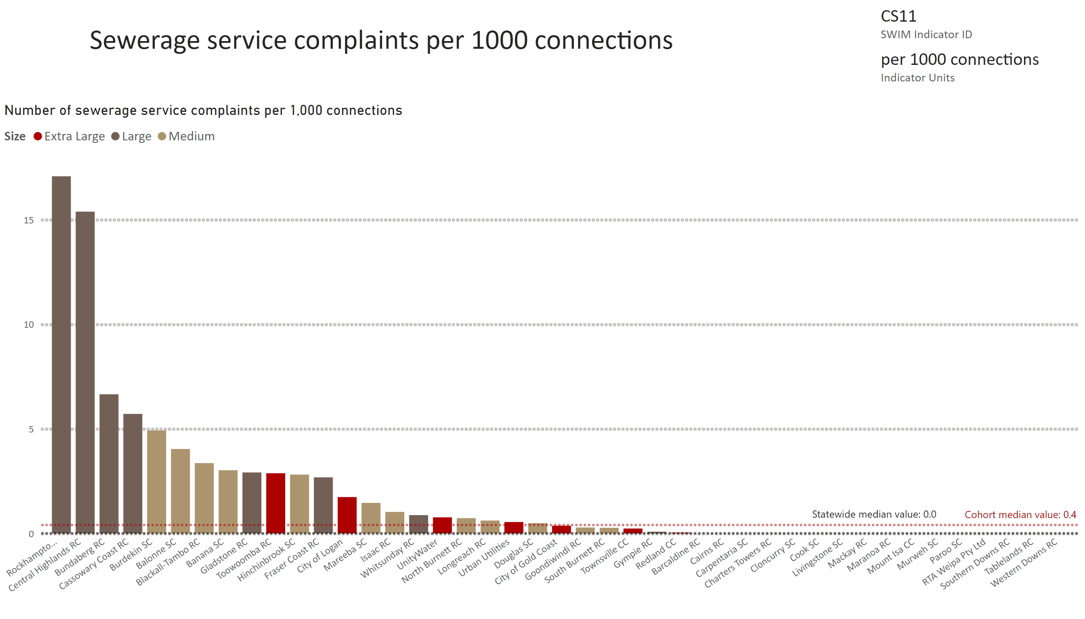
CS11
Notes:
Number of sewerage service complaints per 1,000 connections
No alt text provided
card
No alt text provided
multiRowCard
No alt text provided
textbox
No alt text provided

Slide 8
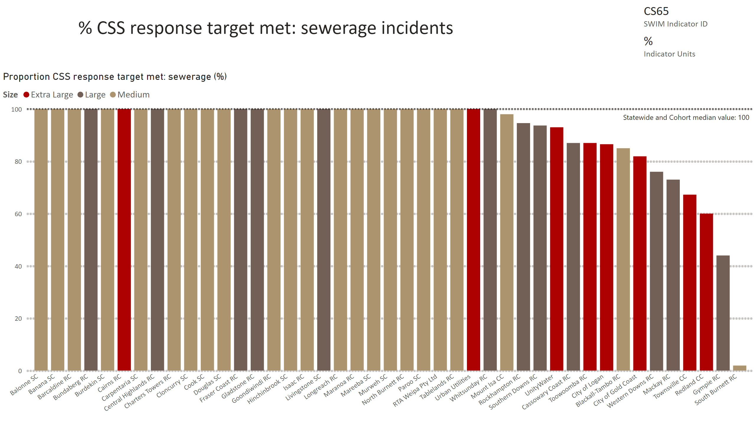
CS65
Notes:
Proportion CSS response target met: sewerage (%)
No alt text provided
card
No alt text provided
multiRowCard
No alt text provided
textbox
No alt text provided

Slide 9
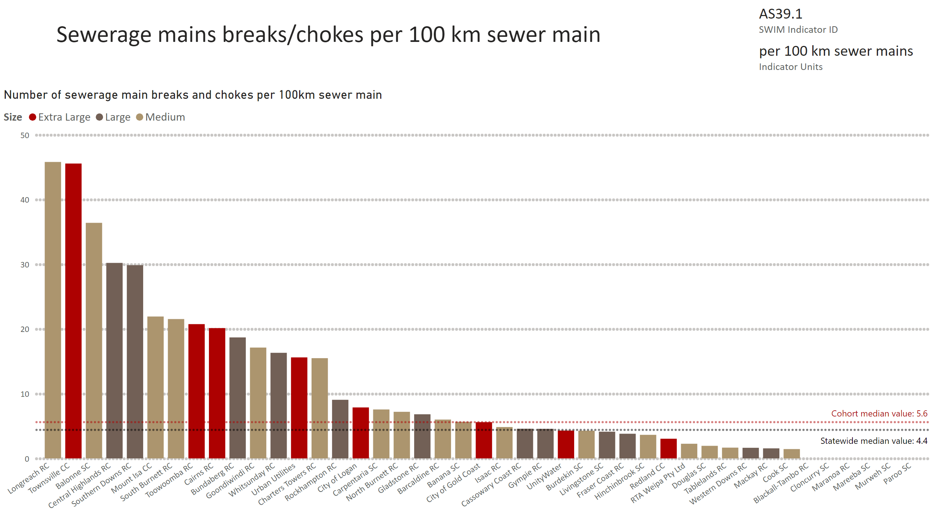
AS39 now AS39.1
Notes:
Number of sewerage main breaks and chokes per 100km sewer main
No alt text provided
card
No alt text provided
multiRowCard
No alt text provided

Slide 10
™
Medium, Large and Extra-large service providers
Water Services

Slide 11
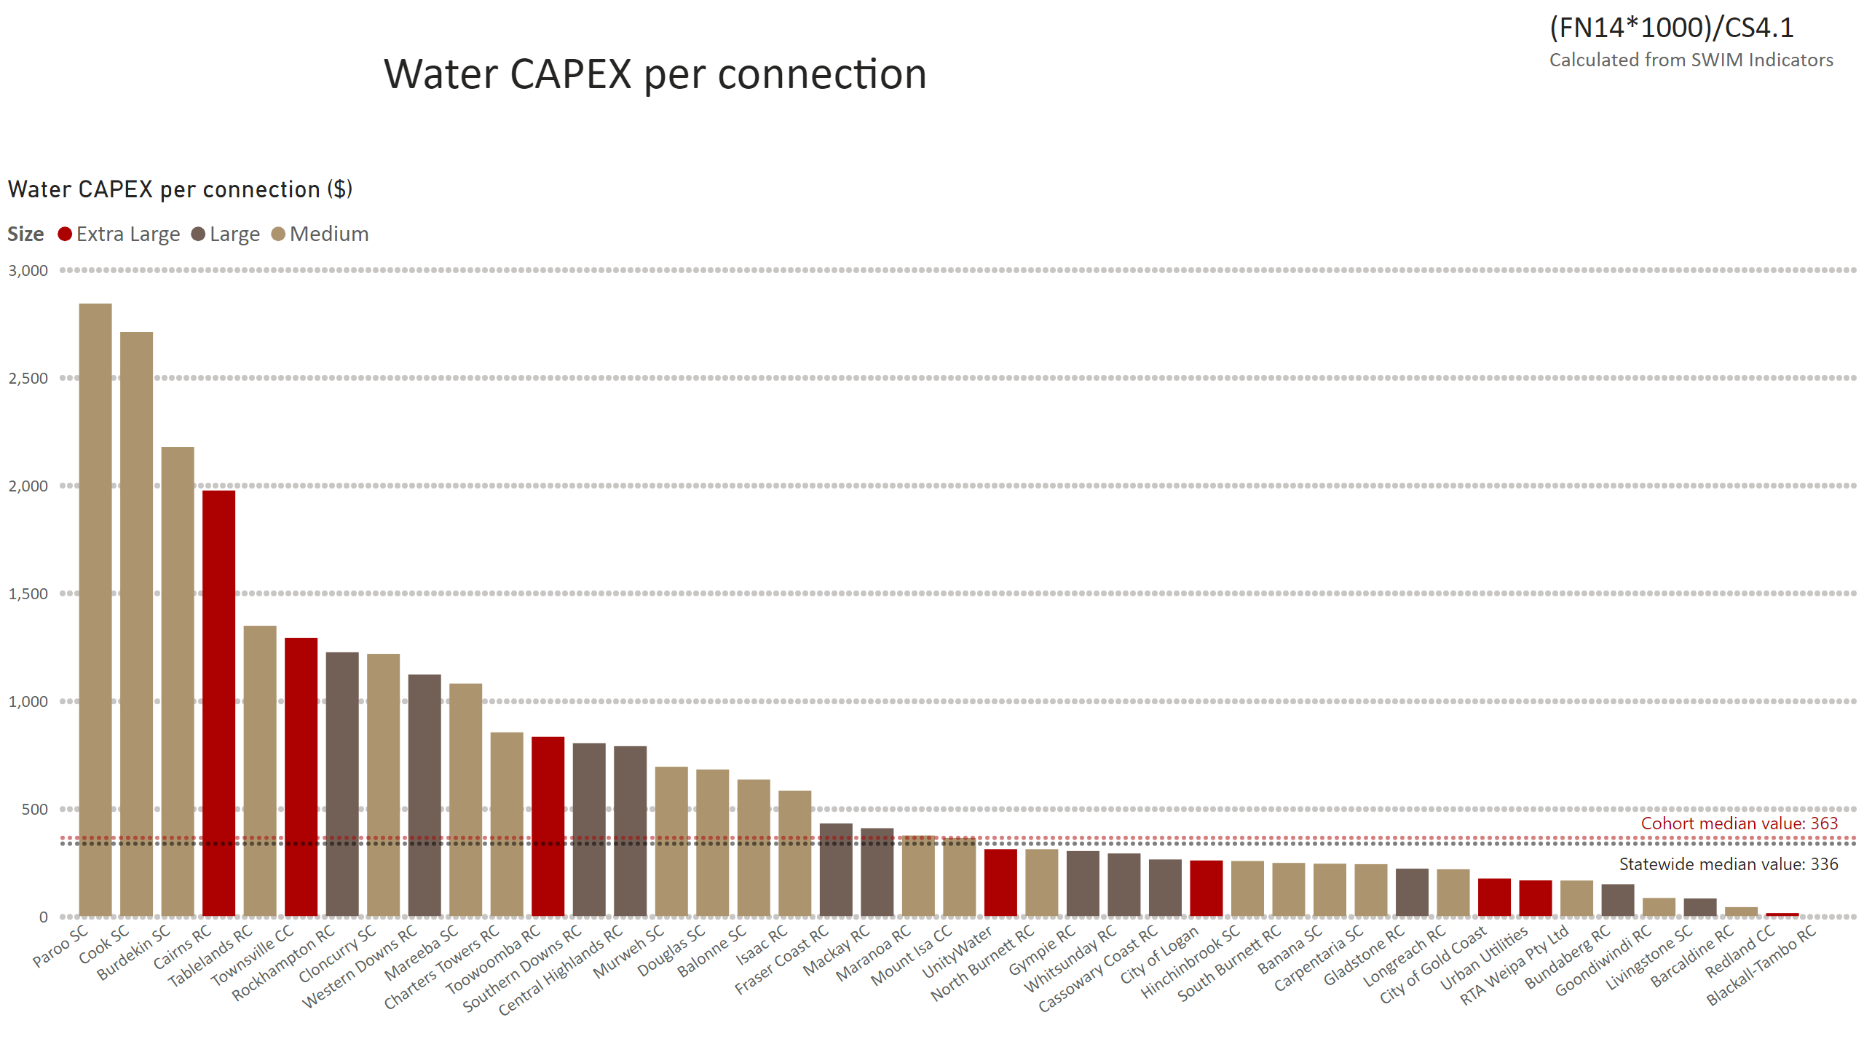
Water CAPEX pp
Notes:
Water CAPEX per connection ($)
No alt text provided
textbox
No alt text provided
textbox
No alt text provided
textbox
No alt text provided
textbox
No alt text provided

Slide 12
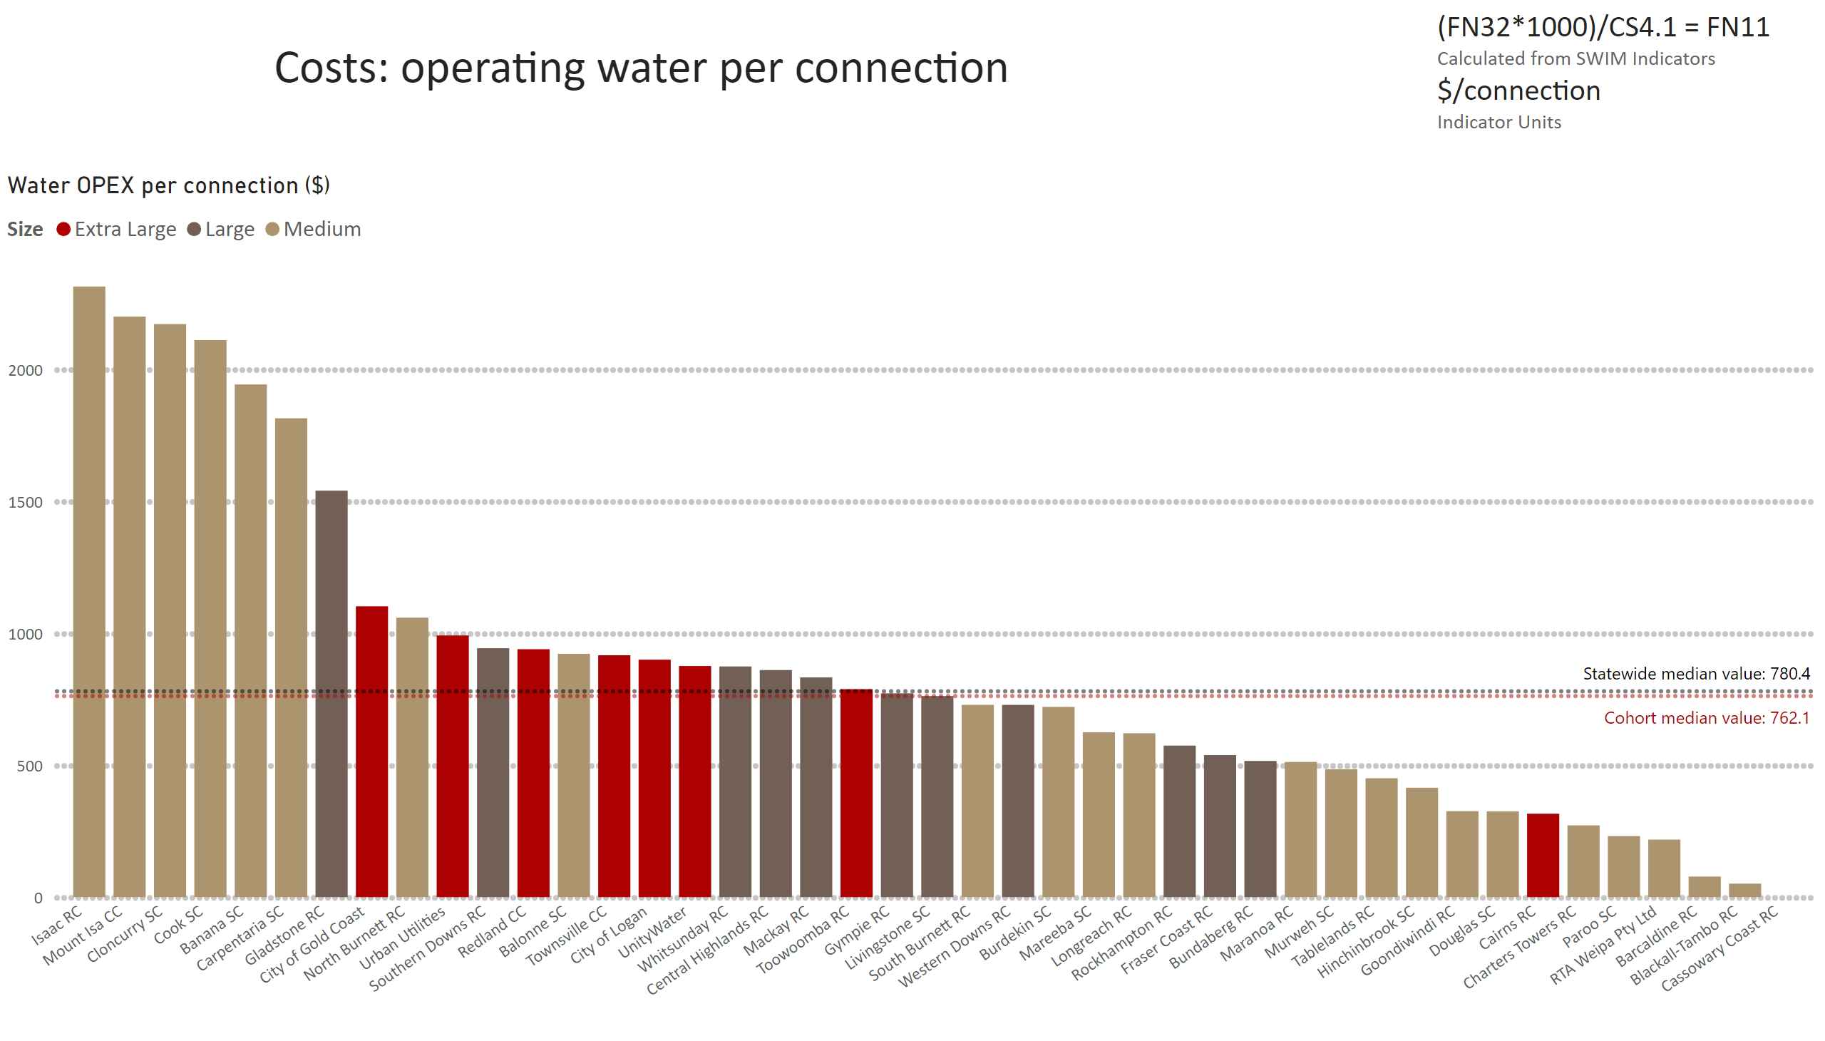
FN11 - need to convert in excel first
Notes:
Water OPEX per connection ($)
No alt text provided
card
No alt text provided
textbox
No alt text provided

Slide 13
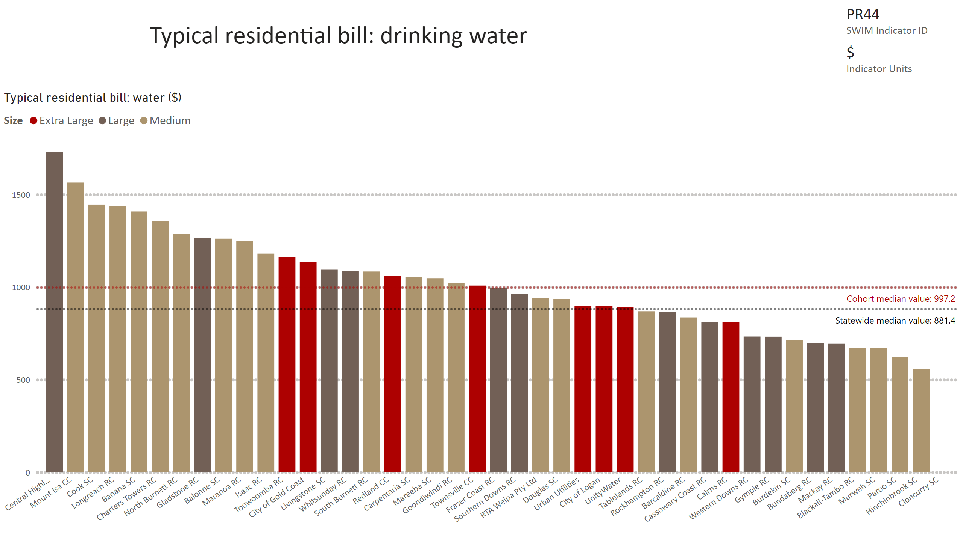
PR44
Notes:
Typical residential bill: water ($)
No alt text provided
card
No alt text provided
multiRowCard
No alt text provided

Slide 14
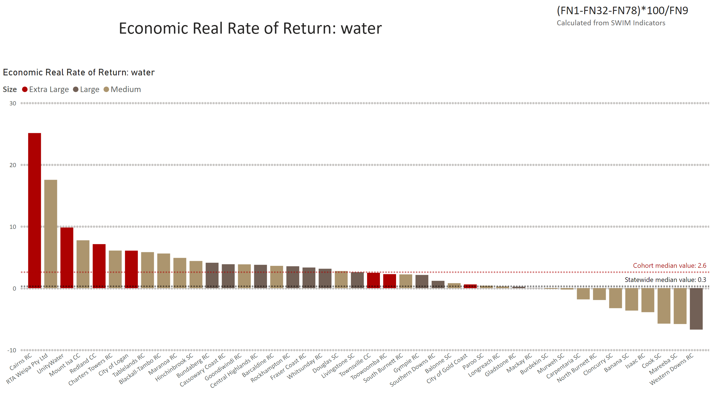
ERRR water
Notes:
Economic Real Rate of Return: water
No alt text provided
textbox
No alt text provided
textbox
No alt text provided

Slide 15
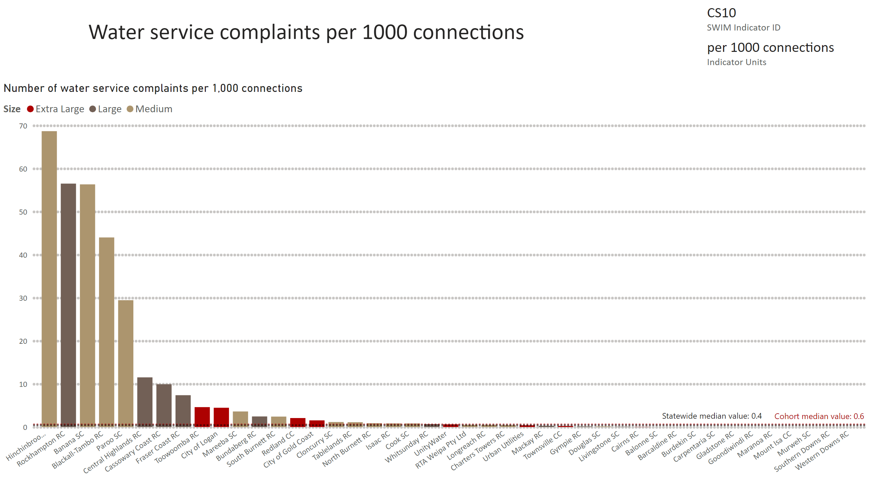
CS10
Notes:
Number of water service complaints per 1,000 connections
No alt text provided
card
No alt text provided
multiRowCard
No alt text provided
textbox
No alt text provided

Slide 16
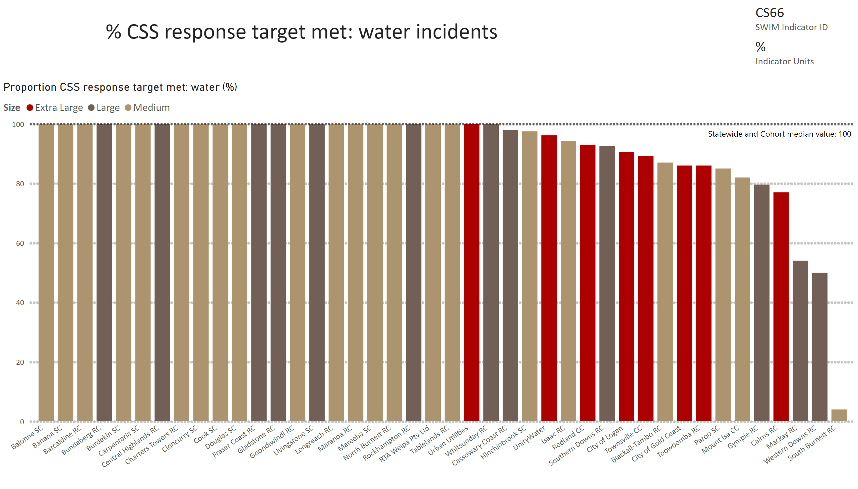
CS66
Notes:
Proportion CSS response target met: water (%)
No alt text provided
card
No alt text provided
multiRowCard
No alt text provided

Slide 17
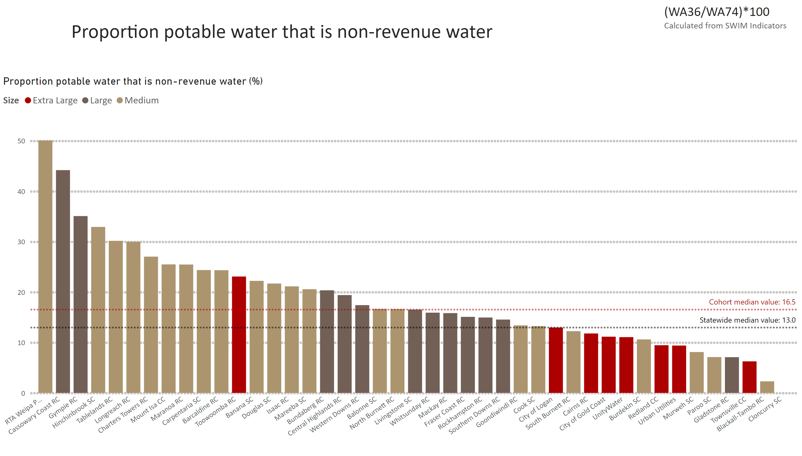
Prop NRW
Notes:
Proportion potable water that is non-revenue water (%)
No alt text provided
textbox
No alt text provided
textbox
No alt text provided

Slide 18
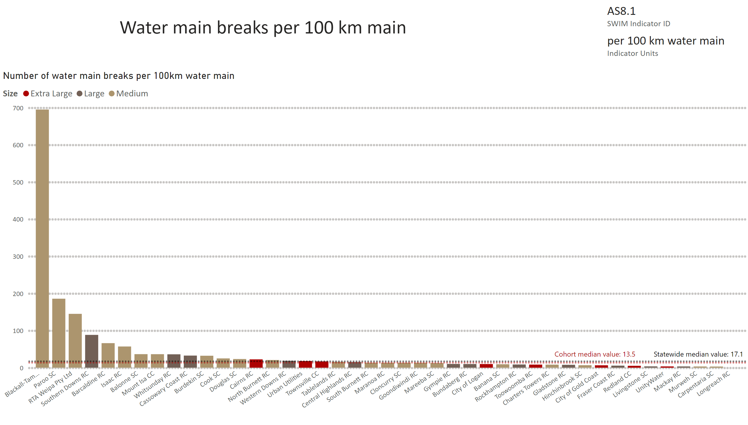
AS8.1
Notes:
Number of water main breaks per 100km water main
No alt text provided
card
No alt text provided
multiRowCard
No alt text provided
textbox
No alt text provided

Slide 19
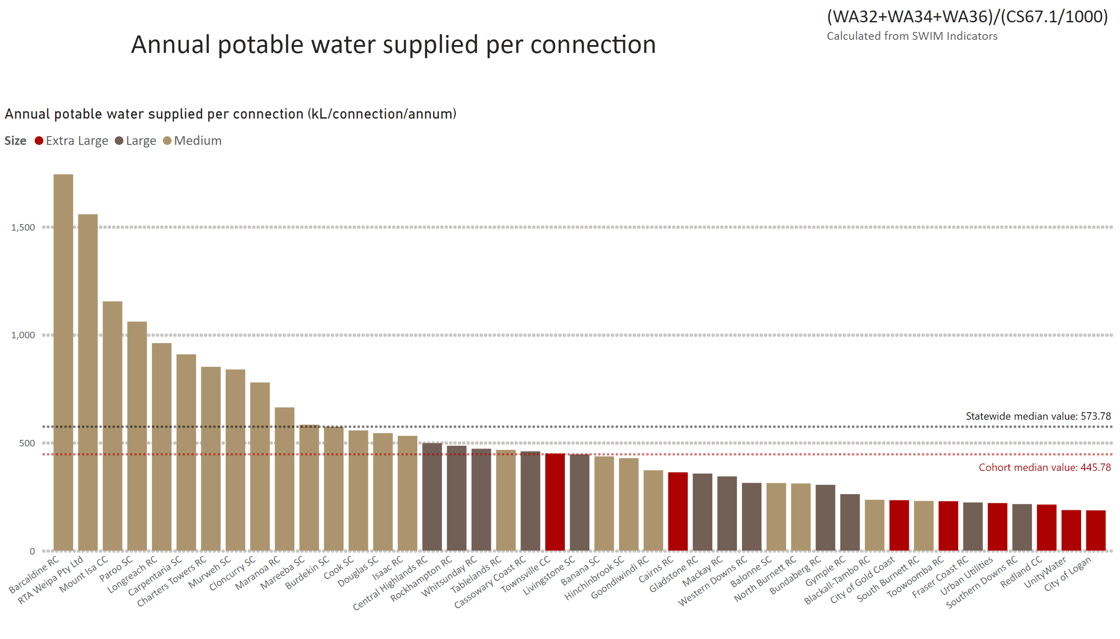
WA30 equivalent
Notes:
Annual potable water supplied per connection (kL/connection/annum)
No alt text provided
textbox
No alt text provided
textbox
No alt text provided

Slide 20
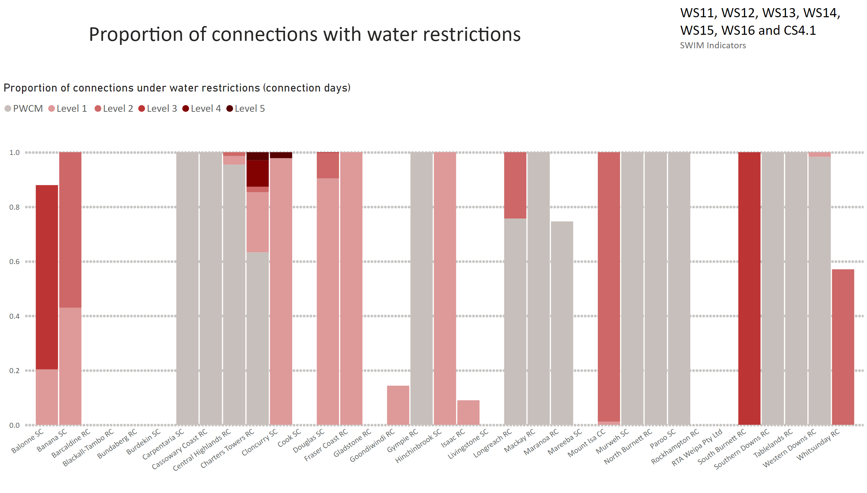
Water security MLXL
Notes:
Proportion of connections under water restrictions (connection days)
No alt text provided
textbox
No alt text provided
textbox
No alt text provided

