Slide 1

Queensland’s Urban Potable
Water and Sewerage
Benchmarking: 2024/25
™
Small and Indigenous service providers
Sewerage Services

Slide 2
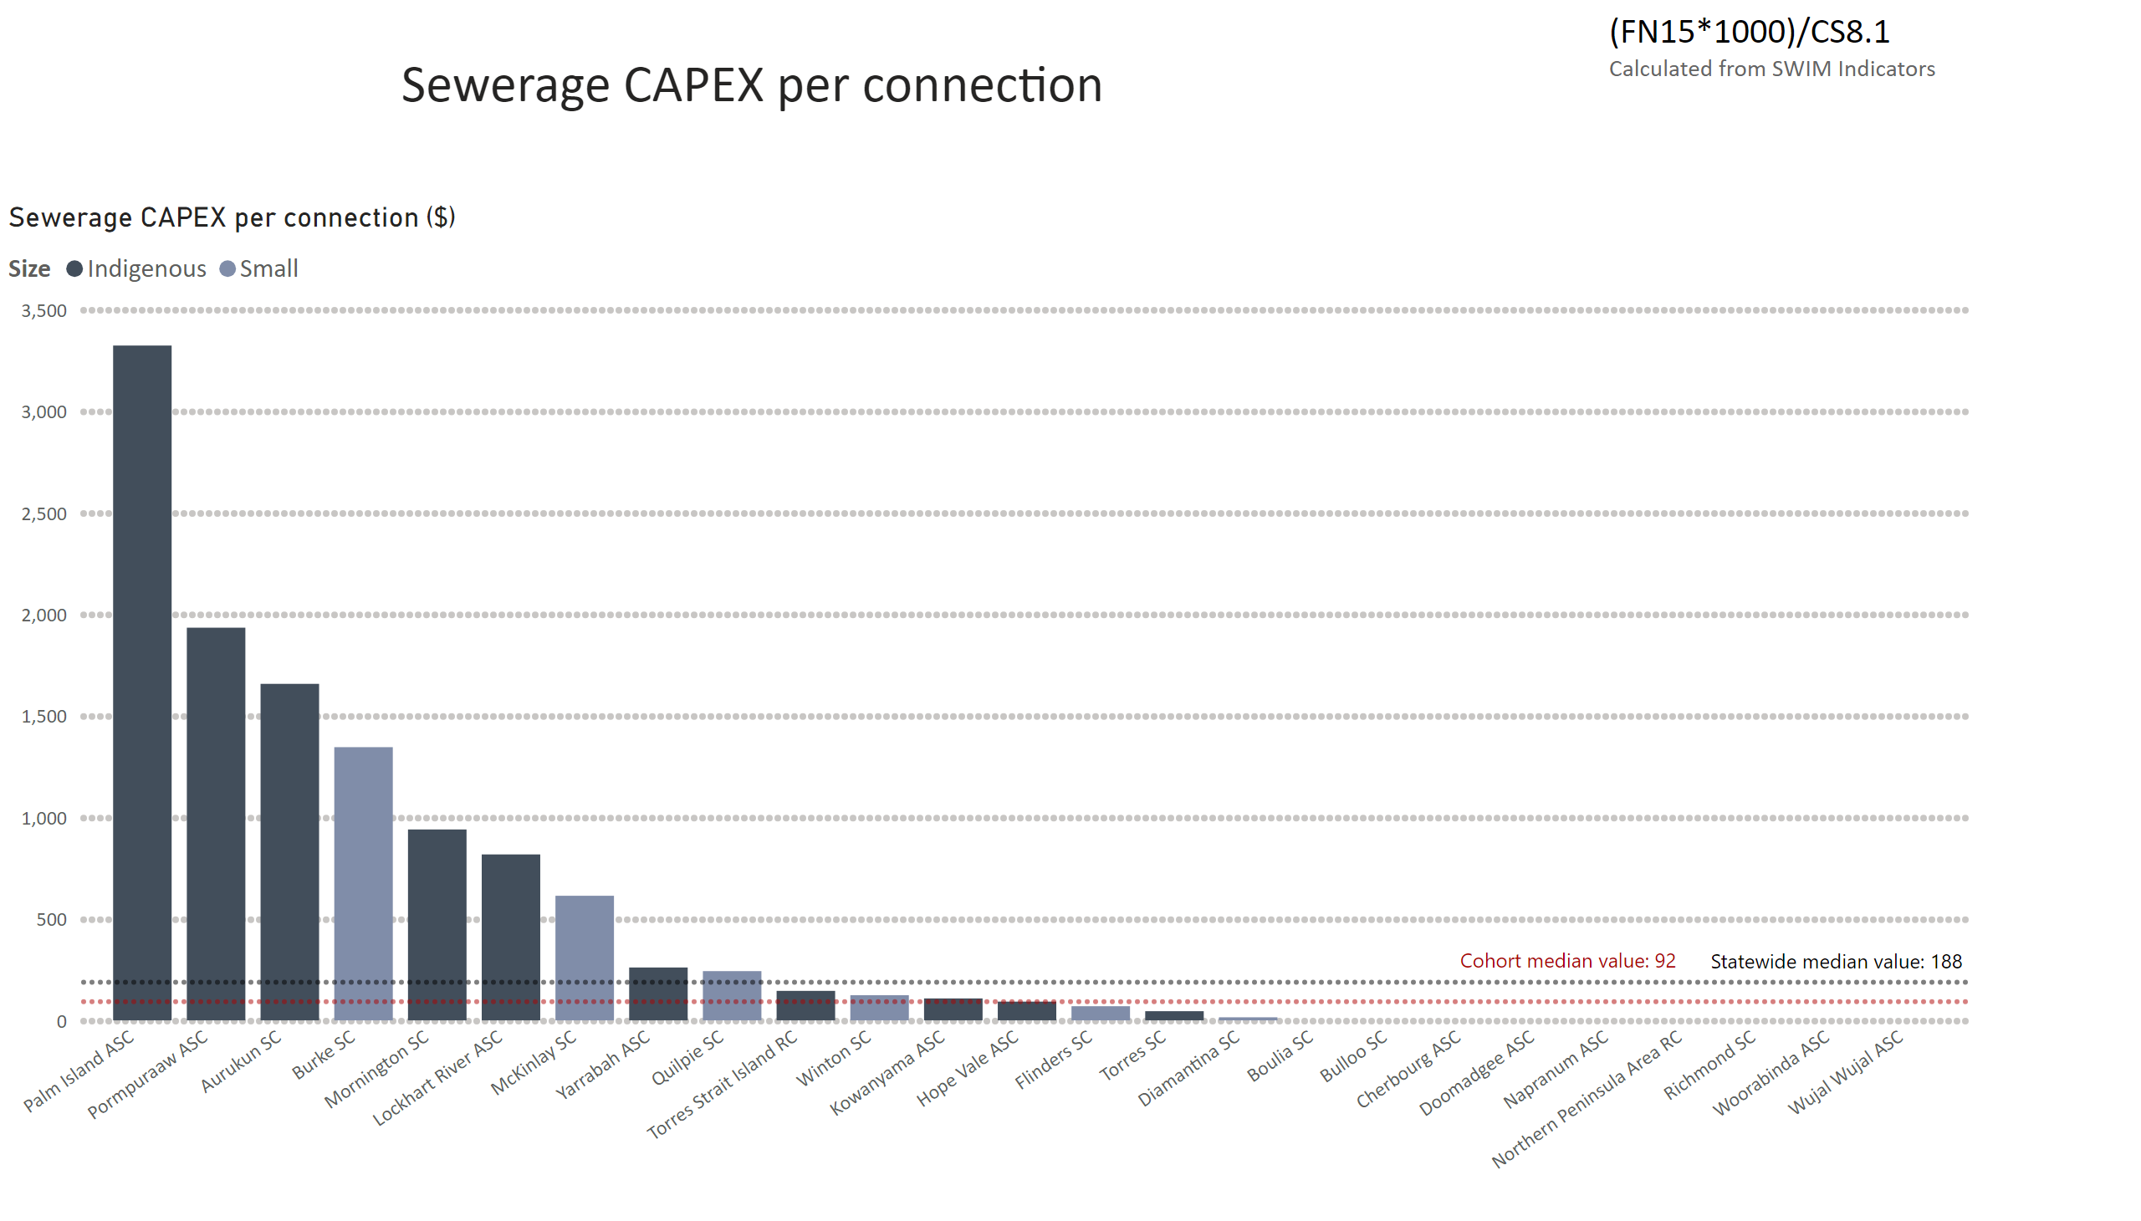
Sewerage CAPEX pp
Notes:
Sewerage CAPEX per connection ($)
No alt text provided
textbox
No alt text provided
textbox
No alt text provided
textbox
No alt text provided

Slide 3
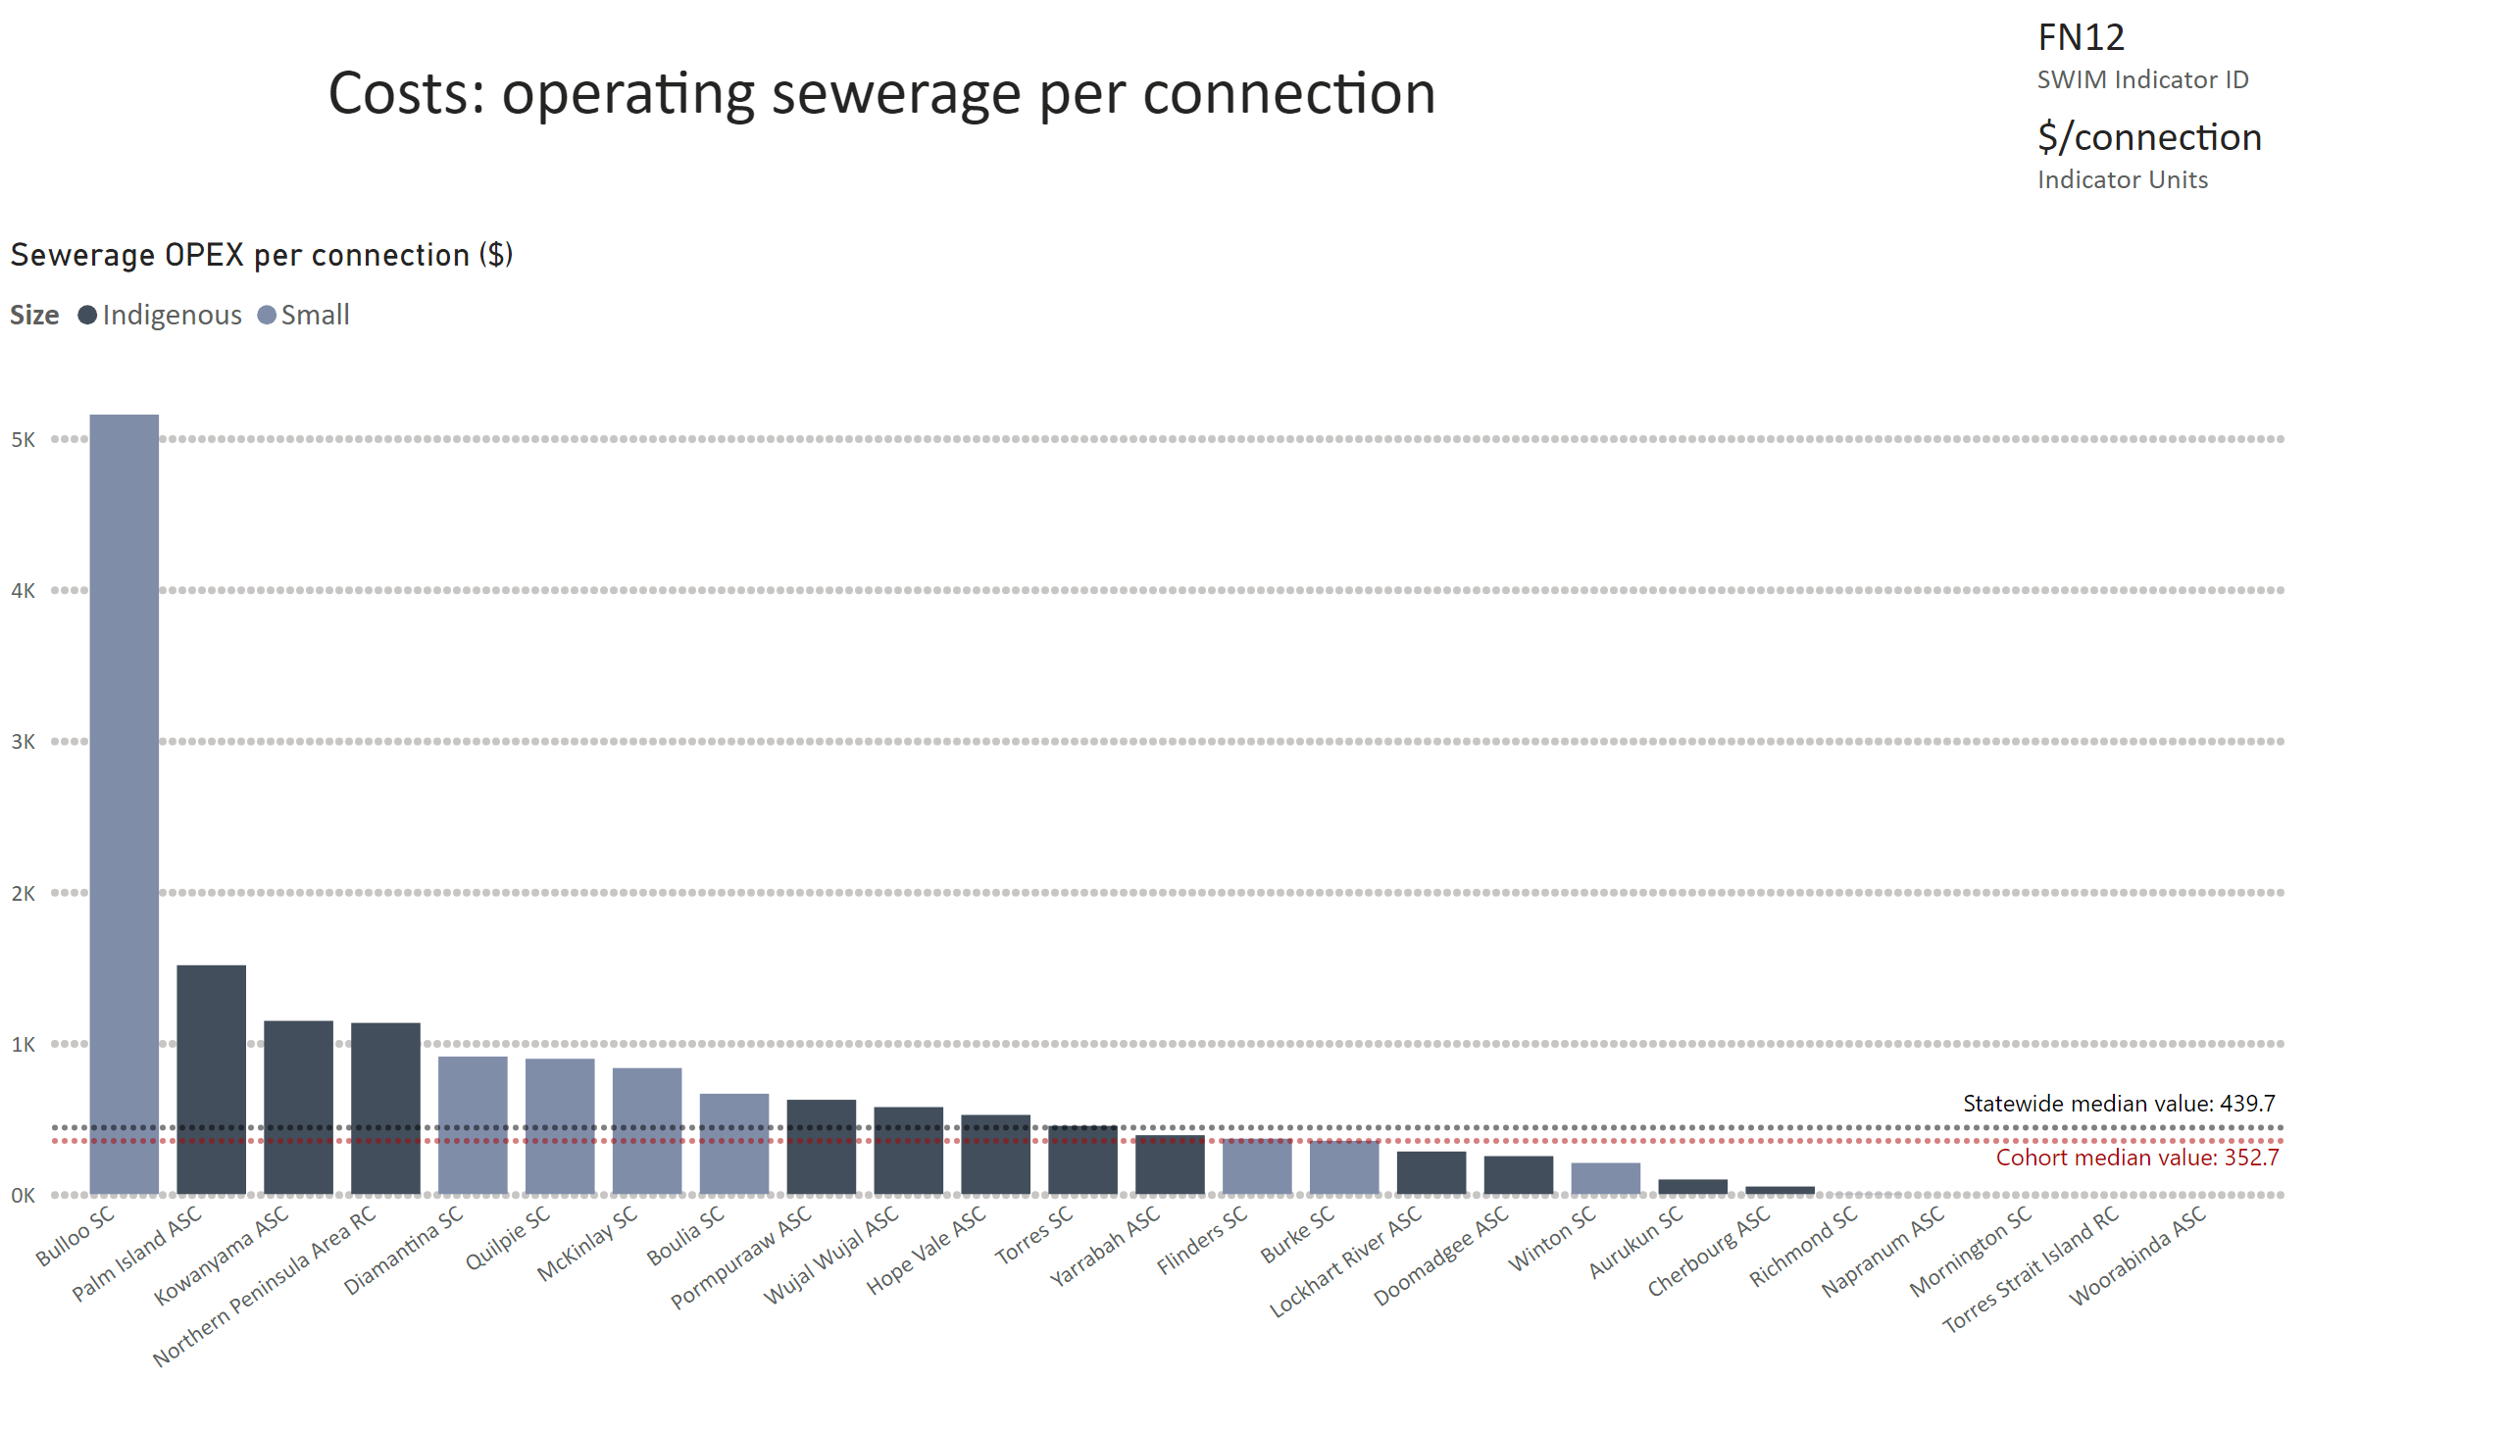
FN12
Notes:
Sewerage OPEX per connection ($)
No alt text provided
card
No alt text provided
multiRowCard
No alt text provided
textbox
No alt text provided

Slide 4
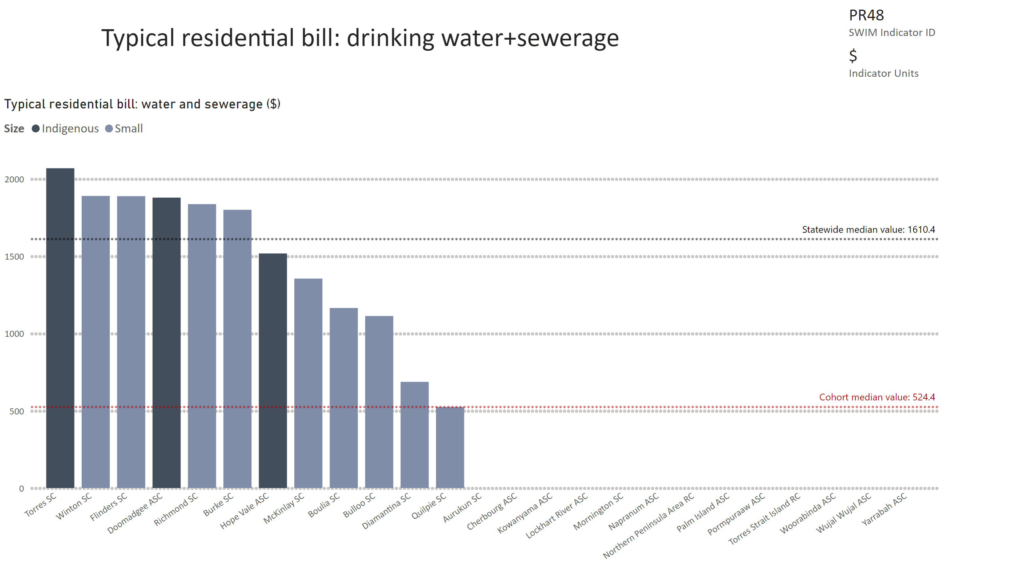
PR48
Notes:
Typical residential bill: water and sewerage ($)
No alt text provided
card
No alt text provided
multiRowCard
No alt text provided

Slide 5
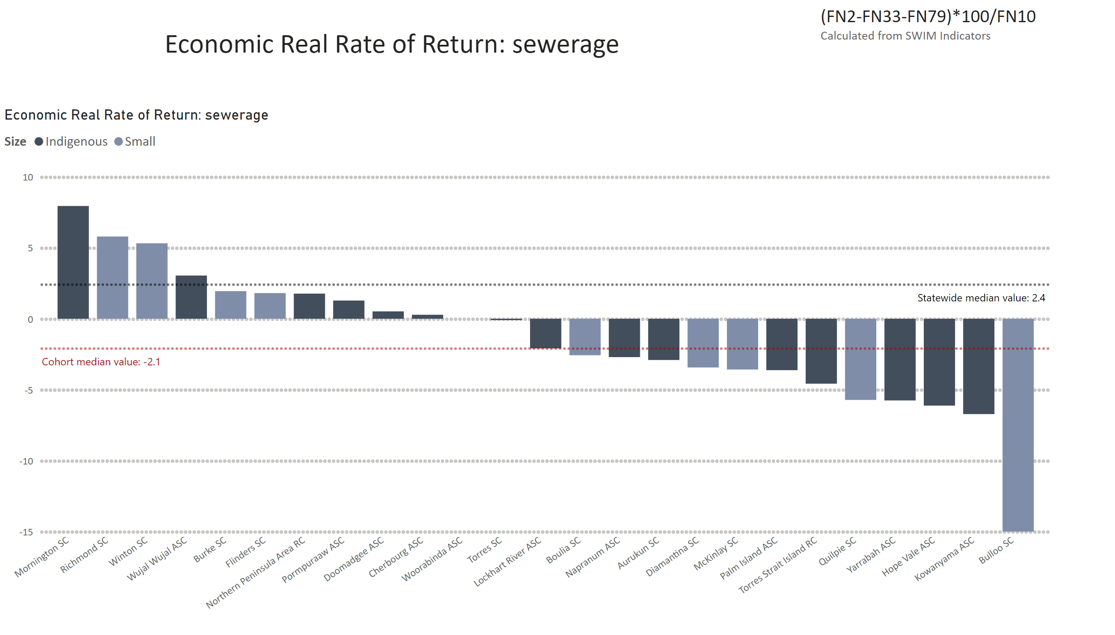
ERRR sewerage
Notes:
Economic Real Rate of Return: sewerage
No alt text provided
textbox
No alt text provided
textbox
No alt text provided

Slide 6
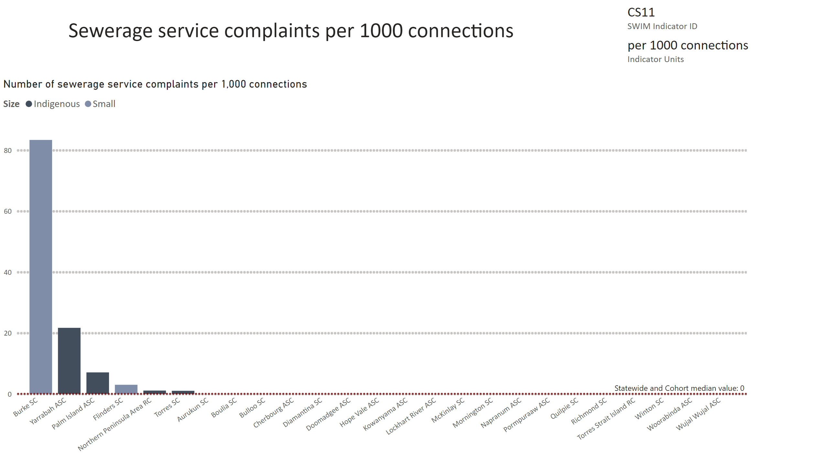
CS11
Notes:
Number of sewerage service complaints per 1,000 connections
No alt text provided
card
No alt text provided
multiRowCard
No alt text provided
textbox
No alt text provided

Slide 7
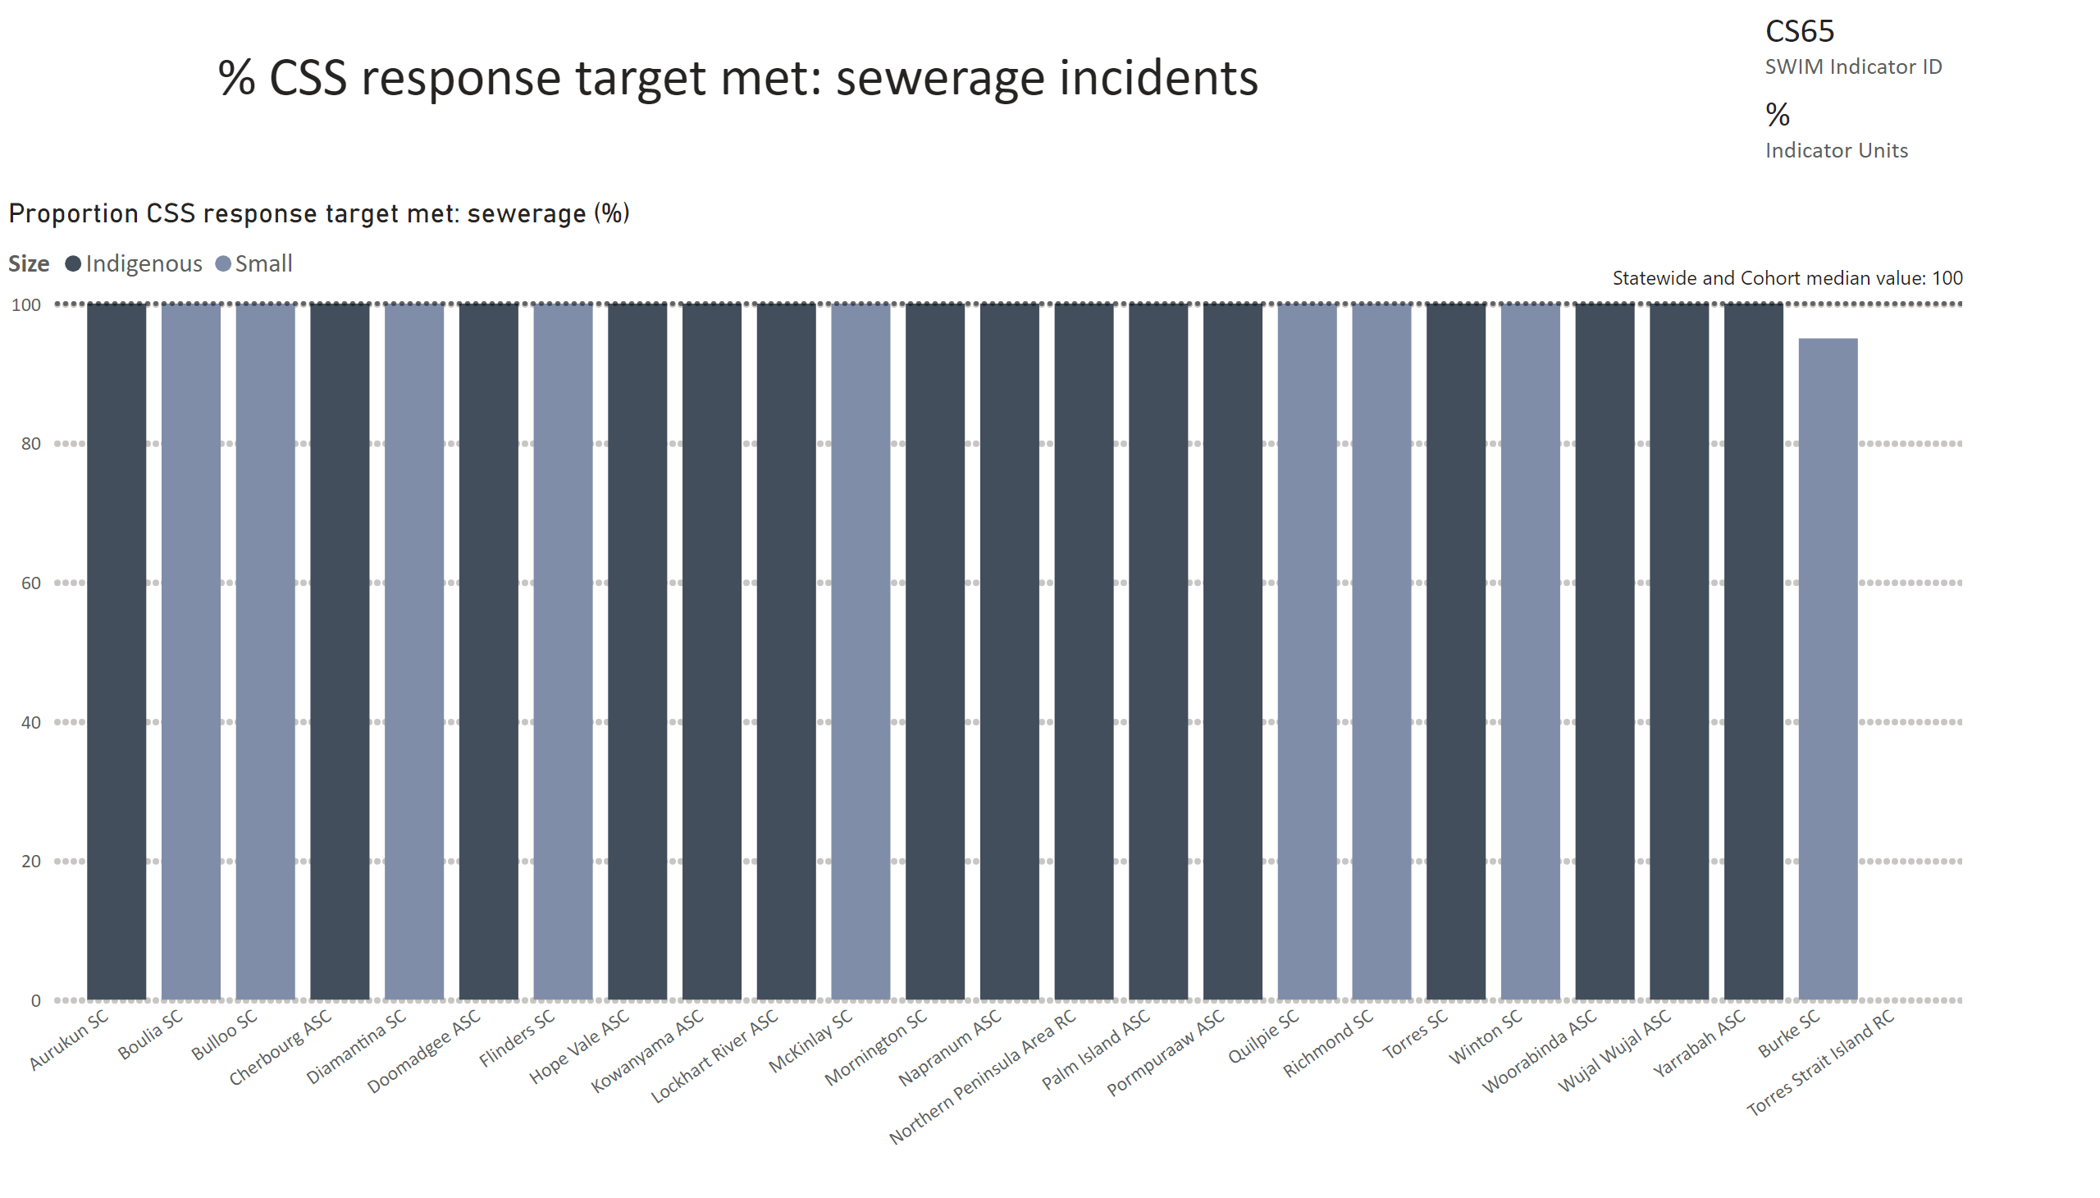
CS65
Notes:
Proportion CSS response target met: sewerage (%)
No alt text provided
card
No alt text provided
multiRowCard
No alt text provided
textbox
No alt text provided

Slide 8
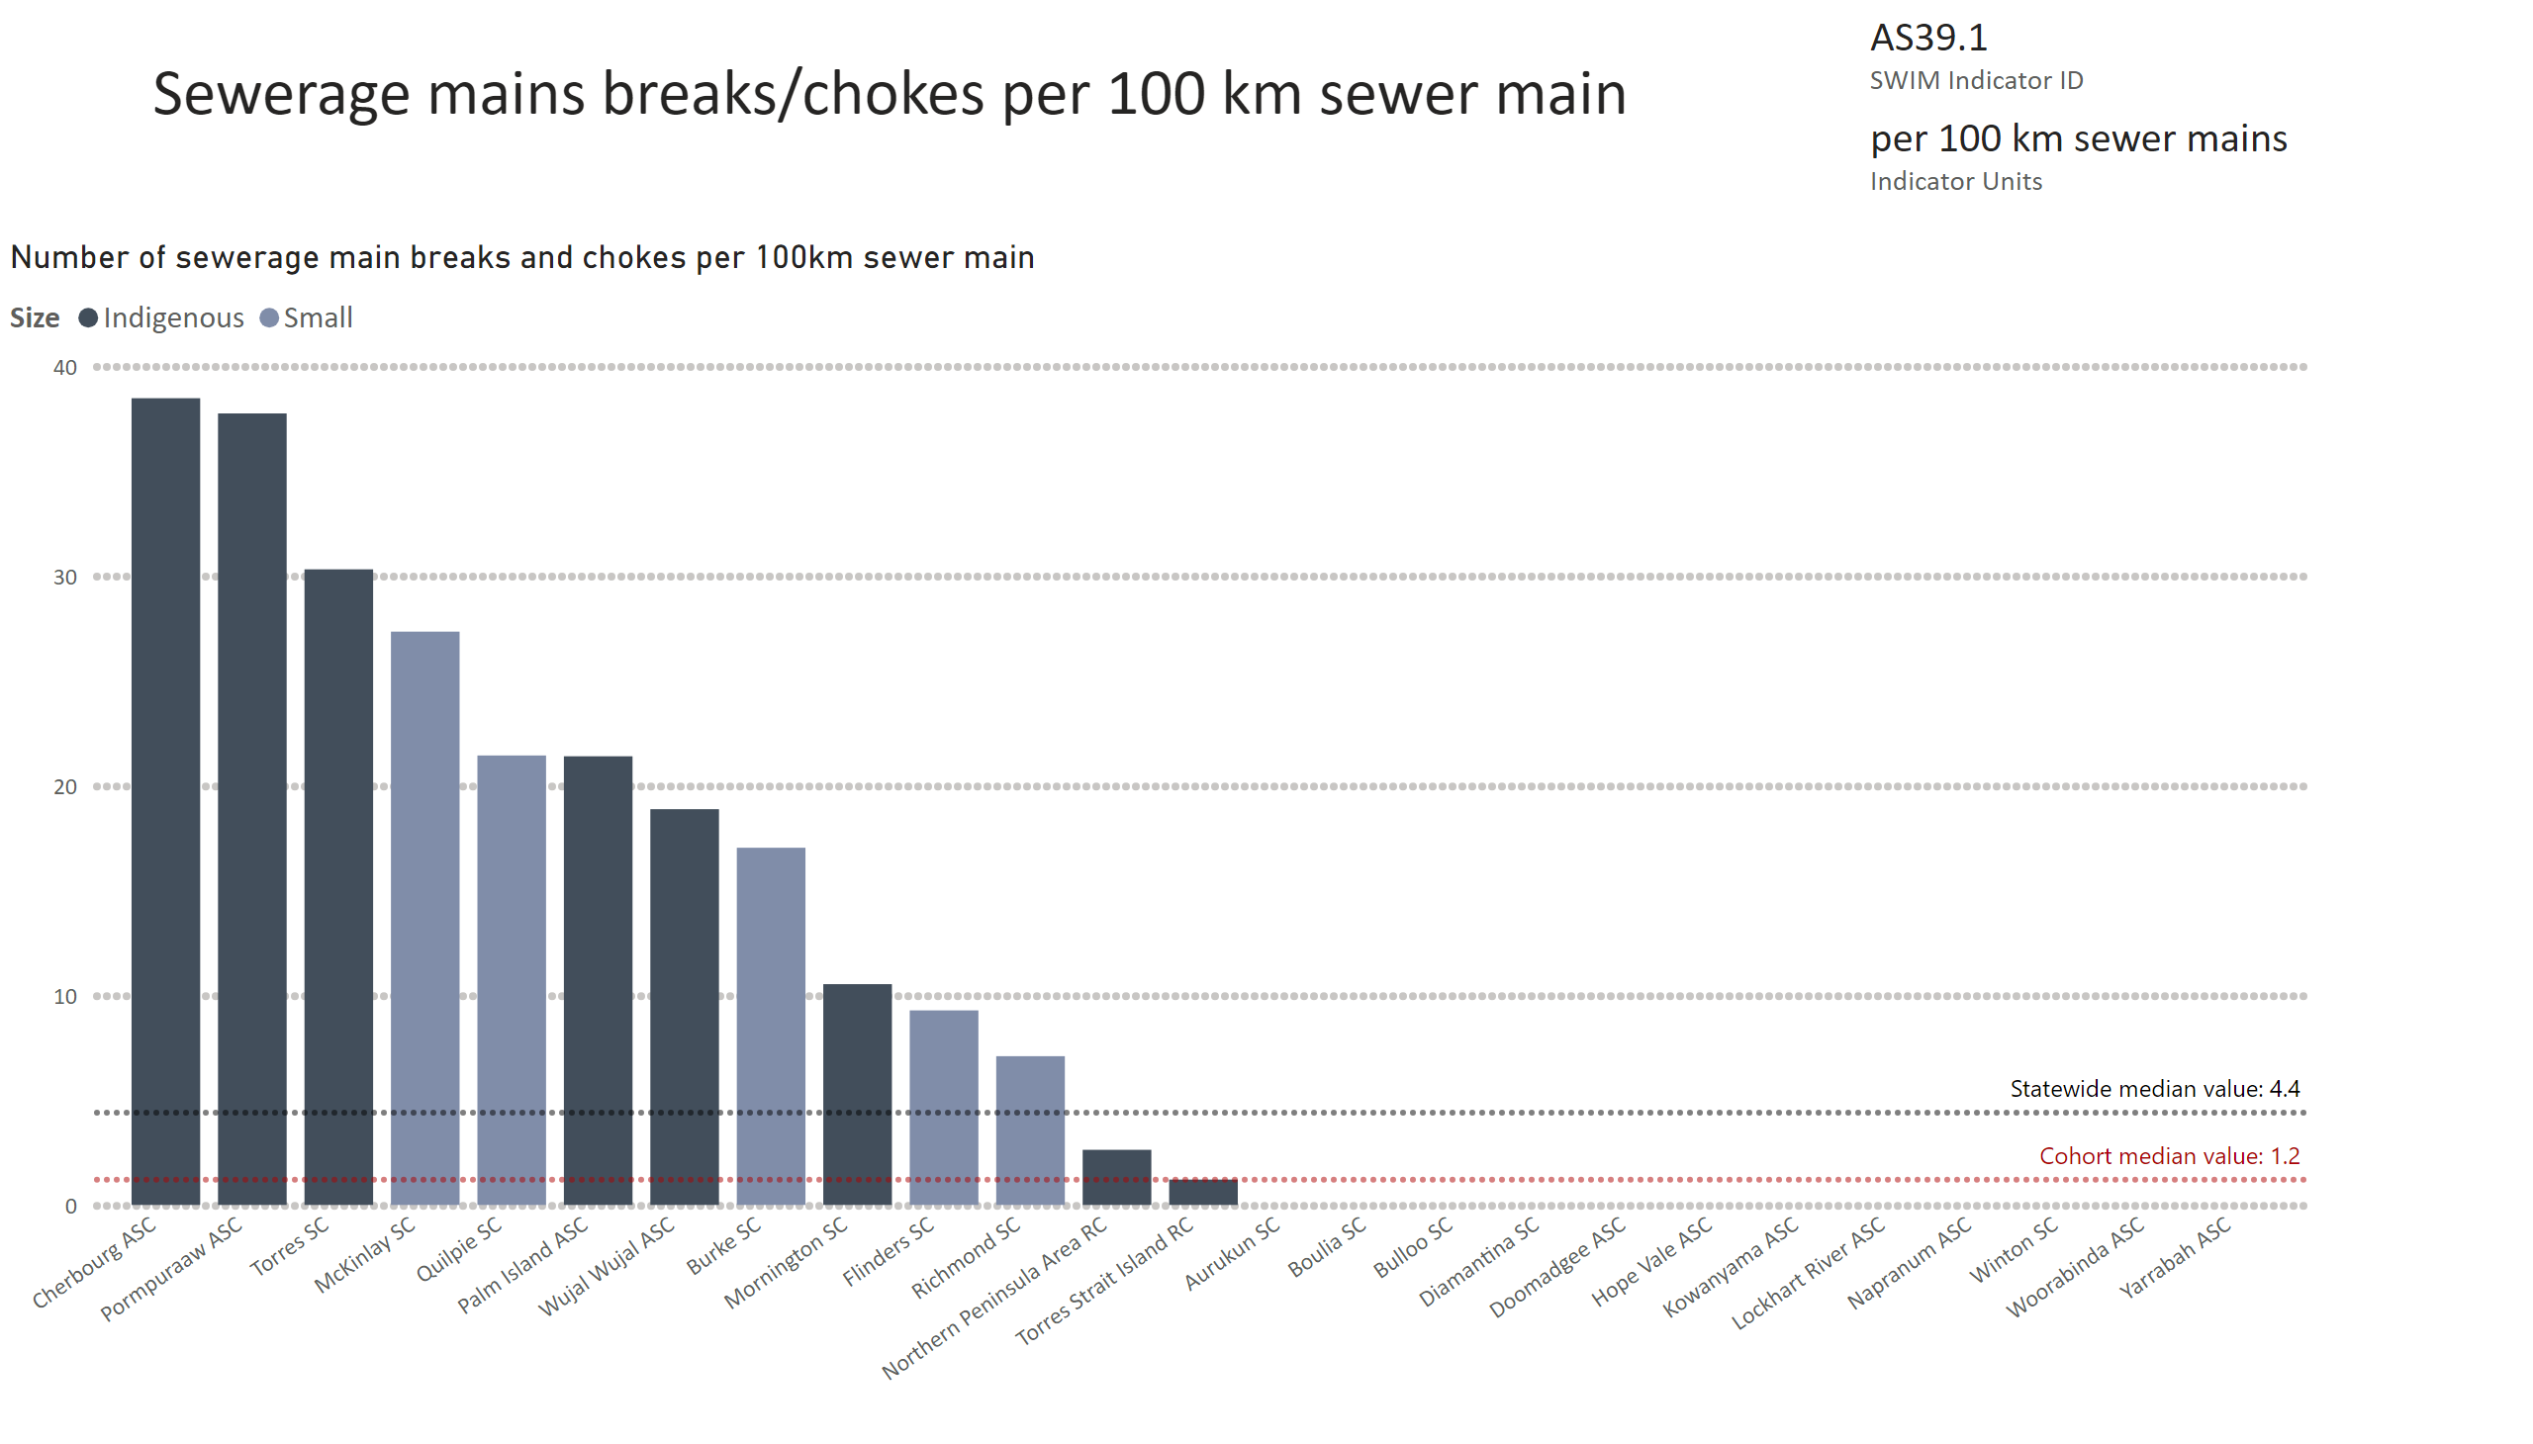
AS39 now AS39.1
Notes:
Number of sewerage main breaks and chokes per 100km sewer main
No alt text provided
card
No alt text provided
multiRowCard
No alt text provided

Slide 9
™
Small and Indigenous service providers
Water Services

Slide 10
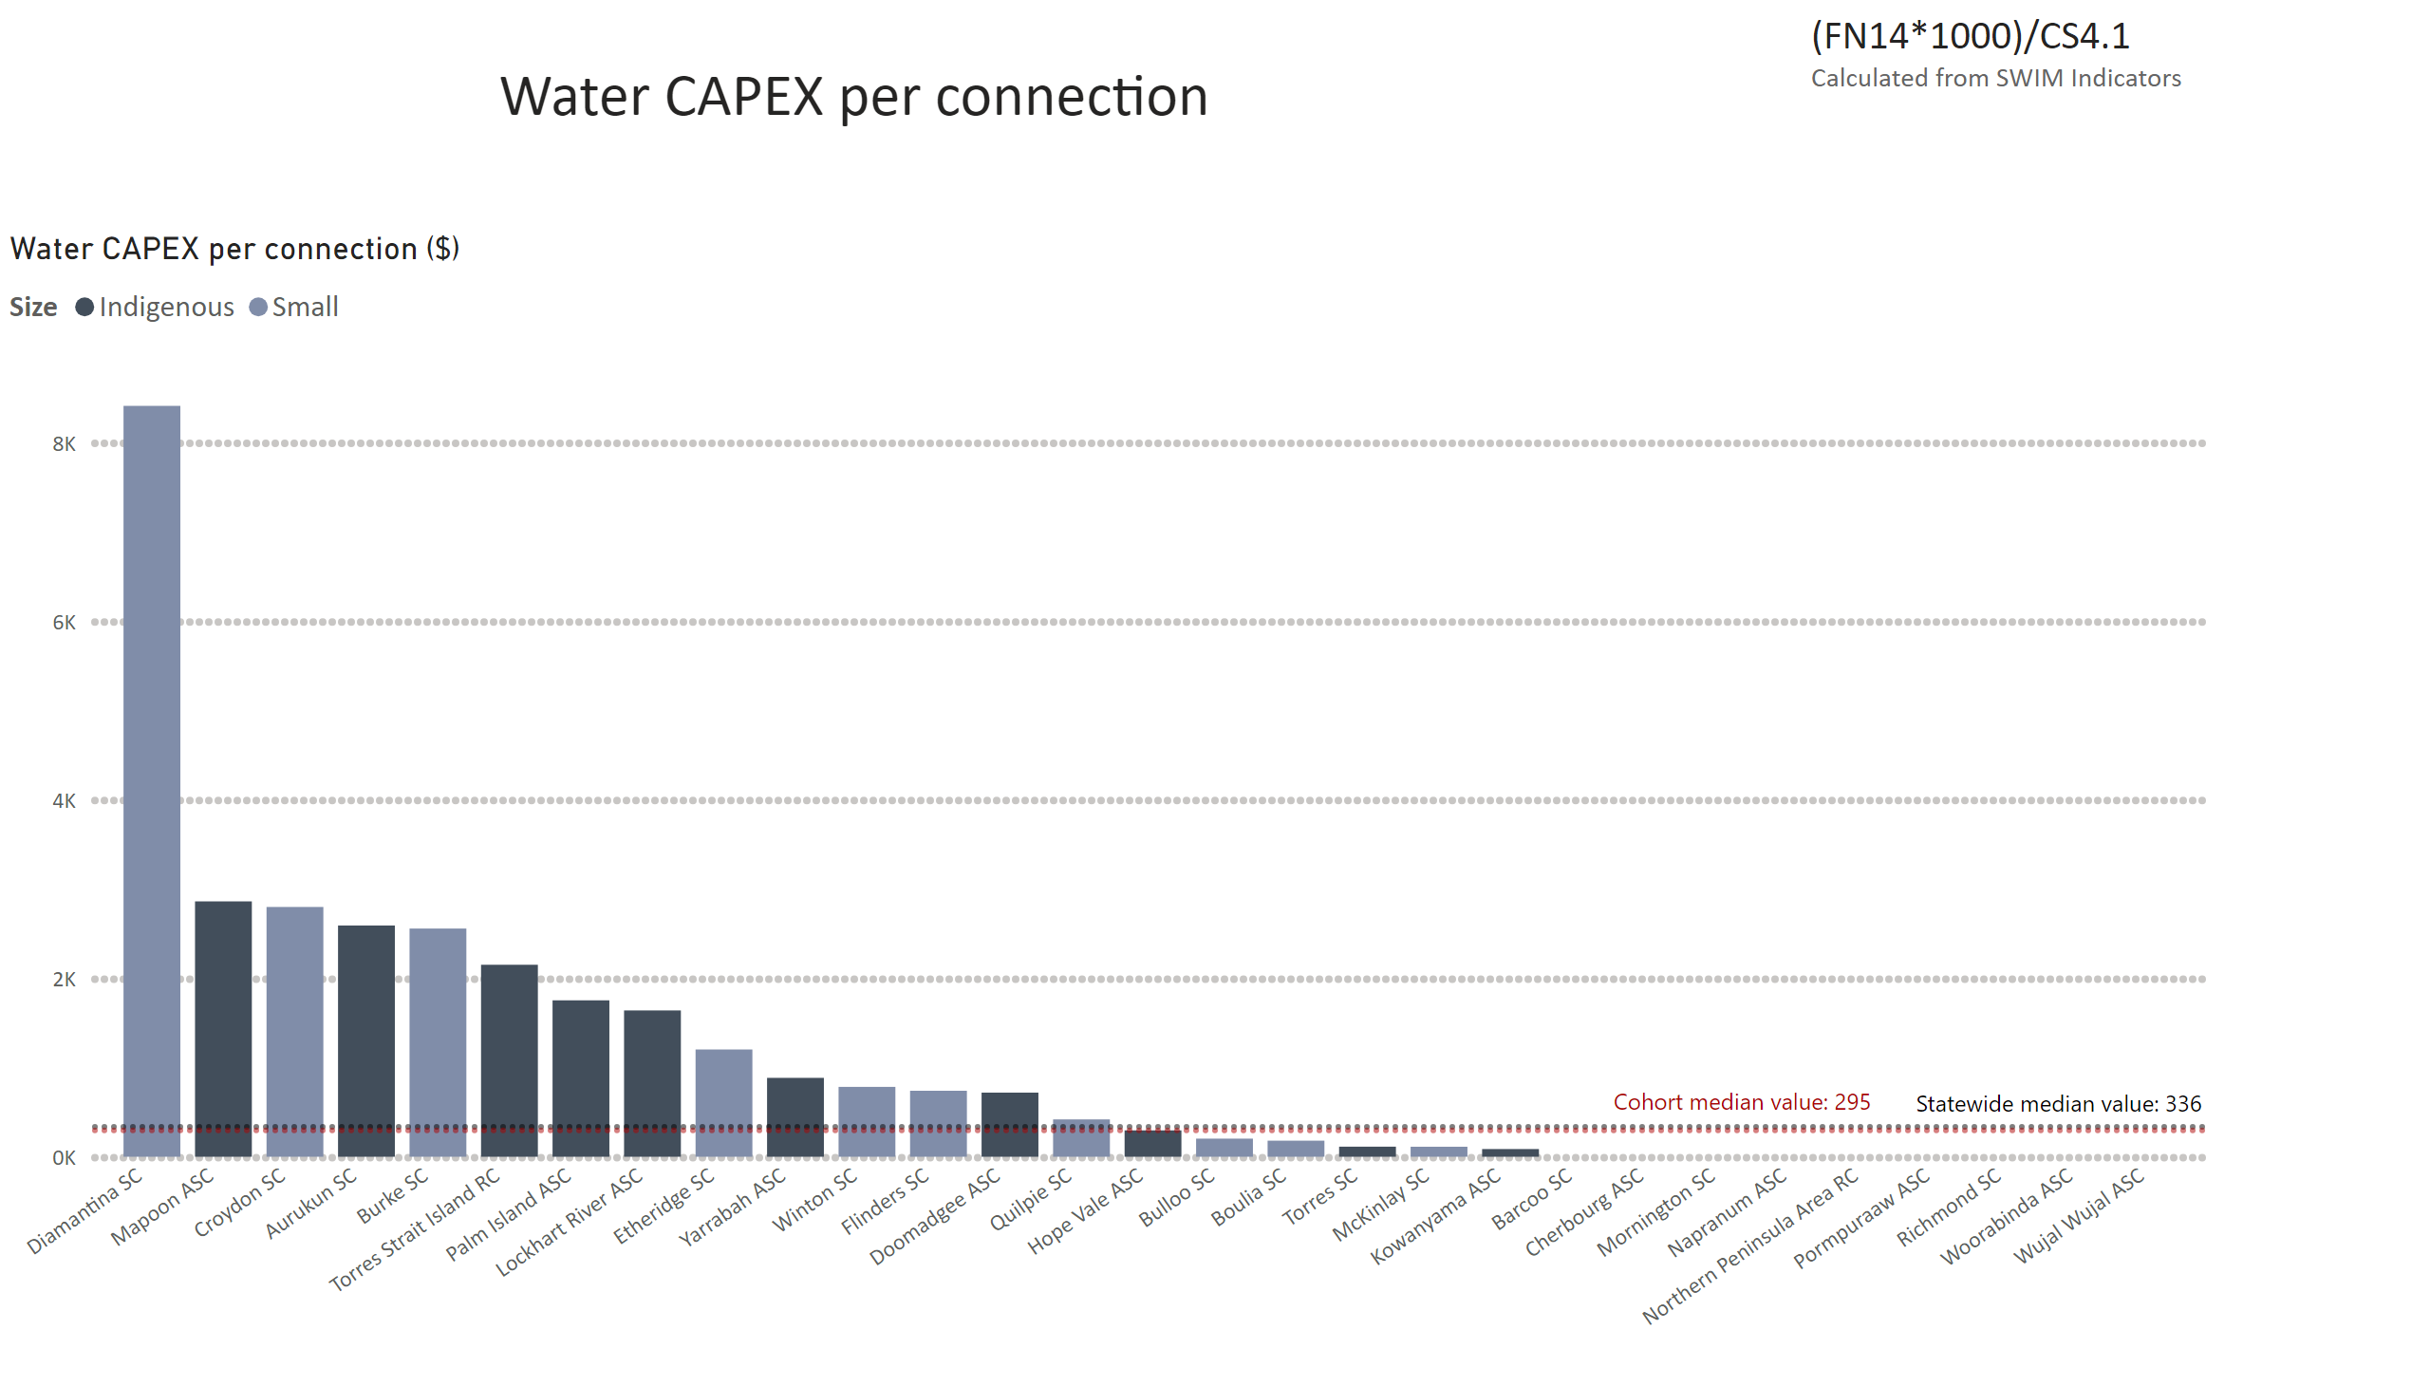
Water CAPEX pp
Notes:
Water CAPEX per connection ($)
No alt text provided
textbox
No alt text provided
textbox
No alt text provided
textbox
No alt text provided

Slide 11
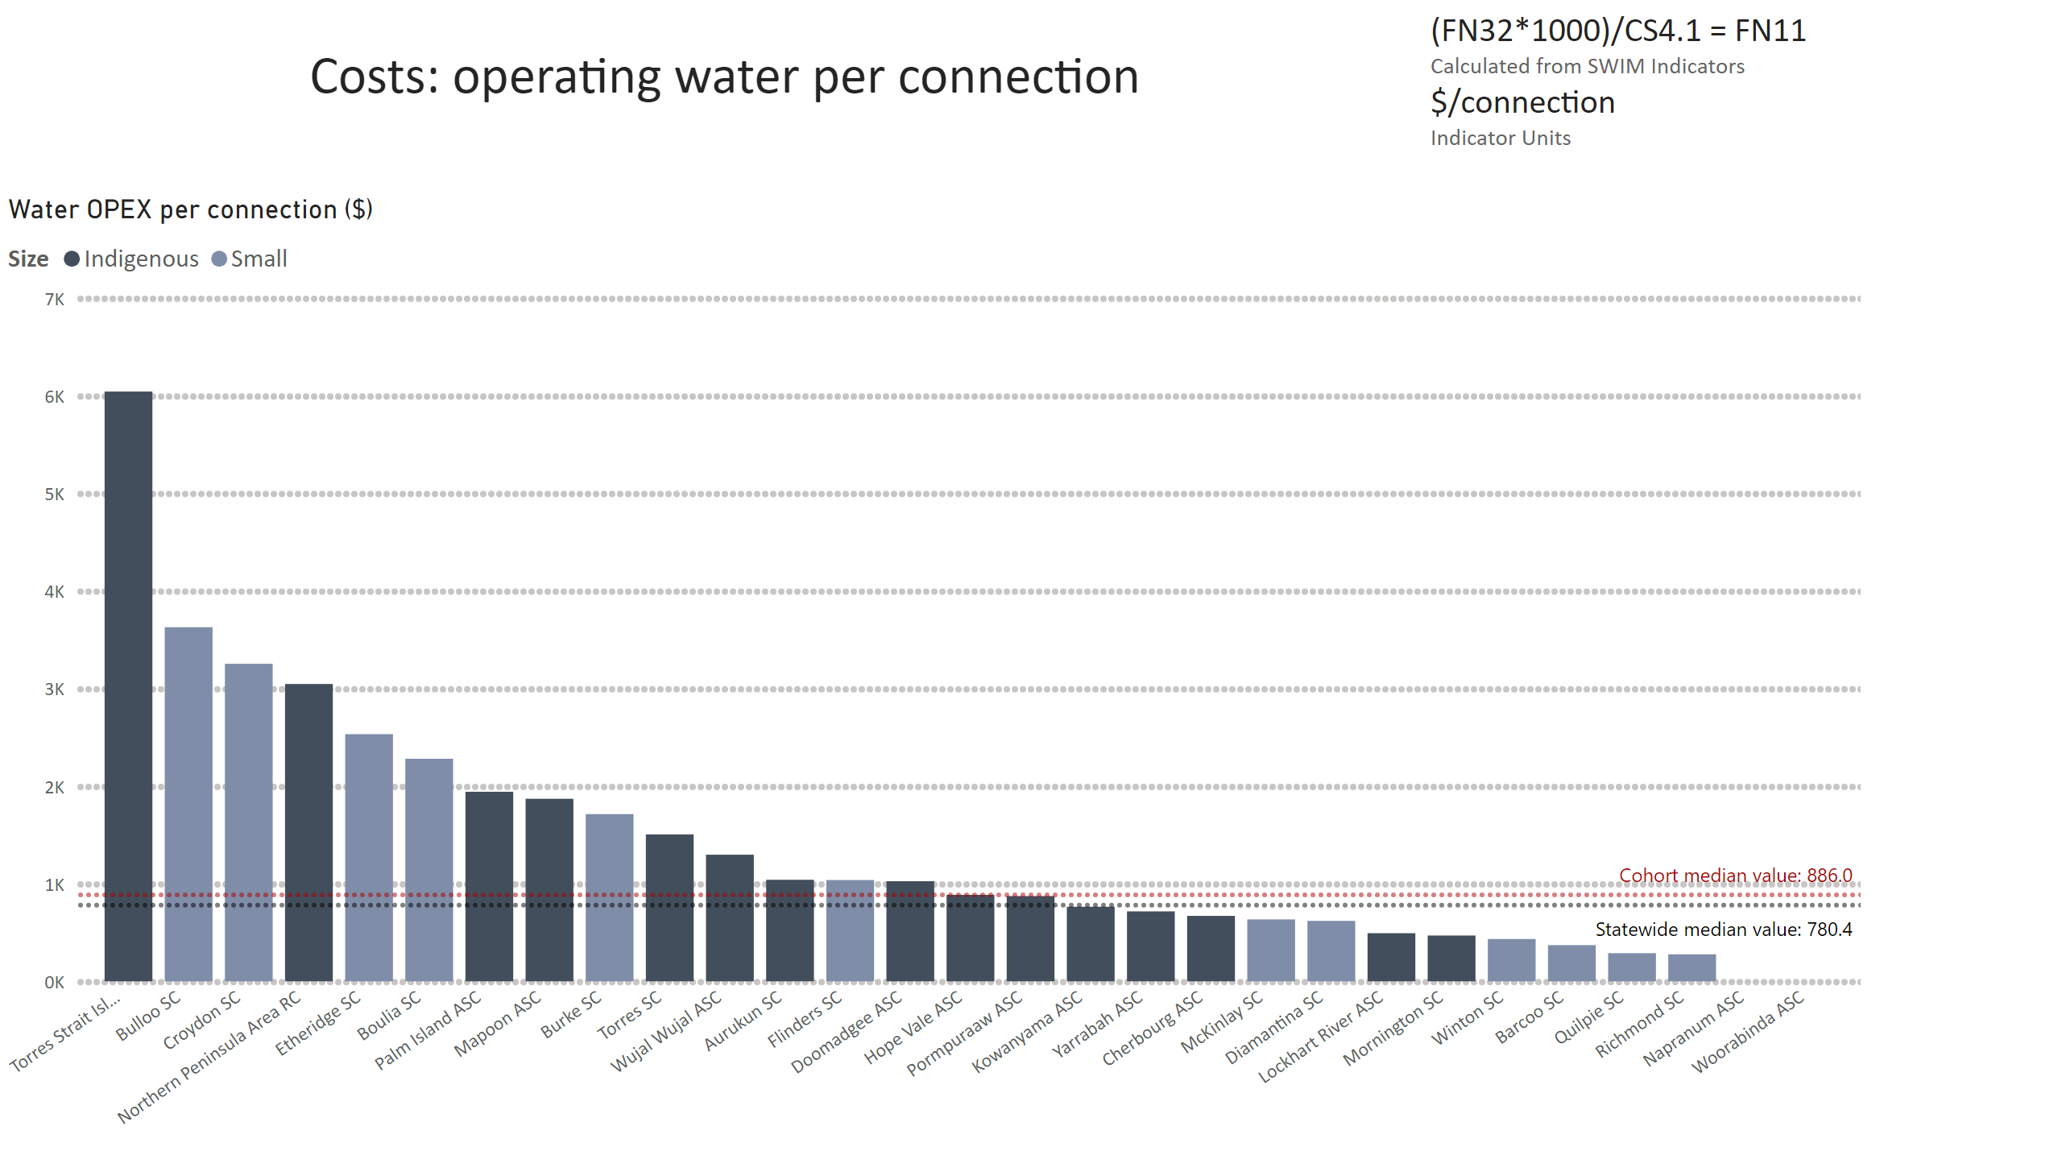
FN11 - need to convert in excel first
Notes:
Water OPEX per connection ($)
No alt text provided
card
No alt text provided
textbox
No alt text provided

Slide 12
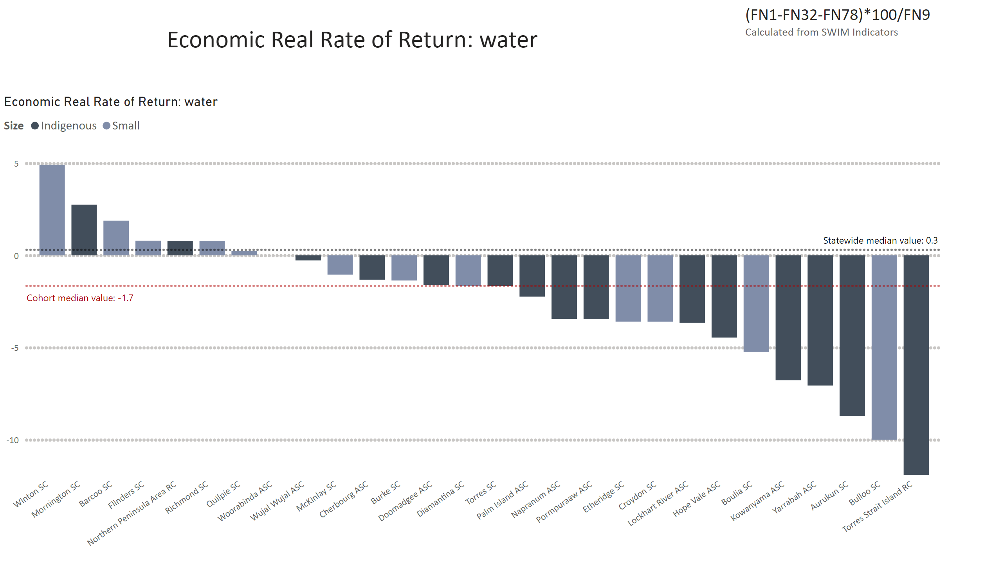
ERRR water
Notes:
Economic Real Rate of Return: water
No alt text provided
textbox
No alt text provided
textbox
No alt text provided

Slide 13
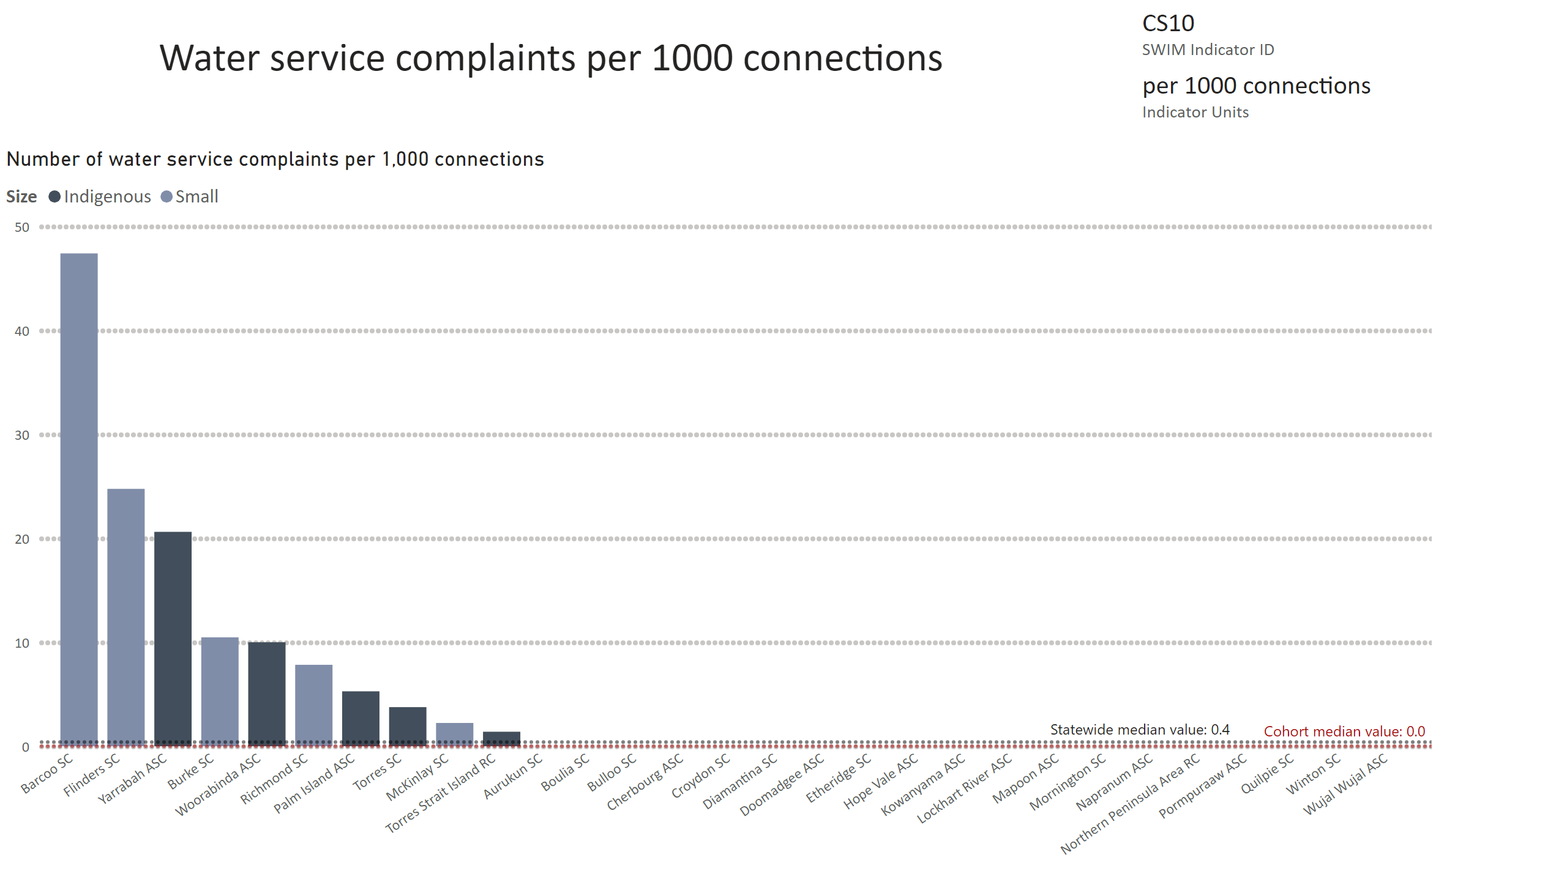
CS10
Notes:
Number of water service complaints per 1,000 connections
No alt text provided
card
No alt text provided
multiRowCard
No alt text provided
textbox
No alt text provided

Slide 14
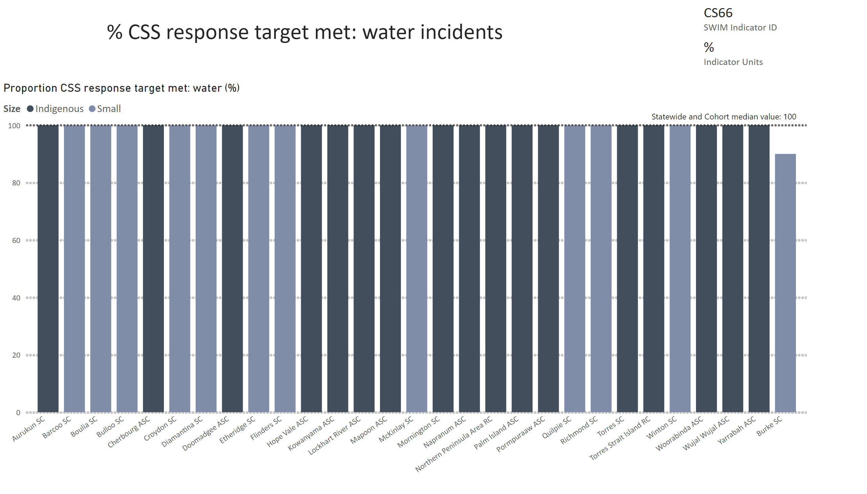
CS66
Notes:
Proportion CSS response target met: water (%)
No alt text provided
card
No alt text provided
multiRowCard
No alt text provided
textbox
No alt text provided

Slide 15
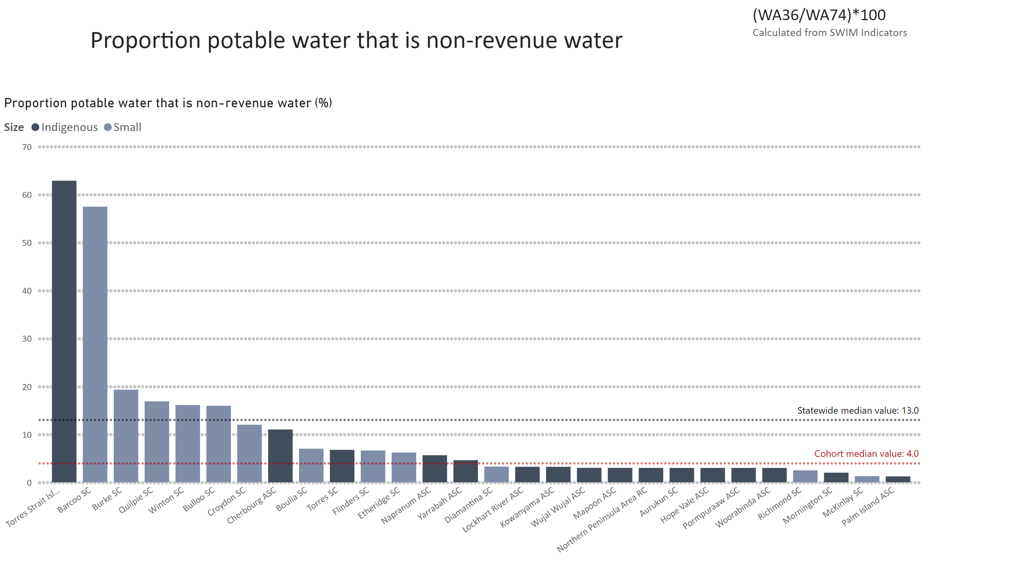
Prop NRW
Notes:
Proportion potable water that is non-revenue water (%)
No alt text provided
textbox
No alt text provided
textbox
No alt text provided

Slide 16
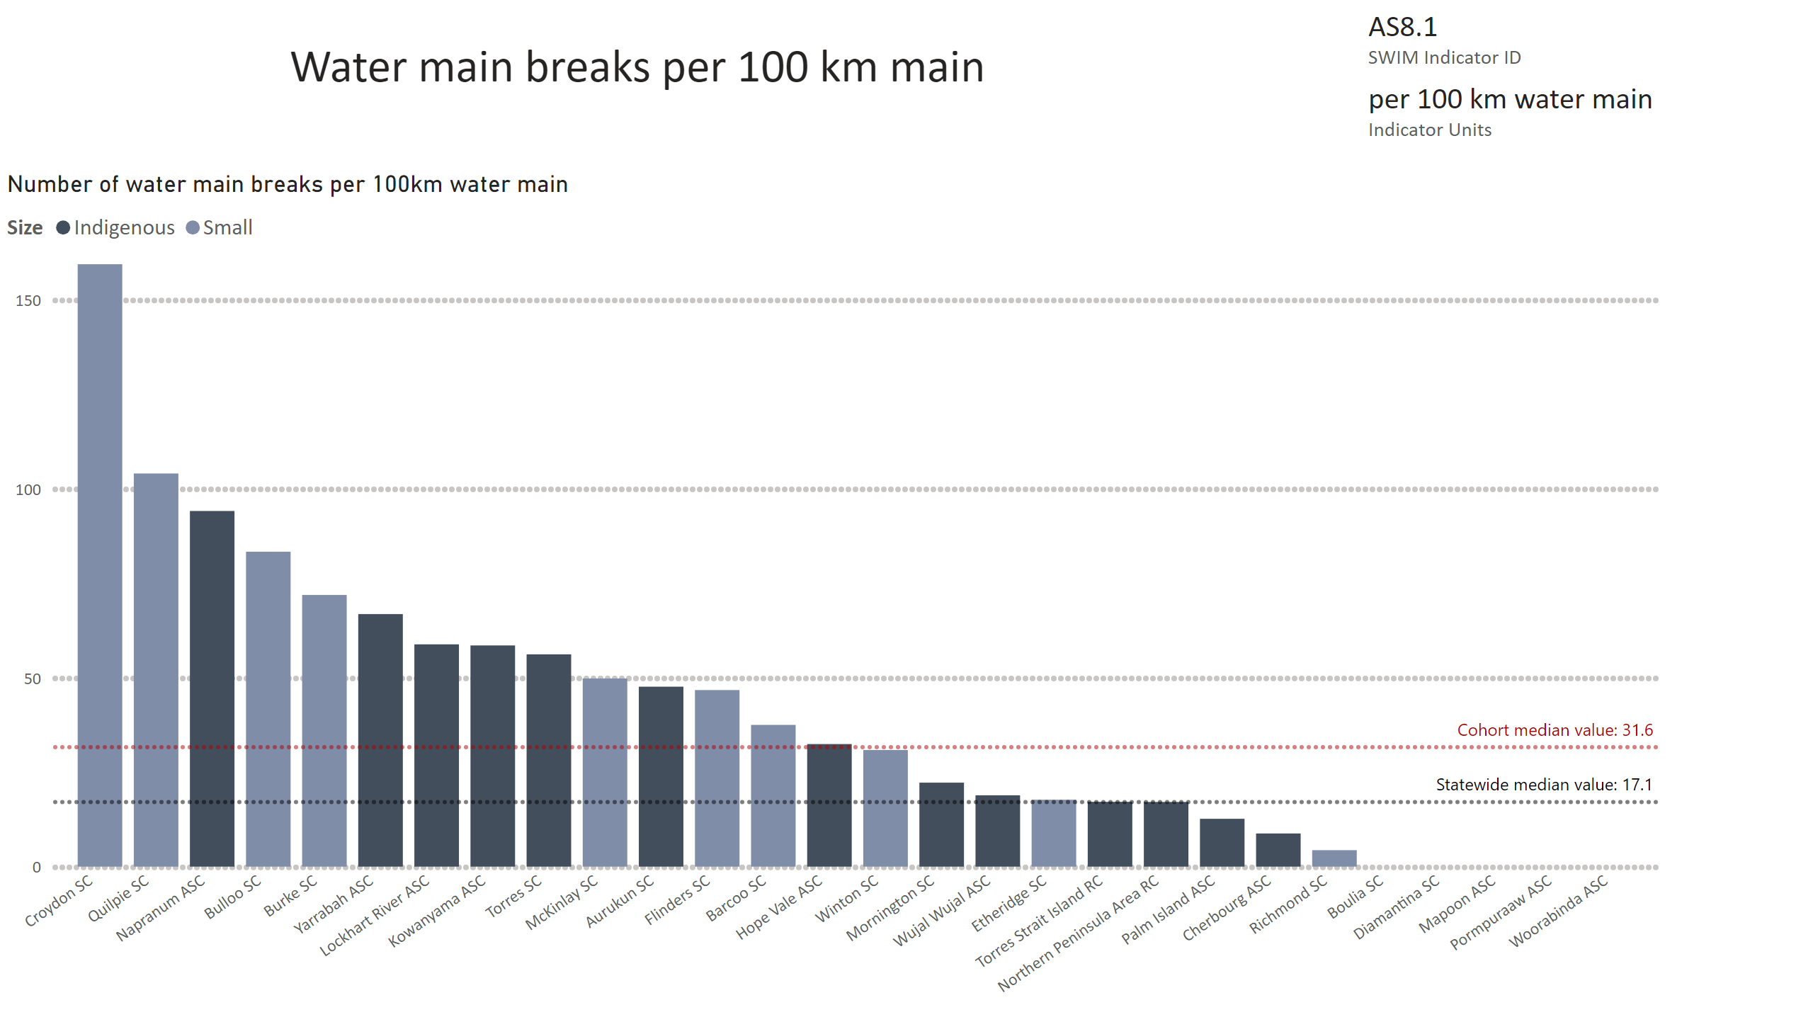
AS8.1
Notes:
Number of water main breaks per 100km water main
No alt text provided
card
No alt text provided
multiRowCard
No alt text provided
textbox
No alt text provided

Slide 17
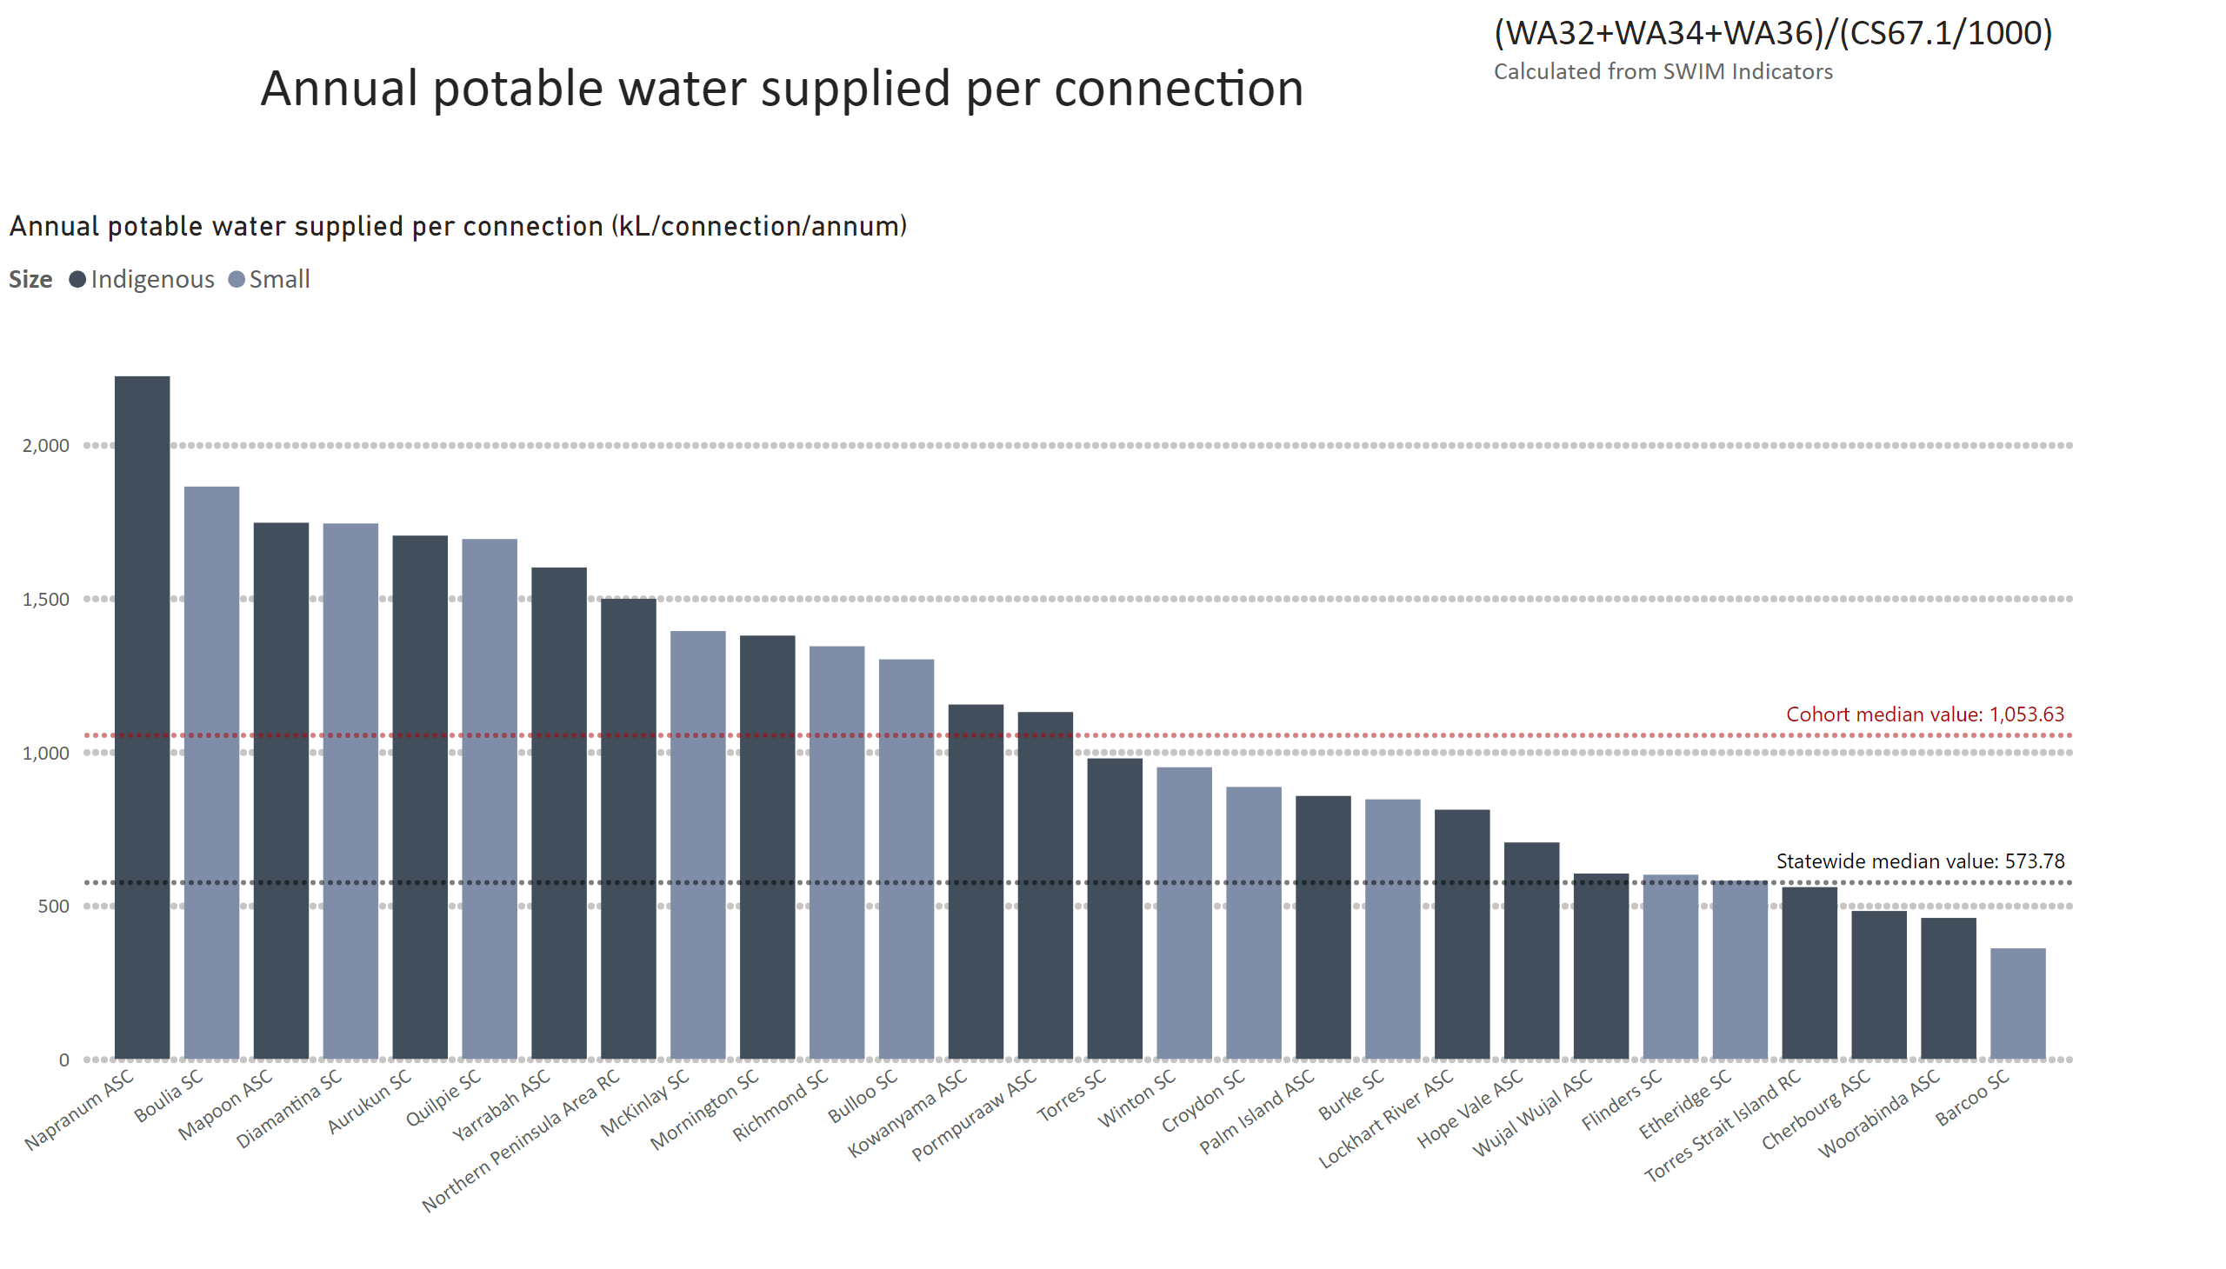
WA30 equivalent
Notes:
Annual potable water supplied per connection (kL/connection/annum)
No alt text provided
textbox
No alt text provided
textbox
No alt text provided

Slide 18
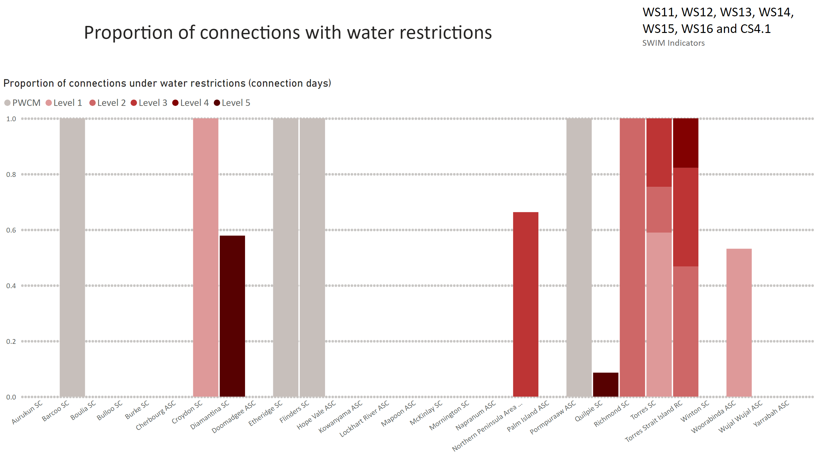
Water security SIND
Notes:
Proportion of connections under water restrictions (connection days)
No alt text provided
textbox
No alt text provided
textbox
No alt text provided

