Slide 1
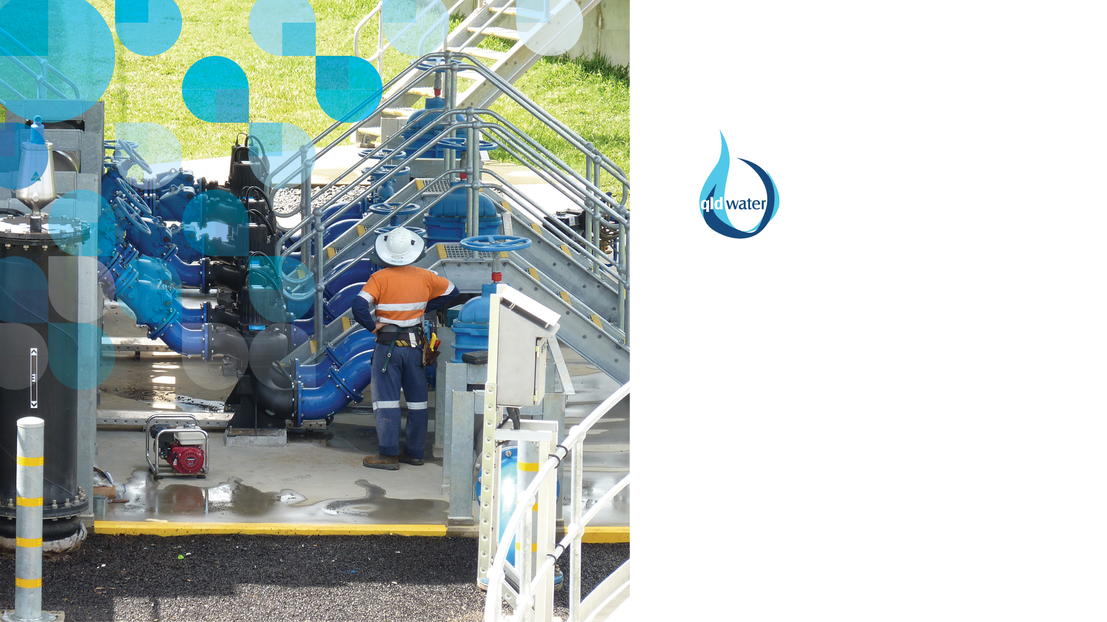


TM
SWIM: helping to satisfy your annual reporting requirements
David Scheltinga and
Jess Dean

Slide 2





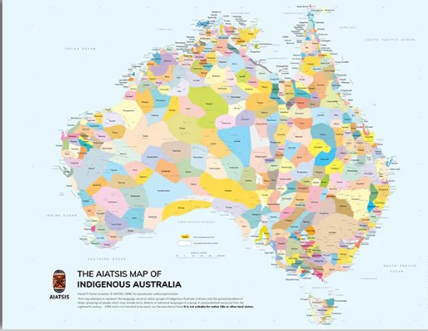












Acknowledgement of Country

Slide 3
SWIM (Statewide Water Information Management) system
SWIM: Water Industry driven and funded
BoM funding assisted with some initial software development – since then all qldwater
SWIM development advised by: qldwater’s Strategic Priorities Group (SPG), SWIM Steering Committee and Users (informally)
Alignment between BoM, NPR, State Govt and ABS
SWIM Help & Information (https://qldwater.com.au/SWIM_Help)
  Documentation
  Videos

Slide 4

Service Provider (SP), manual, SCADA
Single point of data submission
TM
Annual Data Tool
TM
Multiple reporting requirements
Others: e.g. Labs
BoM (Bureau of Meteorology):
Water Resources reporting
NPR
NWA
Category 3, 7 and 9 data
ABS (Australia Bureau of Statistics):
Water Supply and Sewerage Services Survey
State Government
SA Health
OTR (Office of the Technical Regulator)
2. MDB monthly extraction data
3. Drought and Water Security reporting
4. DWQMP Annual Data Report
Others:
WaTERs
SWIM acts as a data broker on behalf of Service Providers

Slide 5
Purposes of SWIM
Increase efficiency and accuracy of reporting by Service Providers
Achieved by integrating multiple reporting requirements, via aligning:
Reporting method (single point of submission)
Reporting content/indicators
Reporting scales (spatial and temporal scales of data required)
Reporting deadlines
Value-add to data and reporting
Tools and training regarding indicators, metadata, QA/QC
Tools (analyses and reports) for comparison and self-improvement (Benchmarking)

Slide 6
Streamlined Reporting (Qld example)
Reporting - 2010 | Number of Indicators required/requested
Queensland Government Water Data: DERM | 243
Queensland Government Water Data: DIP | 280
Bureau of Meteorology (BoM) | 46
National Performance Report (NPR) | 306
Australian Bureau of Statistics | 47
Pre-SWIM 2010 Total | 922
SWIM 2010 total (which removes for duplicate indicators/reporting) | 361 (91 derived and 23 default)
SWIM 2025 total: 318 (83 derived, 13 default)

Slide 7
Why Submit Data?
You have to!
Legislation requirements
Public reporting of data

Slide 8
Performance reporting/benchmarking
Improves performance in public utilities
Used in Australia and internationally
Reflects industry best practice
Has been shown to provide an incentive to improve services

Slide 9
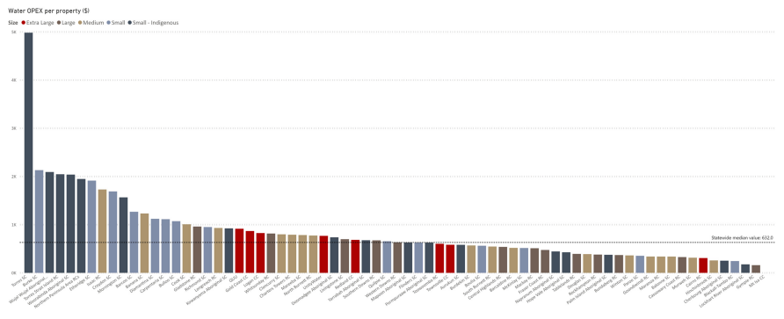
Benchmarking Public Report
qldwater: https://www.qldwater.com.au/reporting
Qld Urban Water Explorer (DLGWV):
https://explorer.water.qld.gov.au/explore-providers

Slide 10
Help with SWIM Annual Reporting
https://www.qldwater.com.au/SWIM_Help (videos, definition docs, calculators, etc.)
qldwater online / in-person training sessions
Contact me or Jess @ qldwater (see contact slide at end)
Your dedicated OTR Officer (Emily - Emily.Lohmann@sa.gov.au)
We will be sending regular emails with helpful information, advice and due dates

Slide 11
Deadlines for submitting Annual Data
Wed 1st October: for all data
31st October: Finalise for NPR and ABS data
SWIM will forward the data on these dates to meet your reporting requirements

Slide 12
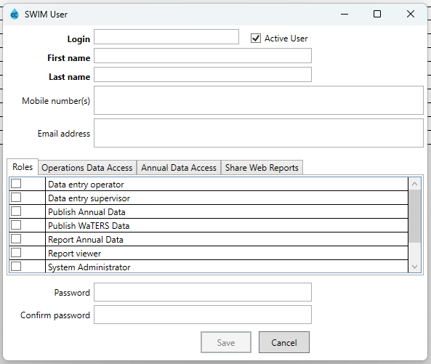
SWIM Administration – Users
Website access

Slide 13
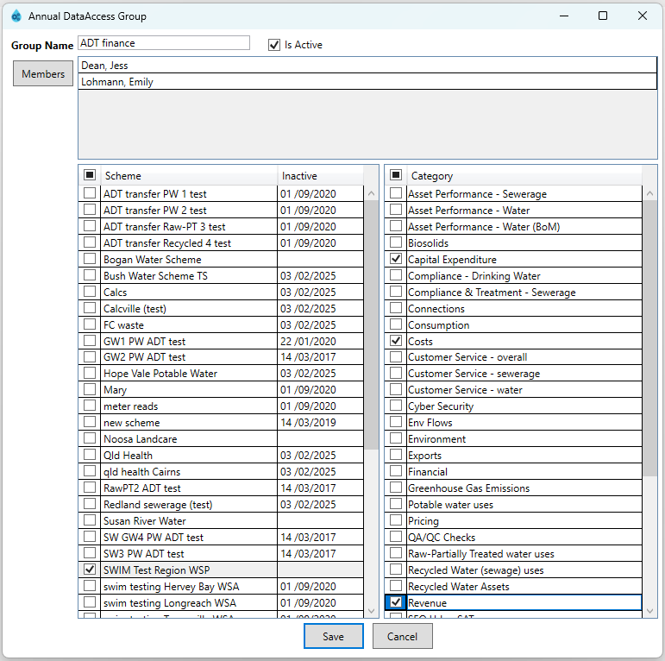
SWIM Administration – ADT Access
Website access

Slide 14
SWIM Annual Data Tool (ADT) – access
Login details:
Username: david79
Password: david79
Region Id: 79
Website: https://staging.swim.qldwater.com.au/adt (only use for training!)
Please note that both username and password are case sensitive.

Slide 15
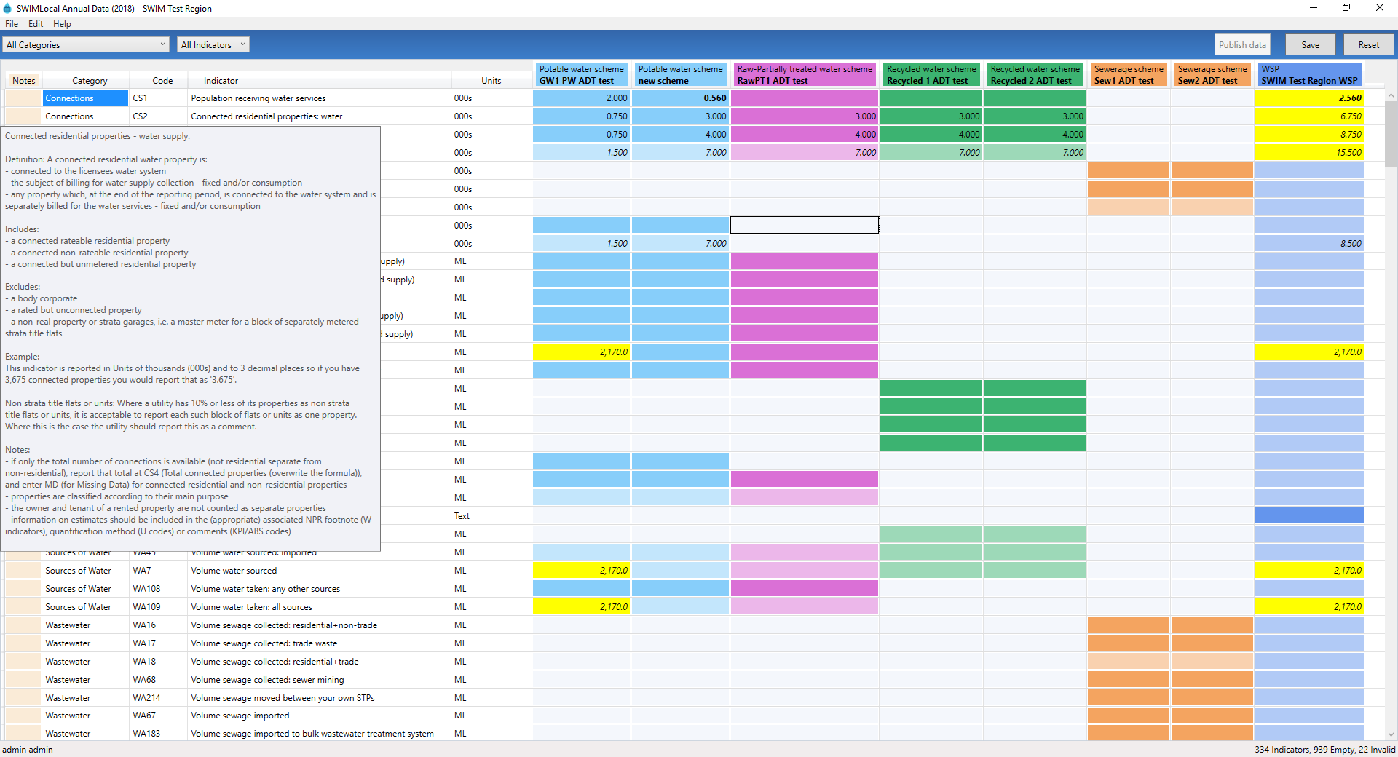
Annual Data Tool

Slide 16
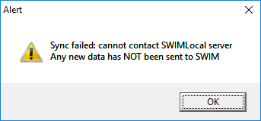

Slide 17
SWIM – Annual Data Reporting
Reporting on water and sewerage data for the financial year
Done via Annual Data Tool (Web ADT – opens 1 July 2025): https://www.swim.qldwater.com.au/adt
Only mandatory indicators (required under legislation) are included (or ones needed for calculations)
Data only sent to appropriate people when ‘published’
SWIM packages up and sends at appropriate time and format

Slide 18
SWIM – Annual Data Reporting
Some of the functionality:
Place the cursor over a cell and the ‘mouse hover-over’ function will provide you with more information (e.g., previous data)
Does calculations for you
QA/QC rules - invalid (i.e., yellow cells)
Add comments
Full indicator definitions available

Slide 19
Text Indicators
Some are simple ‘free written’ text
Some are simple ‘yes/no’ text
Some are further information for another indicator:
WA158.1: Names/volumes imported water suppliers. E.g. WA158 reported 34ML imported. WA158.1 = “34ML imported from Sunwater”
Units will tell you which it is

Slide 20
Recycled water Indicators
There are 2 sources for recycled water:
Sewage (STP or Sewer mining)
Stormwater (Urban run-off)
So, you will see:
Recycled water (means any/all ‘sources’), or
Specific terms:
  Recycled sewage water
  Recycled stormwater

Slide 21
Similar Indicators
WA160 Volume potable+raw-PT water supplied: residential (BoM)
WA8 Volume potable+raw-PT water supplied: residential (NPR)
WA160 excludes any recycled water
WA8 includes recycled sewage and stormwater

Slide 22
Complaint indicators
Be careful what is reported:
Don’t double count (e.g., if you record some and ‘admin’ records others/all)
Make sure it is a complaint and not a question or statement or request to get something fixed

Slide 23
“MD” vs “NR” vs valid “0”
MD or NR are the only ‘words’ you can put in a numeric cell
USE “MD” (Missing Data) if you do something but don’t know how much. You can enter estimates but you should note it as an “estimate” (and how it was estimated) in a comment. Remembering that the data for the NPR will be public so be careful
USE “NR” (Not Relevant) if you don’t do something (SWIM will populate with “NR” in following years)
USE “0” if the value is actually 0 for that year

Slide 24
“MD” vs “NR” vs valid “0” – calculations
The SWIM system will do the following for derived (calculated) indicators in relation to MD, NR and 0:
Simple addition-subtraction calculation:
MD in a calculation will result in the derived cell being invalid and saying “calculation is missing values and is incomplete” #
NR in a calculation will result in the calculation being performed (replacing the NR with a 0 for the purpose of the calculation only which is okay).
0 is fine
Complex multiply-divide calculation:
MD, NR or 0 will throw a “ERROR” or “DIV/0”#
You will need to over-write these with MD, NR or a valid number (which could be a “0”)

Slide 25
Overwriting calculations
Can overwrite calculated values but this is extremely rare and must be done with care
Can ‘revert to calculated value’ if done by mistake
Hover-over, colour of cell (half shade lighter) and italics tells you it’s calculated. Non-italics it has been overwritten
E.g., WA16 (res/non-trade wastewater) + WA17 (trade wastewater) = WA18 (all wastewater collected)

Slide 26
Publishing data
Batches of data can be entered over a period of time
‘Publish’ data to identify when entry of all annual data is complete
SWIM only forwards data from organisations that have ‘published’ annual data

Slide 27
Changing/correcting data
Note data will be sent to the appropriate organisation on the due date
Generally, they will spend two or so weeks to check/ validate the data and get back to you with any questions
qldwater highly recommends you correct any data at any time. This way the SWIM database always has the most up-to-date data
If you do talk with SA Health/OTR/NPR/ABS and correct some data you must also change it in your swimlocal Annual Data Tool (ADT) so that it is also correct in the SWIM database as well

Slide 28
Available NPR documents
2023-24_Urban_NPR_Reporting_Memo
Guidance-memo-2024-25-service-providers-with-less-than-10000-connected-properties
Guidance-memo-2024-25-service-providers-with-more-than-10000-connected-properties
Guidance-memo-2024-25-Bulk Water Authorities
National-Performance-Report-Framework-performance-indicators-and-definitions-handbook-2023
Release-notes-for-NPR-handbook-2023
Urban_NPR_handbook_Applicable_to_2023-24 reporting year

Slide 29
NPR document locations
NPR reports and data: http://www.bom.gov.au/water/npr/
NPR review and documents: http://www.bom.gov.au/water/npr/framework-review/
SWIM Help & Information (includes NPR documents, handbook, etc.): https://qldwater.com.au/SWIM_Help

Slide 30
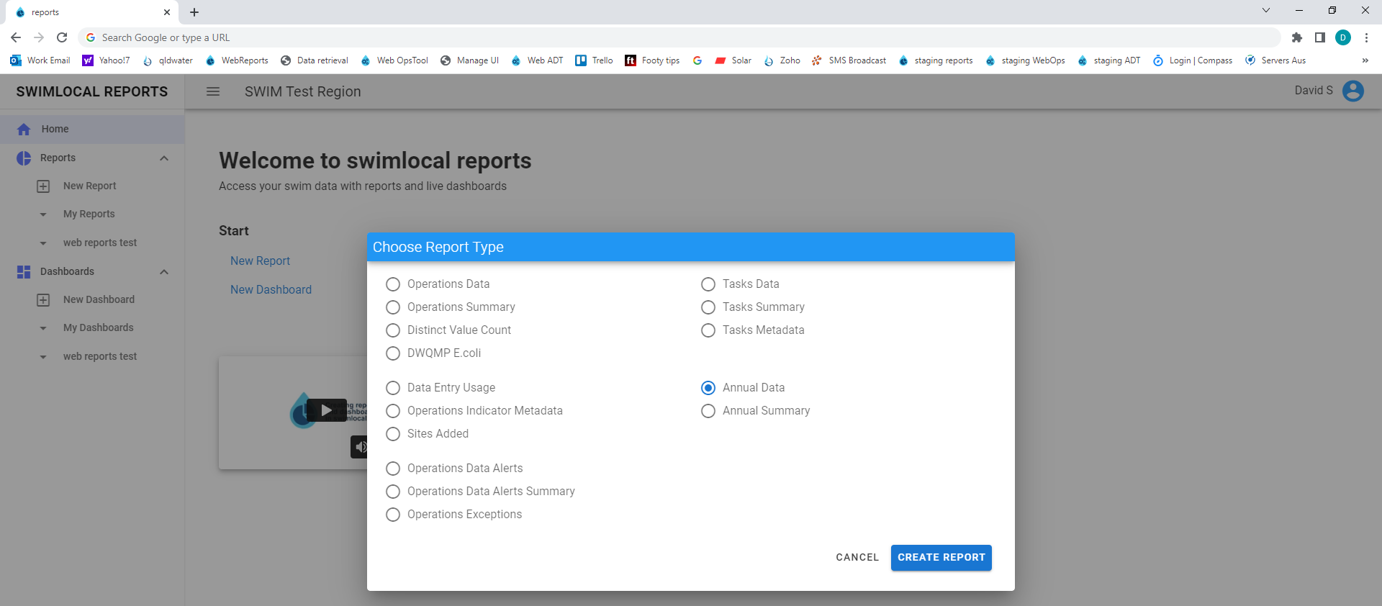
Web Reports https://swim.qldwater.com.au/reports

Slide 31
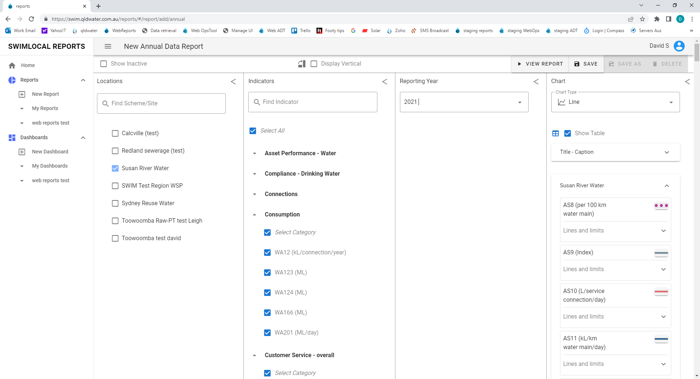
We can upload historical data if anyone is interested

Slide 32
Contact details
Dr David Scheltinga Ms Jess Dean
e: dscheltinga@qldwater.com.au e: jdean@qldwater.com.au
m: 0415 881 195 p: (07) 3632 6852
Brisbane Office: Level 1, 6 Eagleview Place, Eagle Farm, QLD, 4009
w: www.qldwater.com.au

Slide 33
























































Our members

Slide 34













Our affiliates
Queensland Health
Environment, Science
& Innovation
Regional Development,
Manufacturing & Water

Slide 35




qldwater is a business unit of IPWEAQ and is an initiative of:
QNT

Slide 36
Heading
Text

