Slide 1
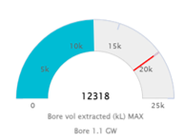
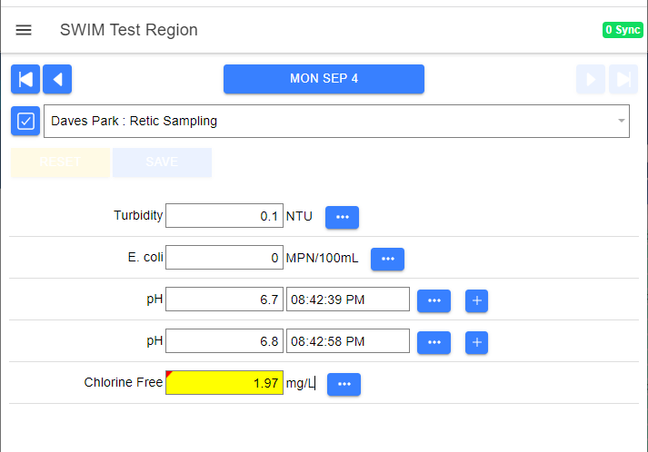
TM
qldwater’s Data Management Tool
David Scheltinga and
Jess Dean

Slide 2
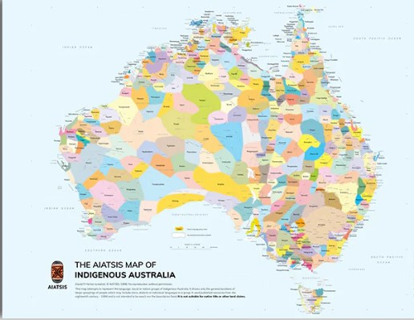
Acknowledgement of Country

Slide 3
swimlocal: IT Servers
We have 3 servers located in Sydney and Brisbane data centres.
We run a primary (production) server, a mirror (back-up that can take over if anything happens to the primary server) and a staging (testing) server that can take over production if needed.
The primary production server runs in a ‘virtual data centre’ with automatic server migration in case of any hardware issues.
We backup the entire production database offsite daily to cloud storage in Sydney and continuously mirror to the server in Brisbane.
Current up-time is 99.9%.

Slide 4
swimlocal: IT Software
The swimlocal PC apps are Windows dotnet apps using SQL Server Express (stand-alone install) or a council SQL Server instance (central install). Can mix different install types within an organisation.
Councils use a ‘central install’ when they want an up-to-date local copy of their data to run their own custom reporting or integrate with other software.
swimlocal uses standard windows installers allowing Council IT to roll out deployments either manually or with various enterprise deployment tools.
We are moving the swimlocal apps to be fully web-based but will retain the ‘central install’ database sync capability.

Slide 5
swimlocal: IT Cyber Security
We have a range of insurances including specific Cyber Security.
Constantly reviewing and refining our cyber security.
Currently undergoing a CSA STAR 1 cyber security self-assessment and are covered by activities of the Cybersecurity Unit (part of the Queensland Government).

Slide 6
swimlocal: Support
External IT contractor with 3 staff dedicated to swimlocal.
2 qldwater staff dedicated to swimlocal with another with basic knowledge.
IT support system (ZohoDesk) – log issues via webform or email.
swimlocal help desk between 9 am to 5 pm weekdays (aka Jess and David).

Slide 7
swimlocal: Data Management Tool
The primary objective of swimlocal is to streamline and add value to the process of collating, managing and reporting data.
The software makes use of data synchronisation via the internet to allow central reporting, and to share and capture data across organisations which have measurement sites in wide-spread locations.
swimlocal thus drastically reduces the time taken to collate data, improving the efficiency and timeliness of reporting, as well as minimising data handling (e.g., limit cutting and pasting data from one spreadsheet to another).
Developed by Operators, for Operators – ease of use.

Slide 8
swimlocal: Data Management Tool
Some additional benefits of swimlocal:
Off-site back-up of all your swimlocal data
Data with a single point of truth
Ability to automatically import data from telemetry/SCADA/Labs via FTPS or API, and historical data manually via multiple ‘Formatted Excel’ files
Easy access to any of the data for anyone with appropriate access rights
Full audit trail of all data entry/changes/modifications
Ability to include any indicator or site you want into the swimlocal system
QC/QA processes are built into the system, e.g., validations, imports
SMS and/or email alerting of indicators outside range/specifications

Slide 9
swimlocal: Included swimlocal Tools
At present the swimlocal software is made up of ‘three’ tools (or modules):
Administration Tool (AdminTool: managing schemes, sites, indicators, Users, Access, Calculations, Alerts, etc.)
Operations Tool (OpsTool: data entry)
Reporting Tool (WebReports: data analysis, reporting, graphing, dashboards/mapboards)
Annual Data Tool (ADT (=SWIM): annual data reporting as per legislative or other requirements, ABS, NPR, BoM, QG KPI, etc.). Daily data can be automatically pushed to the ADT. This is a separate product.
Web and/or PC versions.

Slide 10
swimlocal: Optional Extra swimlocal Tool
An additional Task Tool has been developed.
This tool allows you to set up/schedule regular ‘maintenance’ tasks to be completed by staff and sends emails/SMS alerts if not done on time.
Can be fully reported via WebReports (tasks missed, skipped, priority level (critical-low), who, etc.)

Slide 11
swimlocal: Mobile Data Entry
Data can be entered via tablets/phones/PC (iOS, android or windows).
An internet connection is required for the initial setup synchronisation and to upload data to the swimlocal system but can be taken ‘off-line’ for data entry in between. Will auto-sync when in mobile range/wifi.
Normal QA/QC and other swimlocal functionality occurs on the device.

Slide 12
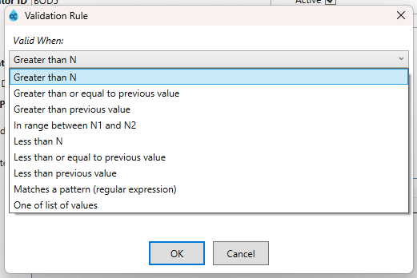
swimlocal: Indicator Validation
Validation rules can be used to check data at the point of data entry.
Cell turns Yellow and triggers some sort of response, for example:
Did I enter the correct value (e.g., entered “65” but should be “6.5”, mixed up numbers in a meter read)?
Do I need to resample / check probe?
If true, do I need to adjust something (e.g., chlorine dose rate)?
If true, do I need to tell someone?

Slide 13
swimlocal: Indicator Alerting
SMS and/or emails can be sent whenever an indicator goes outside a specific limit.
Multiple limits (rules and alert responses) can be set for any one indicator at any one site.
Escalations and acknowledgements can be individually set depending on user requirements.

Slide 14
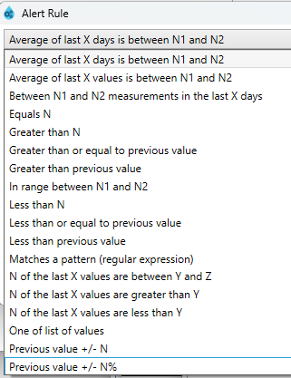
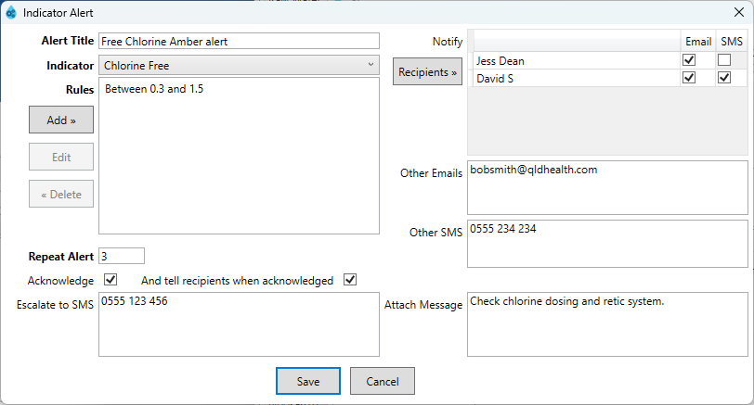
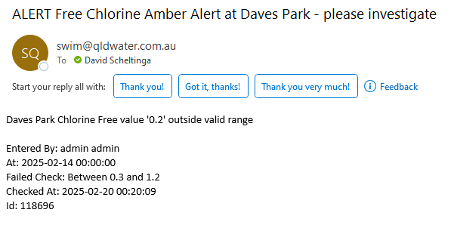
swimlocal: Indicator Alerting

Slide 15
swimlocal: Calculations
A range of calculations are available:
Instantaneous or scheduled (e.g., daily, weekly, monthly, last day of month, quarterly, calendar/financial year)
Typical functions (e.g., +, -, *, /, (), ^)
Statistical functions (e.g., sum, average, count, max, min)
Special functions (e.g., IF, NOT, OR, BUT, Previous, Log10, coalesce)
Can be performed within sites or across sites

Slide 16
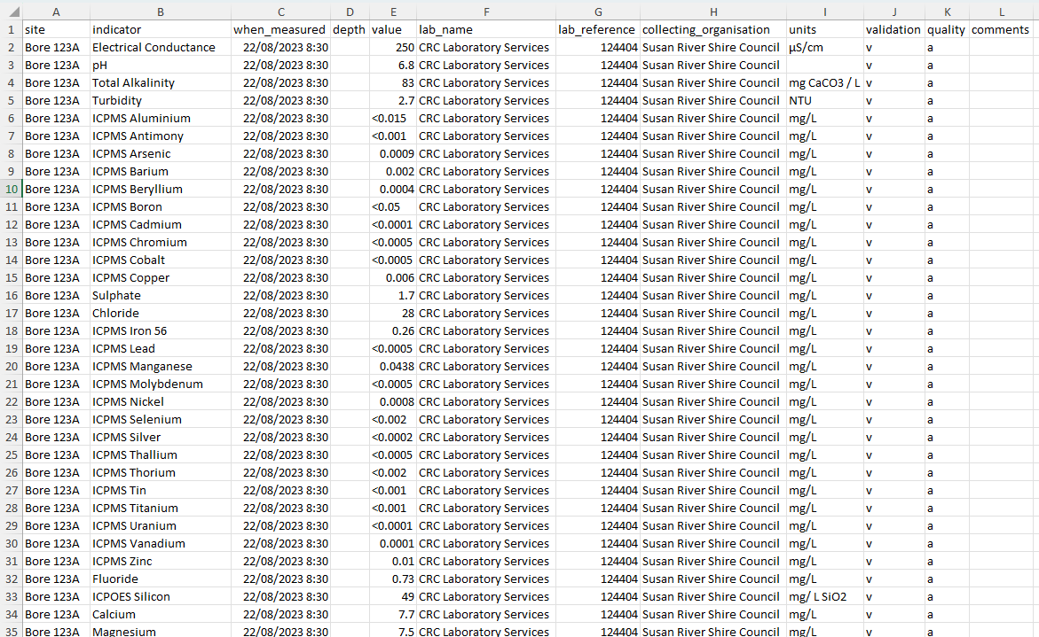
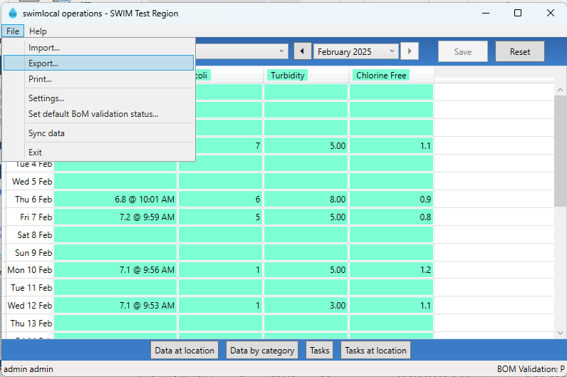
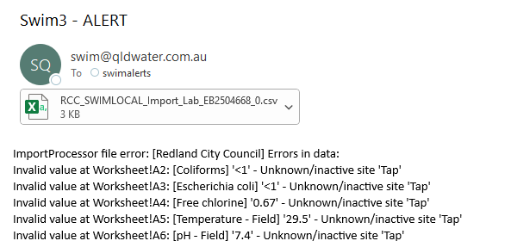
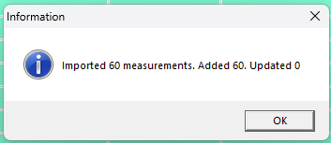
swimlocal: Data Imports
Ability to automatically import data from telemetry/SCADA/Labs via FTPS or API, and historical data manually via multiple ‘Formatted Excel’ files

Slide 17
swimlocal: Costs and Services Provided
There is an annual licence fee payable at the beginning of each financial year.
This provides you with the software (Admin, Ops and WebReports).
Access to the swimlocal help desk between 9 am to 5 pm weekdays (and Support Desk via email/web form).
Access to any, and all, swimlocal upgrades.
We can provide help with initial setup for an additional minimal fee.
Generally, the first on-site training is free, with future on-site training and help setting up the system can be provided for an additional minimal fee.
Training and help via the phone/TEAMS (including liaison with IT staff when needed) is included in the annual licence fee.
There are unlimited users.

Slide 18
swimlocal: Who Uses swimlocal?
Currently there are 65 organisations signed up to use the fully licenced swimlocal system. This is made up of:
58 Qld councils providing water and sewerage services
1 State Govt Department
1 Qld independent water authority
1 Qld council using it for water quality data management in conjunction with community groups
1 Qld Natural Resource Management Group
3 NSW councils providing water and sewerage services

Slide 19
swimlocal: Who Uses SWIM?
Currently there are 137 organisations who use the Annual Data Tool (ADT) function of the swimlocal system. This is made up of:
75 Queensland councils/organisations providing water and/or sewerage services via qldwater (SWIM)
62 South Australian councils/organisations providing water and/or sewerage services via qldwater (SWIM) and SA Department for Energy and Mining

Slide 20
swimlocal: What Data is in swimlocal?
Absolutely everything and anything that was in Excel, written down, in another database, etc. For example:
Typical water and sewerage data (e.g., daily Treatment operations (flows, WQ), lab results (metals, pesticides, PFAS), retic sampling, chemical use)
Landfill sites (e.g., leachate, bore and/or stream WQ)
Source, discharge, environmental WQ (e.g., rivers, lakes, weirs, dams)
Refuse/Tip sites (e.g., volumes in/out, types)
Plant (grader, excavator, tractor) hire and vehicle use/mileage
Quarry materials (e.g., tonne rock out and to whom)
Dam volumes, stream flows and heights, rainfall

Slide 21
swimlocal: Data Reporting/Transfers
The system is designed around being able to send data automatically to the right people, at the right time, in the right format. Examples of what data/reports that swimlocal currently can automatically send:
Sewerage data straight from swimlocal into the Qld Department’s (DETSI) WaTERS’ database. What could be day(s) work now ‘minutes’
Direct data transfer of 4-monthly water security and monthly drought reporting to the Qld Regulator
BoM reporting (e.g., WQ data (Cat. 9), urban water (Cat. 7), Dam levels (Cat. 3), etc.)
Consultants (ad hoc and regular access – can be setup by User)
WebReport products directly into your websites (setup by User)
DWQMP E. coli reporting and Annual Report Data?

Slide 22
swimlocal: Future
Moving to a fully web-based system.
Looking at several functions to improve the system, such as, QR site codes (scan to directly access the site’s data entry form), uploading photos, drop down text boxes, etc.
Bringing more Labs on board for automatic data (results) transfers (current ones include ALS, SGS, Cairns, Toowoomba, SAS, etc.).
Examining other automated reporting/data transfer options to reduce your reporting burden. The system is designed around being able to send data automatically to the right people, at the right time, in the right format. For example, Qld Drinking Water Quality Management Plan (DWQMP) Annual Data Reports.

Slide 23
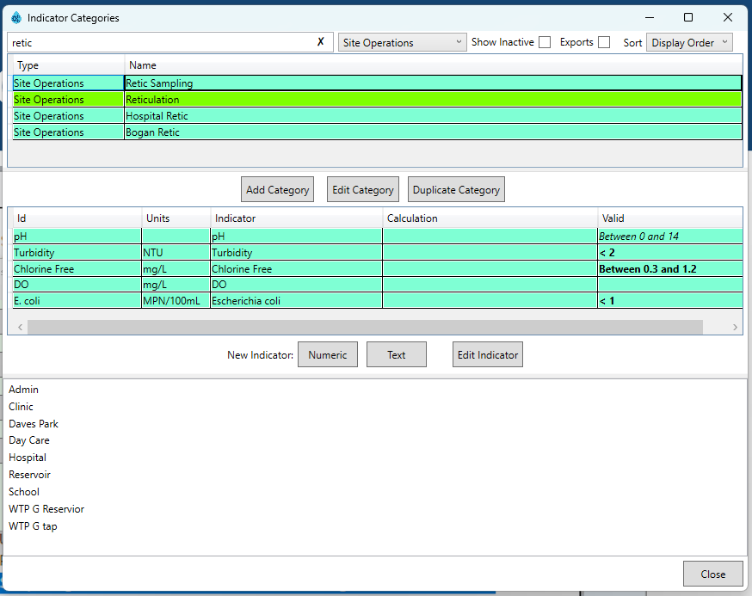
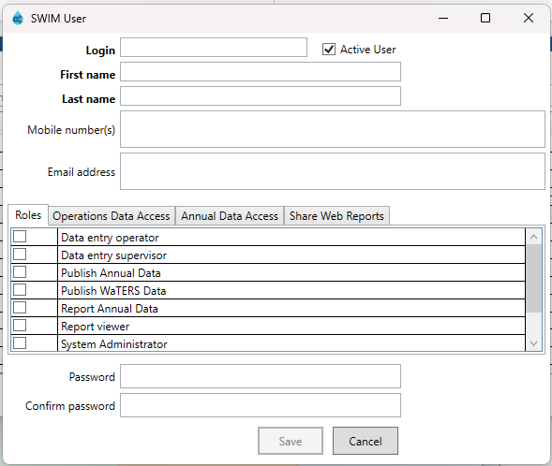
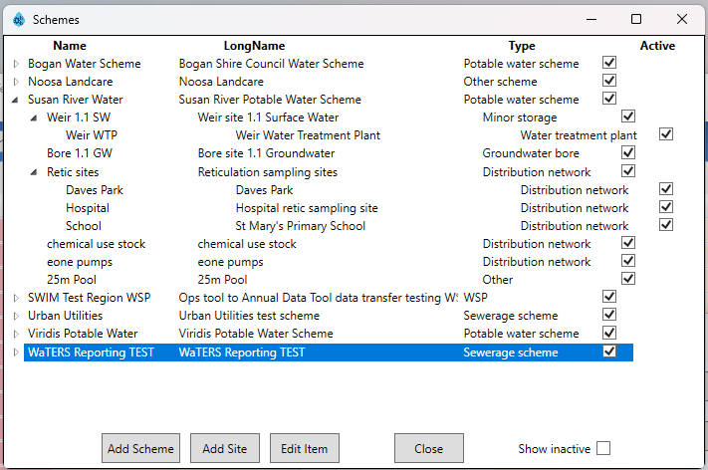
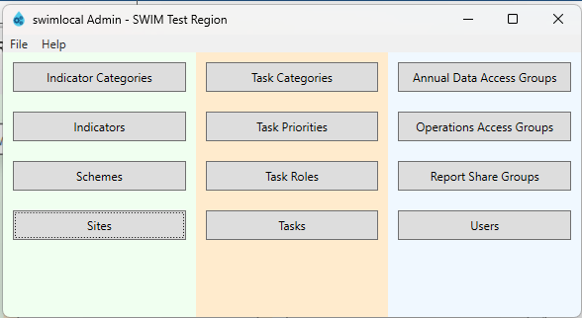
swimlocal: AdminTool

Slide 24
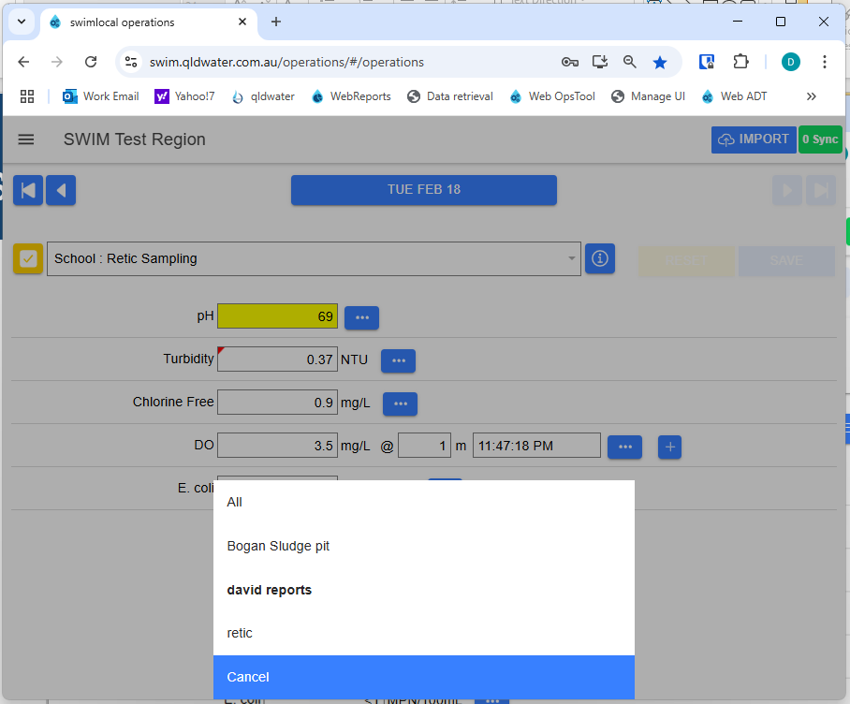
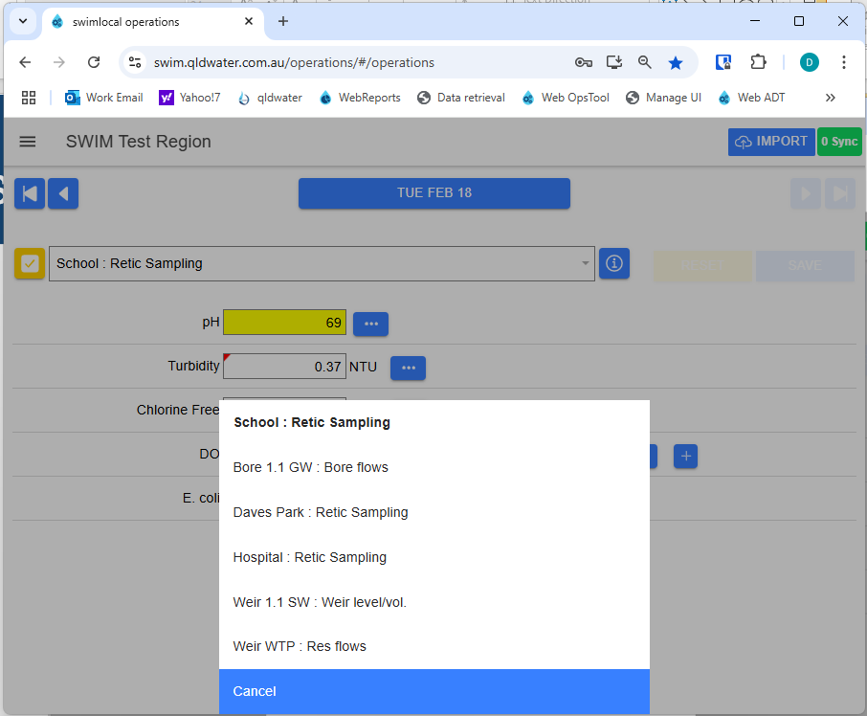
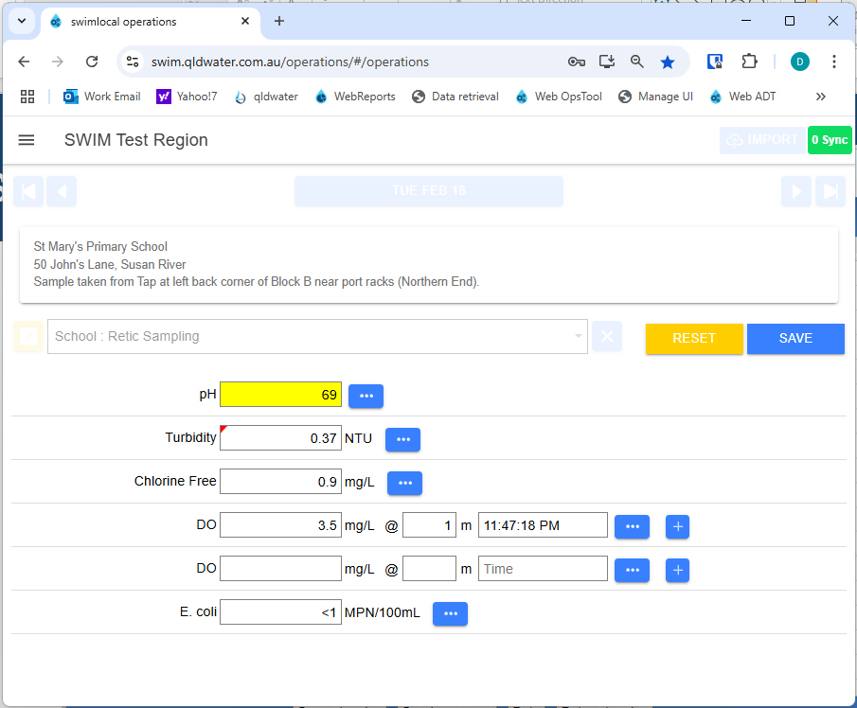
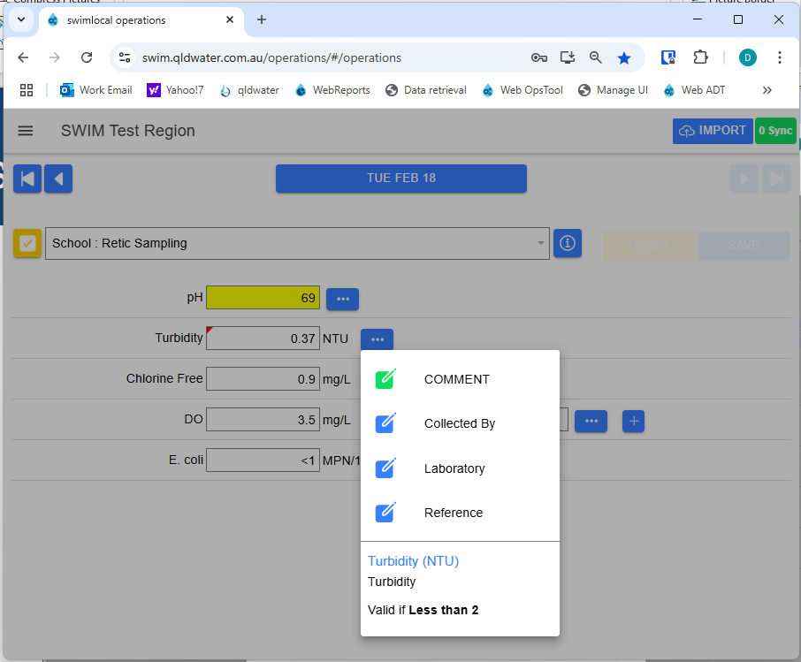
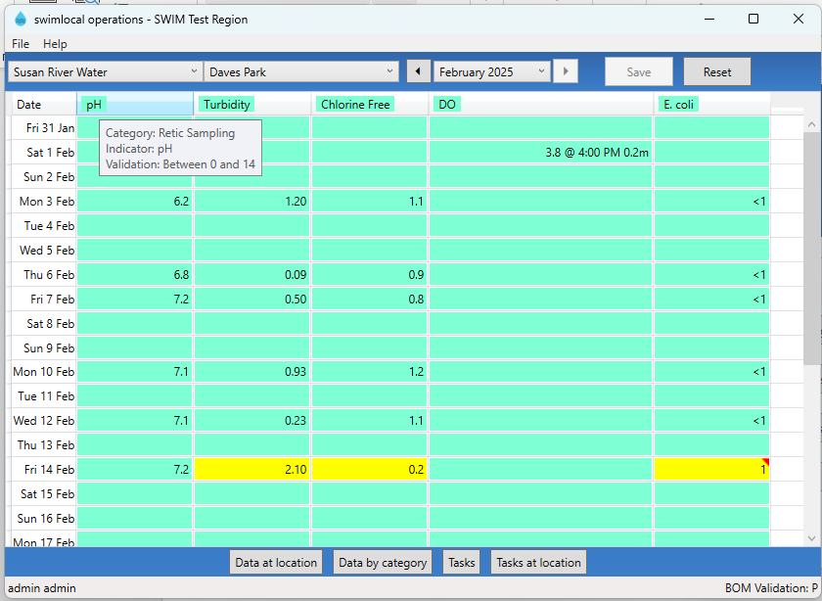
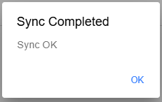
swimlocal: OpsTool

Slide 25
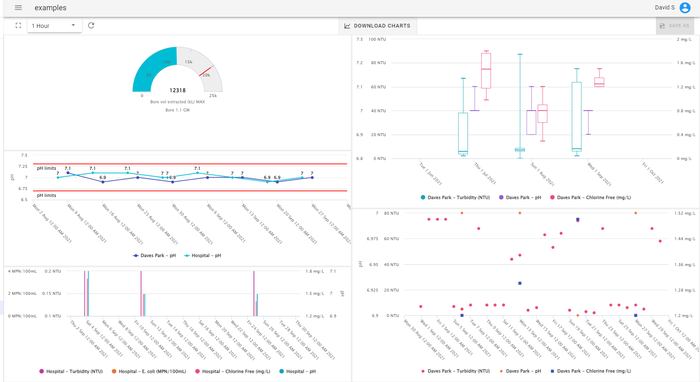
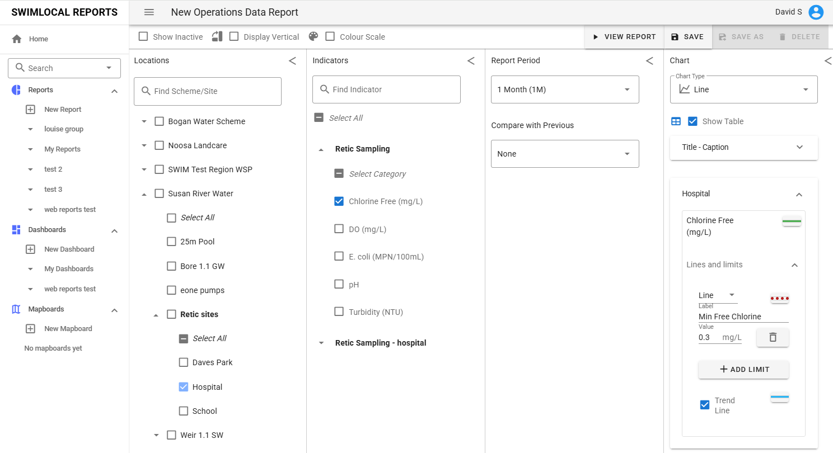
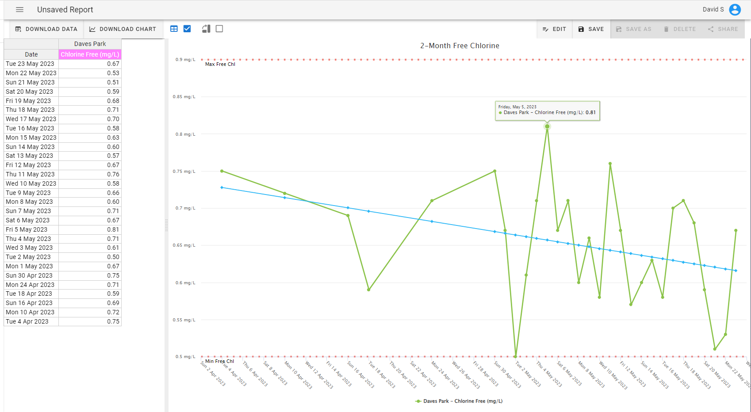
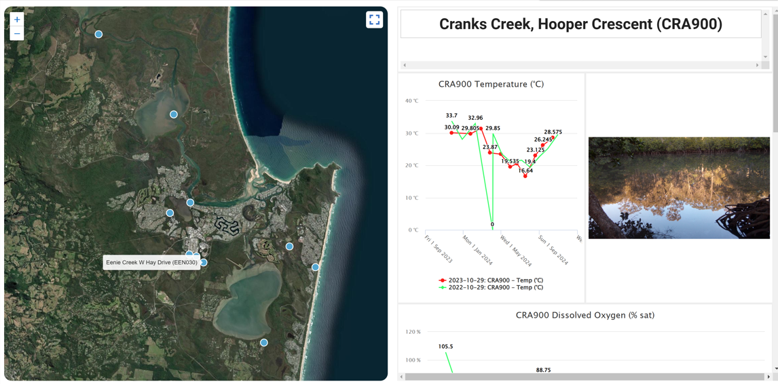
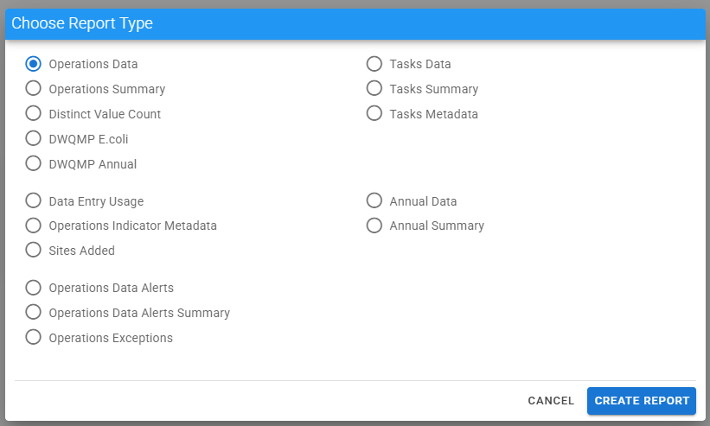
swimlocal: WebReports

Slide 26
Contact details
Dr David Scheltinga
e: dscheltinga@qldwater.com.au
m: 0415 881 195
Ms Jess Dean
e: jdean@qldwater.com.au
p: (07) 3632 6852
w: www.qldwater.com.au
Brisbane Office: Level 1, 6 Eagleview Place, Eagle Farm, QLD, 4009

Slide 27
Our members

Slide 28
Our affiliates
Queensland Health
Environment, Tourism, Science & Innovation
Local Government,
Water & Volunteers

